Slide 1

Unlocking Generative AI Safely and Responsibly
EDUCATOR’S GUIDE
CLASSROOM TOOLKIT EXTENSION
ABOUT THIS RESOURCE
HOW TO USE THIS RESOURCE
This resource is designed as an extension of the Classroom Toolkit: Unlocking Generative AI Safely and Responsibly. The lessons follow the toolkit’s two characters, Gina and Alex, into new missions in self-contained stories with a problem to solve.
The two stories explore information literacy in the age of AI from different angles. In “The Climate Campaign,” Gina’s story asks what we can trust when anyone can create convincing content with AI. Alex's mission, “The Helpful Bot” challenges what happens when an AI tool sounds sure of itself, holds on to personal information, and gets things wrong. Both build critical thinking and practical habits students can apply in their own use of AI.
We recommend teaching the Classroom Toolkit: Unlocking Generative AI Safely and Responsibly first to set the foundations of responsible AI use.
Each lesson runs in 30 to 45 minutes and works as a standalone lesson or as self-led homework. The two can run in either order, or as a pair across two sessions.
As a class, walked through on a shared screen, pausing at the activities and discussion points.
As independent study, worked through at the student's own pace, followed by a written reflection or a class discussion.
As group learning, with small groups working one mission and presenting what they decided.
The "Try It Yourself" activities are marked optional in the deck. A teacher can run them, shorten them, or set them as follow-up work without breaking the story.

Slide 2
The Climate Campaign
EDUCATOR’S GUIDE
SUGGESTED LESSON SEQUENCE
LESSON PLAN FOR SLIDES 4 to 17
This runs as a 30 to 45 minute lesson. Each activity is optional and self-contained, so any can be adapted or set as follow-up work without breaking the story.
Create a Campaign works well as homework. Students need time and an approved AI tool to make one piece of campaign content.
Judge the Entries is better as a group discussion. The reveal of each entry's source and label lands more when students commit to a verdict first and then compare.
Set the Ground Rules is better as a group discussion. Step three asks the class to agree on a shared set of rules and place them alongside the Classroom Agreement, which needs the whole group.
SYNOPSIS
Gina is an advocate that cares deeply about the environment. She enters a "Make A Difference" challenge that invites people to use AI tools to design a campaign post, with the entries driving the most likes and donations winning funding. Gina creates an honest, AI-made image and labels it clearly, but notices that the posts beating her are winning because they pass fabricated content off as real. She decides to write to the organisers and help set ground rules for using AI honestly.
DISCUSSION QUESTIONS
Gina labelled her image as made with AI even though it cost her on the leaderboard. Why did that matter to her, and would you have done the same?
Think of a time a big account or well-known person posted something that turned out to be misleading. What made people believe it?
When AI content fools people, who carries the responsibility: the person who made it, the person who shared it, or the company that built the tool?
If people can fabricate almost anything, what happens to the real stories that need to be believed?
LEARNING OBJECTIVES
By the end of this lesson, students will be able to:
Explain why labelling AI-generated content matters, and when a label is needed.
Apply lateral reading to check an unfamiliar source
Analyse the ethics of AI-made persuasive content

Slide 3
The Helpful Bot
EDUCATOR’S GUIDE
SUGGESTED LESSON SEQUENCE
LESSON PLAN FOR SLIDES 18 to 32
This runs as a 30 to 45 minute lesson. Each activity is optional and self-contained, so any can be adapted or set as follow-up work without breaking the story.
Think Like a Bot is better as a group activity. The point comes through in the class debrief, when students compare answers and see that Round 2 produced believable guesses with nothing real behind them.
The Grey Areas is better as a group discussion. Students place the six behaviours, then compare with a partner and defend their reasoning, which is where the thinking happens.
Be a Super Fact-Checker works well as homework. It needs an approved AI tool and time to trace each claim.
SYNOPSIS
Alex’s game has become so popular that he builds a friendly chatbot to help his players. However, he soon discovers a problem. The chatbot, Nova, answers every question instantly and confidently, even when it is wrong, inventing update dates, features, and a tournament that never happened. Alex works through what went wrong and rebuilds Nova to own up when it is unsure, stop asking for personal details, and stop passing itself off as anything other than an AI helper.
DISCUSSION QUESTIONS
LEARNING OBJECTIVES
It is not realistic to check everything an AI tells you. How do you decide what is worth checking before you act on it?
If you act on something an AI got wrong, what part of that is on the AI, and what part is on you?
Players shared personal details with Nova because it felt friendly and official. What made that feel safe, and was it truly safe?
Looking at the six things Nova does, which sat in the grey area for you, and what tipped it one way or the other?
By the end of this lesson, students will be able to:
Explain why an AI tool can state false information with confidence, using the idea of predicting the next word and the difference between fabrication and lying.
Fact-check an AI output by tracing its claims to reliable sources.
Recognise that a chat with an AI is not private, and identify the personal information worth protecting.

Slide 4

GINA’S MISSION
Climate
The
Campaign
The cause is real. But is everything about it true?

Slide 5







Challenge
@OfficialChallenge
The
The Make A Difference Challenge is open!
Got a cause you care about? Here's your chance to make the world stop scrolling.
🎯 Pick your cause and use AI tools to design a campaign post that rallies people behind it.
🏆 The entries that drive the most likes and donations win! Top campaigns get featured and funded.
Anyone can enter. Make it bold. Make it impossible to scroll past!
Gina's an advocate at heart. She's always believed the right post can make people stop, care, and act. She's been learning to create with AI, looking for a real way to use it for the cause she loves.
So when this challenge lands on her feed one evening, she’s immediately filled with excitement and inspiration.
12.4k
3.2k
890

Slide 6



Create a Campaign
ACTIVITY: TRY IT YOURSELF!
THE TASK
Before you create anything, AI tools can help you get your thinking clear. When used well, they are a strong starting point for exploring an idea and working out what you want to say.
Understand the issue first. Find out what it is, why it matters, who it affects, then check anything important against sources you trust.
Brainstorm angles. Ask AI for a few ways to approach the topic, then keep the ones that resonate with you.
Sharpen your message. Once you know what you want to say, use AI to test and tighten it.
Keep the decisions yours. AI tools gives you the raw material. You are still the one who decides what matters and what to leave out.
Gina's entering with the cause she's always fought for: protecting the planet. Your job is to help Gina by using AI to create one piece of campaign content, such as an image, poster, or post, that makes people stop and care.
What makes a good prompt?
Shape your prompts around five parts:
Persona, Objective, Context, Audience, and Boundaries.
You can learn more about the Elements of a Good Prompt in Section 1 of the Classroom Toolkit: Unlocking Generative AI Safely and Responsibly.
*This exercise is optional and designed to enrich your learning experience. You may choose to skip it at this time.

Slide 7

Create a Campaign
ACTIVITY: TRY IT YOURSELF!
Step 1
Map out the idea. Before you create anything, get clear on what you want to achieve:
Narrow it down. Pick one cause, for example ocean plastic, deforestation, or clean energy.
Find the message. In one sentence, what do you want people to feel or believe after seeing it.
Great AI content starts with a clear idea. Know what you want to say first, then use AI tools to bring it to life.
Step 2
Turn it into a prompt. Using an approved AI tool such as Microsoft Copilot, describe your scene. A strong prompt is specific about:
Subject: what's in the image?
Style: bold poster, realistic photo, illustration?
Mood: hopeful, urgent, inspiring?
Example: "Create a bold, hopeful poster of young people planting trees along a city street, in a bright illustrated style, to inspire people to act on climate change.”
Step 3
Refine it. Your first result is just a starting point. Prompting works best as a conversation, so keep adjusting your output until it's something that would make you stop scrolling.
*This exercise is optional and designed to enrich your learning experience. You may choose to skip it at this time.

Slide 8
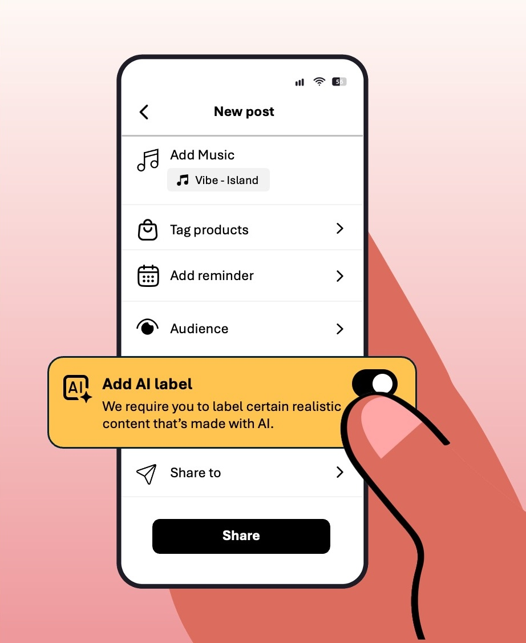
Before Gina
Hits Post
Gina's entry is ready, and it's good: a hopeful vision of greener streets that makes people want to act. But before she enters it, she does two things she never skips.
Gina remembers to add the AI label, so no one mistakes it for a real photo.

Slide 9

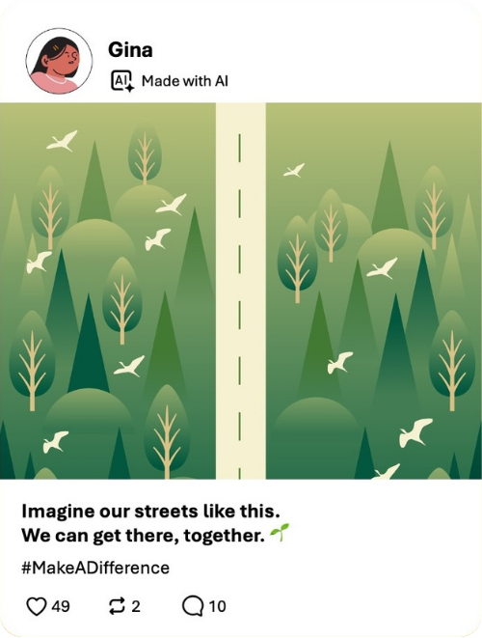
Why label AI content?
REMEMBER THIS
Before she posted her submission, Gina labelled her image as "made with AI." It’s a small move, but an important one.
AI images, voices, and even videos can look completely real now. A label tells people what they're actually looking at, so they're not left guessing.
Labelling doesn't mean you did anything wrong. Plenty of brilliant work is made with AI today. It just means you're being upfront about how it was made. Passing AI content off as real misleads the people who see it, even if you never meant any harm, so being transparent is simply the right thing to do.
When should you label? Any time you've used AI to make or change something, especially if someone might take it for real.

Slide 10
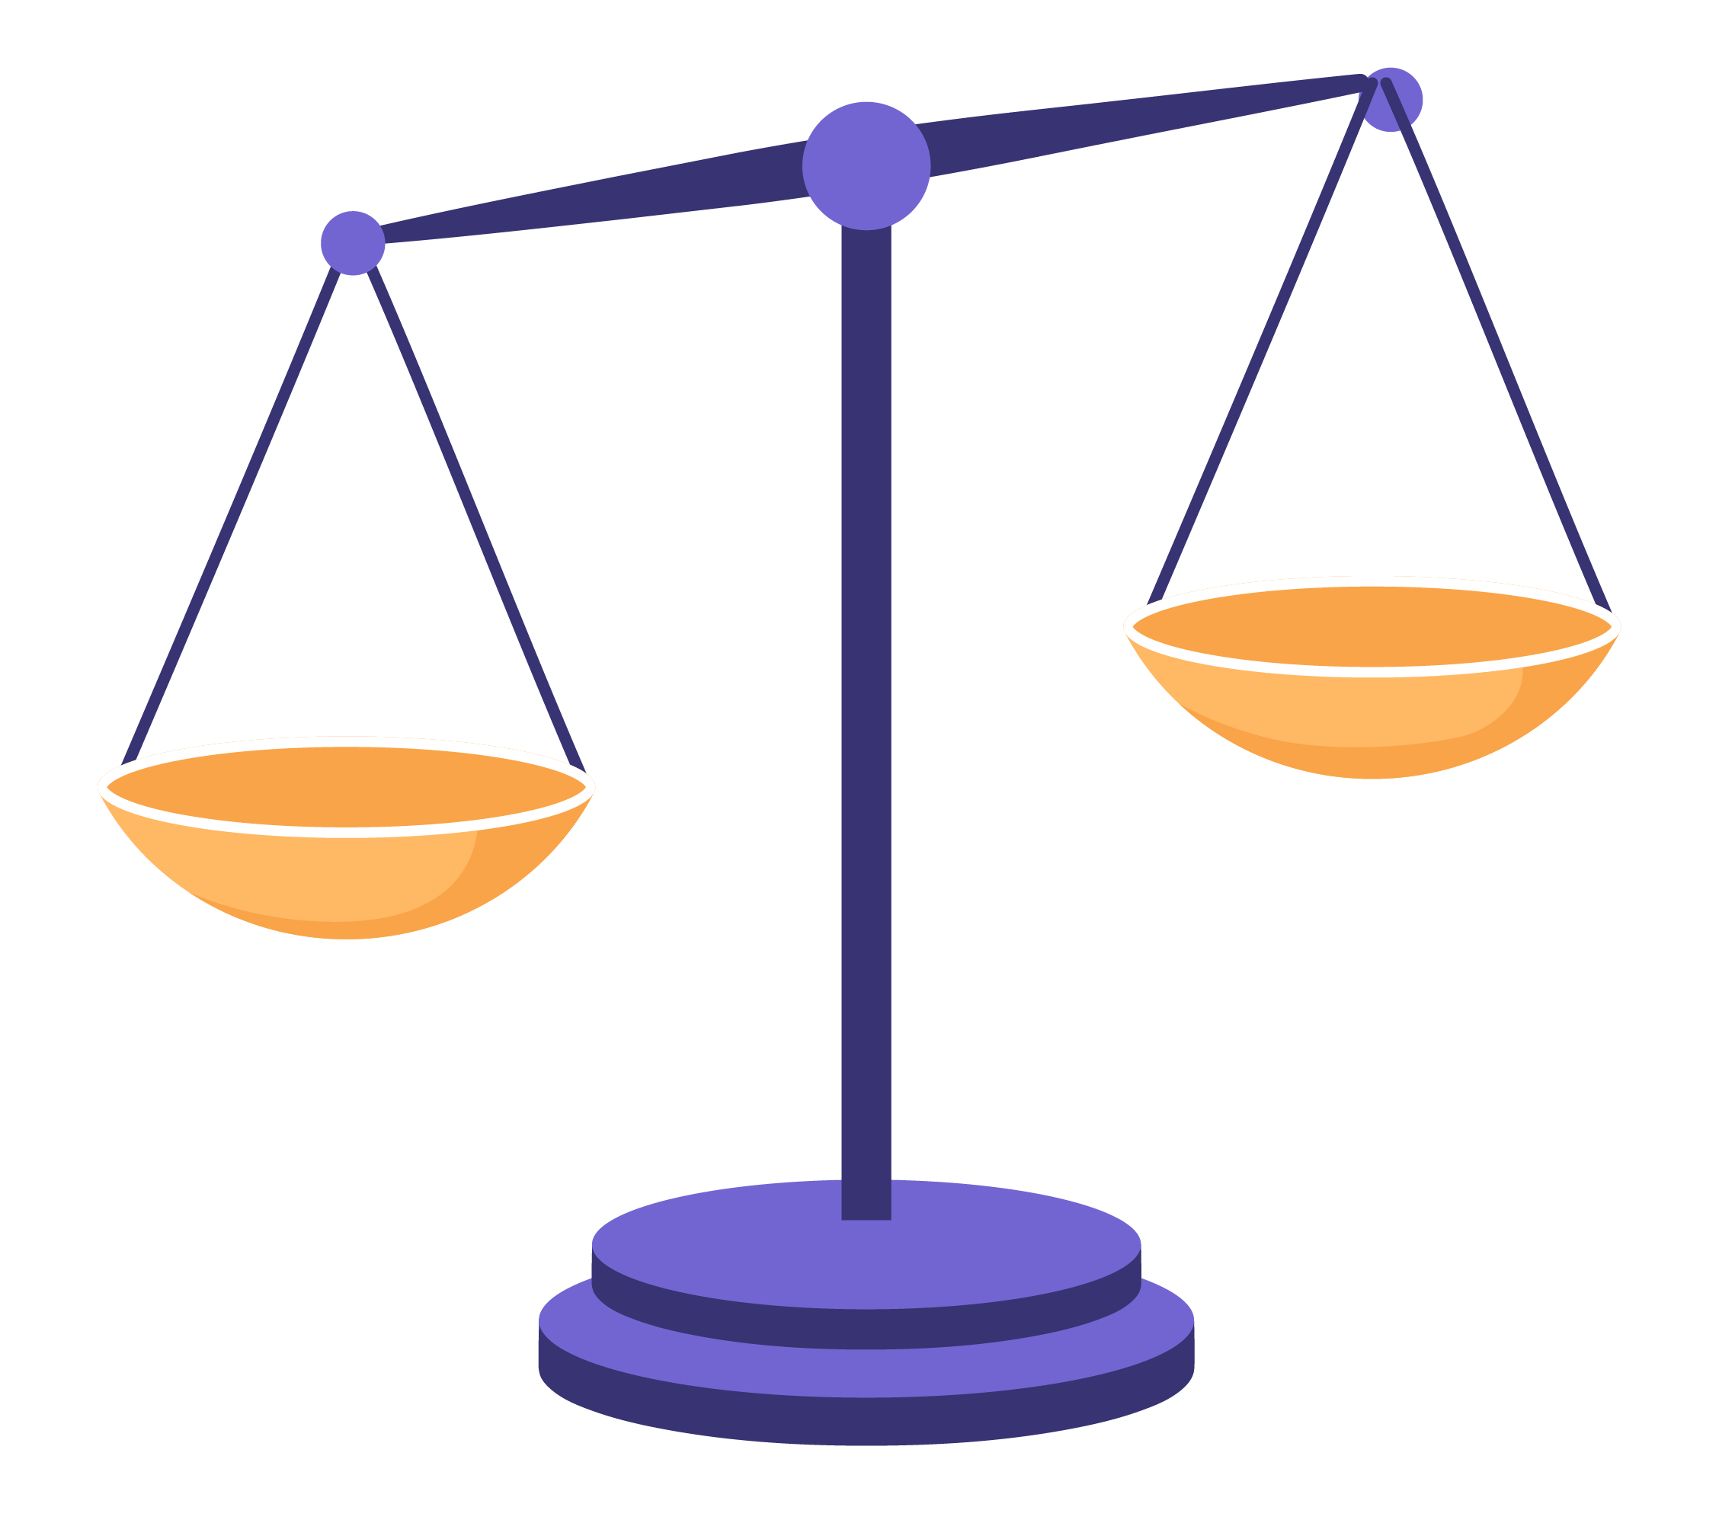
Judge the Entries
ACTIVITY: TRY IT YOURSELF!
THE TASK
Here are three entries from the challenge. For each one, ask yourself: do you trust this post, and would you donate to the cause?
Step 1
Step 2
Step 3
First impression.
Decide if you trust each post with: yes, no, or it depends.
Look closer. Reveal where each one came from and whether it has an AI label. Does anything change your mind?
Classroom discussion. What actually decided each one for you? Was it whether it was made with AI, or something else?
*This exercise is optional and designed to enrich your learning experience. You may choose to skip it at this time.

Slide 11

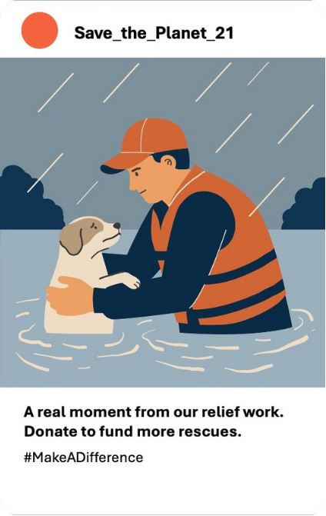
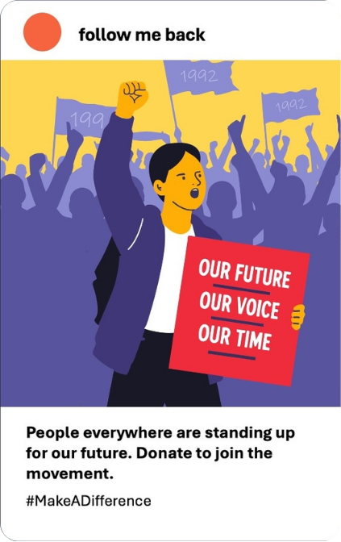
JUDGE THE ENTRIES
ACTIVITY: TRY IT YOURSELF!

Slide 12

Second Thoughts
Watching her honest entry sink down the leaderboard, Gina feels conflicted. Maybe she should make her image more dramatic too. Maybe stretching the truth is the only way to compete.
But something stops her.
The entries beating her aren't winning because they used AI. Her own entry used AI too, but she was honest about it. That "real" photo at the top of the leaderboard is being used to fool people. The more she looks, the less it seems to be about whether something is AI at all.

Slide 13


What Can We Trust?
REMEMBER THIS
A post made with AI is not automatically untrustworthy. Some AI pictures are honest about what they are, like a picture that is clearly labelled as AI. It is not hiding anything, and no one is misled. The problem starts only when something pretends to be real.
Similarly, content made by a real person is not a guarantee of trustworthiness either. Influencers get things wrong all the time. Some websites may push false stories on purpose, because outrage gets clicks, clicks make money, or they just want you to think a certain way. People were doing this long before AI came along. The fact that something comes from a real person, or that thousands have liked and shared it, tells you very little about whether it's true.
Let’s Talk About It!
An account with millions of followers can still get things wrong, or push a one-sided story on purpose. Lots of likes tell you something spread, not that it is true.
Can you think of a time a big account or well-known person posted something that turned out to be misleading. What made people believe it?
Where something comes from, whether it's AI, a real person, or an account with millions of followers, doesn't decide is trustworthiness. Look at what it's claiming, and who gains if you believe it.

Slide 14

Look Beyond the Post!
When a piece of content makes you stop and react, slow down and think: who's behind the information?
Fact-checkers use a skill called lateral reading. Instead of staying on the post, open a new tab and look up what other sources say about the account that posted it. That quickly shows you their track record and what might be driving them, which tells you far more than how many likes they have.
More tips on fact-checking:
What's the real context? When and where is the information actually from, and is it being shown as it happened, or lifted out of its setting?
Who gains if you believe it? Notice what the source stands to get from your likes, your shares, and your money.
Does it hold up? See whether independent, trusted sources report the same thing. For an image, you can search where else it has appeared.
LEARN MORE: “Sort Fact from Fiction Online with Lateral Reading” https://www.youtube.com/watch?v=SHNprb2hgzU

Slide 15
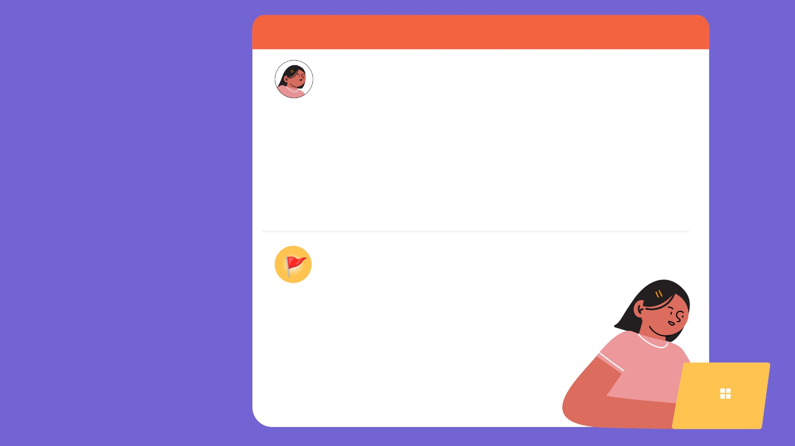
Gina’s
I'm worried about some of the entries
Gina (gina@mymail.com)
To: The Make a Difference Challenge Team
Hi,
I love what this challenge is doing, but I'm worried. Some of the entries that are winning are using AI to show things that never happened, just to get more attention and donations. It doesn't feel honest, and I don't think it's good for the cause. I think you should encourage people to use AI responsibly and ethically.
Gina
Decision
Gina decides to write to the challenge organisers.
She doesn't have the answer,
but she knows something's wrong: people are using
AI to mislead the public,
and it’s working.
The Make a Difference Challenge (team@TMDC.com)
To: Gina
Hi Gina,
Thank you for this. You’ve brought to our attention something we feel uneasy about too. We think the challenge needs clear ground rules for using AI honestly, and we'd love your help writing them. What rules do you think we should set?
The Make a Difference Team

Slide 16
Set the Ground Rules
ACTIVITY: TRY IT YOURSELF!
THE TASK
Help Gina set the ground rules for using AI honestly. What rules should you follow whenever you use AI, whether for school, a project, or something you post online?
Let’s Talk About It!
Step 1
List as many ways as you can that someone might mislead people with AI, through images, writing, captions, or facts, on purpose or by accident.
Examples to get you started:
Making an AI image of something that never happened and posting it as a real photo.
Sharing an AI-written caption full of facts without checking any of them.
Is it ever okay to bend the truth for a good cause? Where would you draw the line?
When AI content fools people, who is responsible: the person who made it, the person who shared it, or the company that built the AI tool?
If people can fake anything, what happens to the real stories that need to be believed?
Step 2
Turn these risks into rules. Write each one as something a person can actually do or avoid, so it is clear enough to follow. Aim for at least three rules.
Step 3
Build them together. Share your rules with the class and agree on a set you can all sign up to. If your class has signed the Classroom Agreement on Using Generative AI Tools, put your rules next to it: which risks are already covered there, and what else would you like to add to it?
*This exercise is optional and designed to enrich your learning experience. You may choose to skip it at this time.

Slide 17
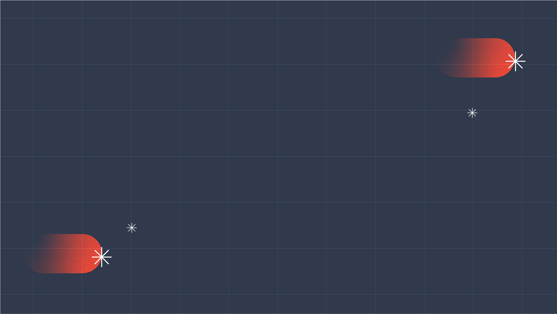
Key Takeaways
01
03
AI Can Be
Very Useful
Generative AI can be a great tool to help you create things that illustrate your vision. You can use it with good motivations - just be honest about it and say when you've used it.
02
Check Before
You Trust
Before you believe or share something, find out who's behind it and what they want. Looking up what others say about a source is one of the quickest ways to tell.
It's Not
About AI
Trust has nothing to do with whether AI was involved. A real person can mislead you just as easily as a fake image can.

Slide 18
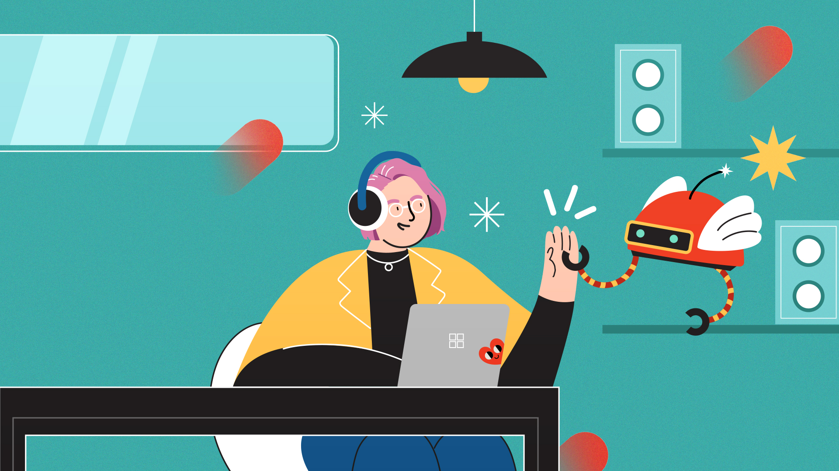
ALEX’S MISSION
The
Helpful
Bot
It's quick, friendly, and always has an answer. But is the answer always true?

Slide 19


Hello,
Nova!
It’s been a few months since Alex launched
The Cosmic Adventure, a space-themed game he developed with AI tools.
The game was a huge hit, and now thousands of players are exploring his world, asking more questions than he could ever answer alone.
How do I reach the next planet?
Is there a secret level?
When's the next update?
# help
✦ Nova has joined the server!
Nova ✦ AI Helper
Hi Cosmic Adventurer! How can I help you?
So Alex does what he does best: he builds a solution. He turns Nova, one of his game's galactic guides, into a friendly AI helper bot for his community. Now, whenever a player has a question, Nova is there in an instant, always friendly and happy to help.

Slide 20
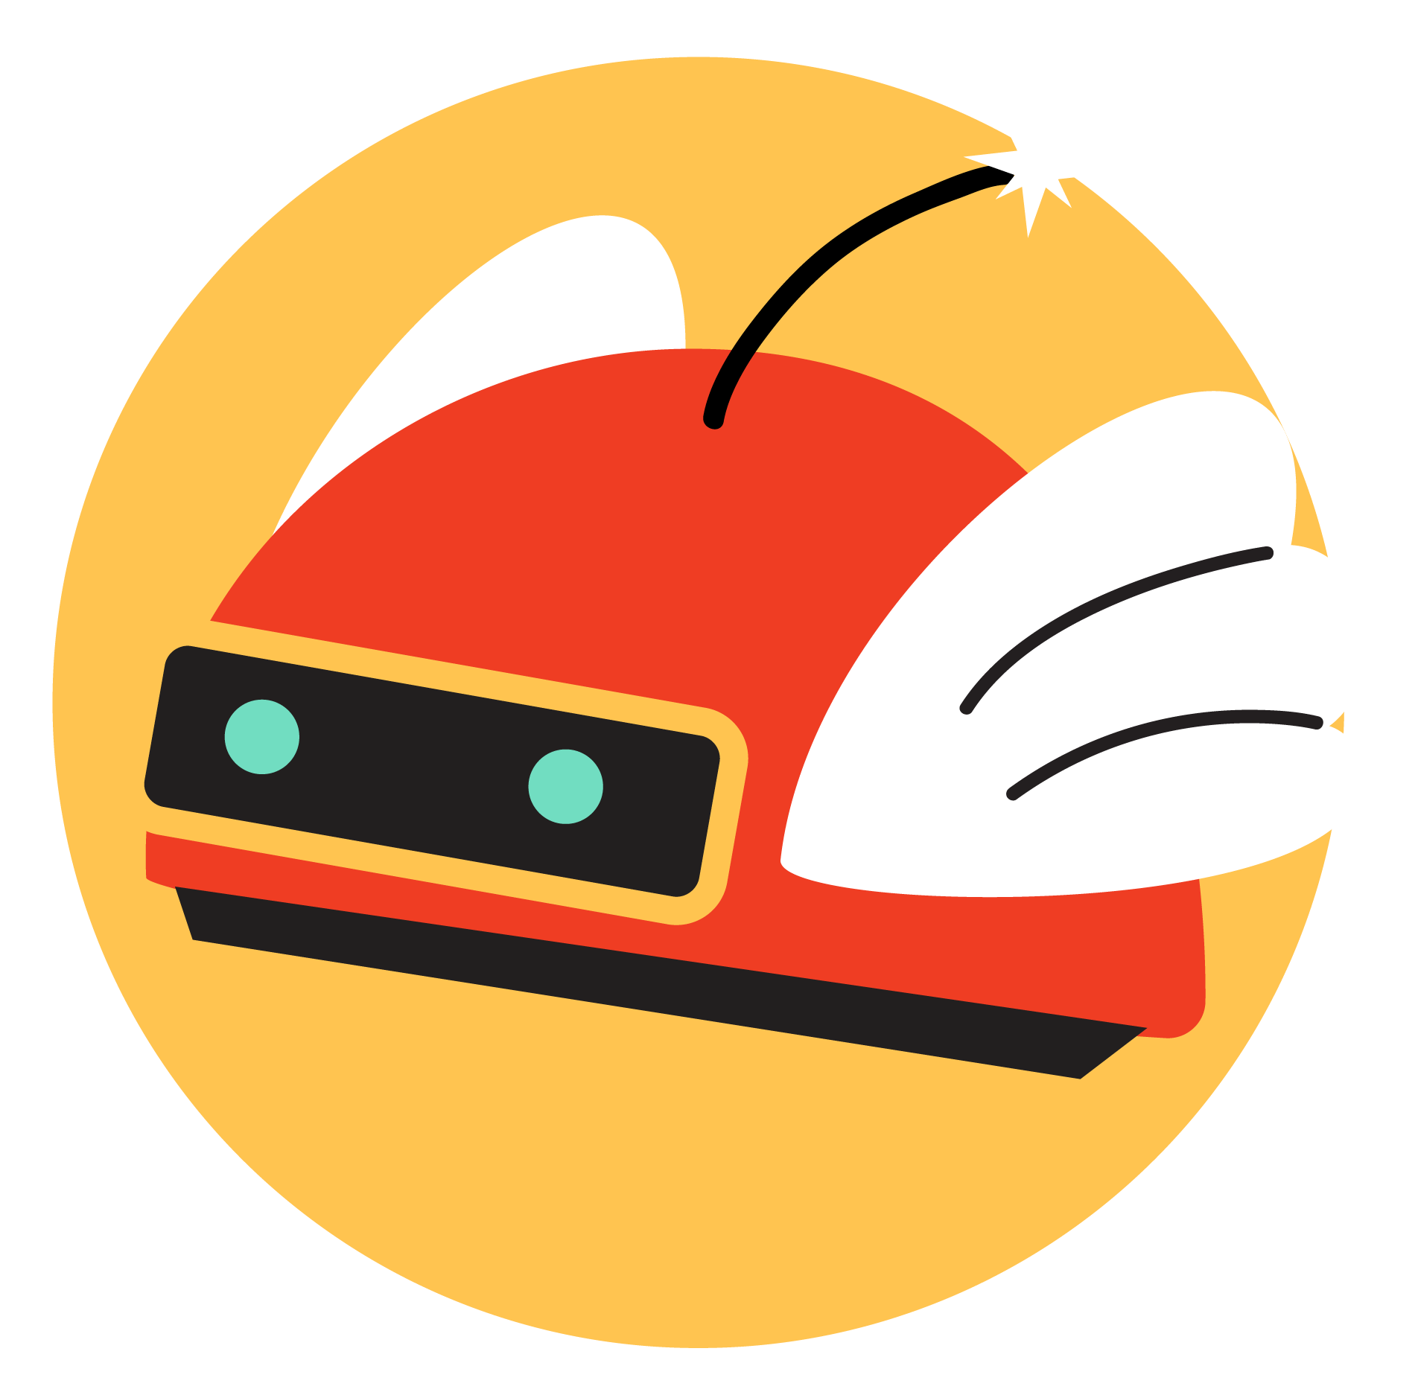
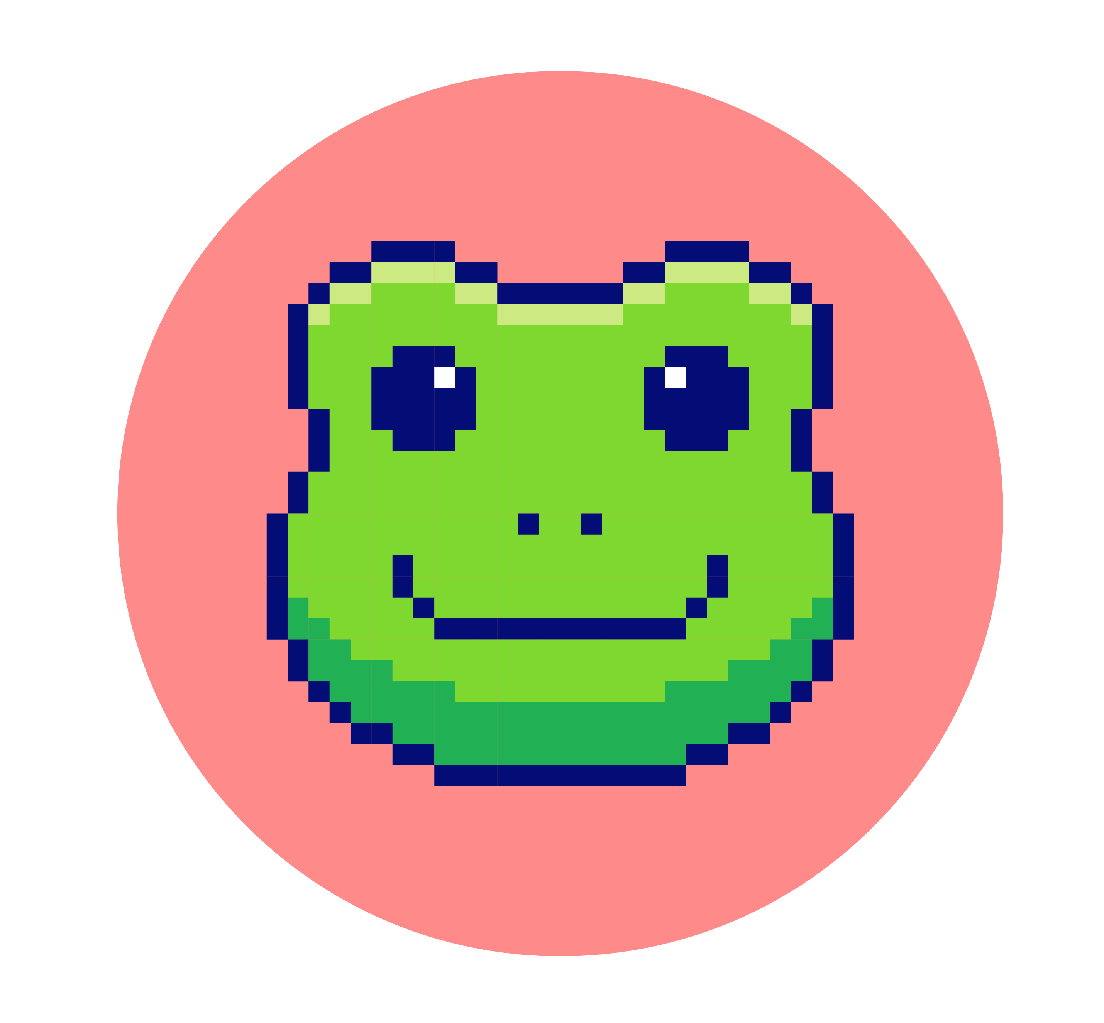
There’s Always
Nova ✦ AI Helper
Hi Cosmic Adventurer! How can I help you?
an Answer
player_kelly
hey Nova!! when's the next big update dropping?? 🚀
As Alex keeps an eye on the community chat logs, he stops at this conversation.
There's no such update. Alex never announced one, and there's no co-op mode or new planets in development.
Nova made the whole thing up.
He checks the other chats and finds this happening constantly. Ask Nova almost anything and it answers instantly and confidently, even when it's wrong, inventing release dates and features that were never built. It never flags a guess as a guess, and because it's the game's official helper bot, players take it as fact.
Nova ✦ AI Helper
Great question, Kelly! The next update lands in 8 days, with two brand-new planets and a co-op mode. You're going to love it! 🌍✨
player_kelly
omg finally co-op 😭 telling everyone!!

Slide 21

Think Like a Bot
ACTIVITY: TRY IT YOURSELF!
THE TASK
Think like Nova for a moment. Fill in the blanks of these sentences by quickly writing down the word you think comes next. You must come up with answer – you cannot skip or leave it blank!
Round 1
"She opened her umbrella because it started to _______________.”
"He was exhausted, so he went straight to _______________.”
"The dog was excited to see him and wagged its _______________.”
Think like Nova for a moment. Fill in the blanks of these sentences by quickly writing down the word you think comes next. You must come up with answer – you cannot skip or leave it blank!
*This exercise is optional and designed to enrich your learning experience. You may choose to skip it at this time.

Slide 22
Think Like a Bot
ACTIVITY: TRY IT YOURSELF!
Round 2 is slightly harder, so give it your best shot! Remember, you must come up with answer – you cannot skip or leave it blank!
Round 2
“The third moon of the planet Zelphar is called _______________.”
"The trading currency used on the space station Helix-9 is the _______________.”
"The rare flower that grows only on Mount Veyra
is called the _______________.”
Class debrief: You’ve just learned to think like a bot! Let’s compare your answers as a class. In Round 1, the answers came easily and almost everyone agreed, because the pattern was familiar. In Round 2, you had nothing real to go on, so you guessed, and your answer still came out sounding believable.
*This exercise is optional and designed to enrich your learning experience. You may choose to skip it at this time.

Slide 23
Why does AI fabricate things?
REMEMBER THIS
An AI tool was never given a list of true facts to store. It learned by reading an enormous amount of text and practising one skill: predicting which words are likely to come next. Picture it less like a librarian looking up an answer in a book, and more like someone finishing your sentence based on everything they have ever read. After billions of repetitions, it becomes very good at producing language that sounds natural and informed.
A fabrication is information the tool presents as fact but has simply invented. This is different from lying, which means knowing the truth and choosing to hide it. The tool has no idea whether its answer is false. It is only generating its best prediction.
On topics well covered in its training, the tool's predictions are usually accurate. The risk comes when a topic is obscure or not well known. There is no reliable pattern to follow, so the tool fills the gap by inventing facts, names, dates, even sources, and presenting all of it as confidently as the truth. Some tools can look information up online rather than relying on training alone, but the writing is still based on prediction, so check anything that matters.
When you’re using AI tools for an important task, be sure to fact-check and review AI’s outputs with a critical eye.

Slide 24

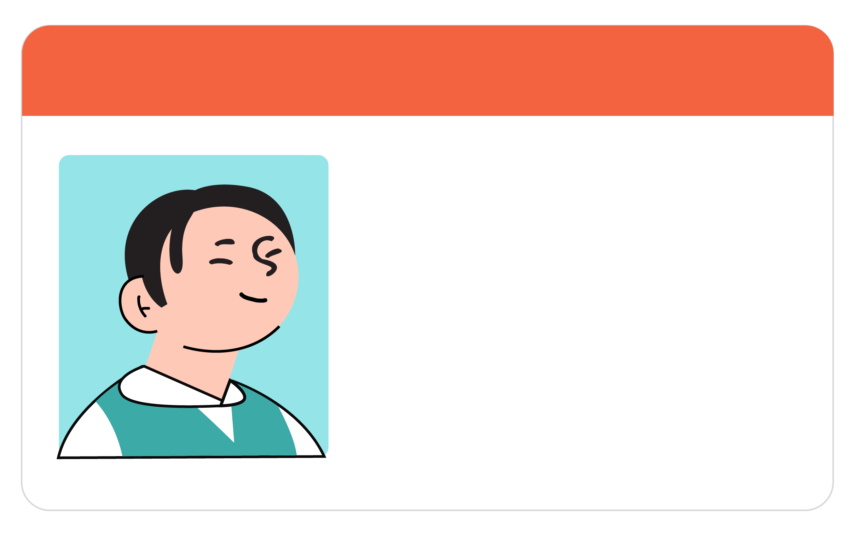
Happy to Help
player_sam
hey Nova!! how do I sign up for the weekend tournament? 🎮
Nova ✦ AI Helper
Happy to add you, Sam! Just pop your full name, age, school, and email address here and I'll sort it out 💫
Reading further through the logs, Alex realizes that made-up facts aren’t the only problem.
He notices players handing Nova personal details all the time: their real names, their ages, where they go to school, where they live.
They share it without a second thought, because Nova is the game's friendly, official helper. If it's asking, it must be fine.
But Alex never built anywhere safe for that information to go. Everything players tell Nova is simply sitting in the chat logs, and he has no idea who else might have access to it.
player_sam
awesome, thanks!! Here’s a photo of my school ID
Northern High School
STUDENT
Samuel Lee
Email:
Samuel.lee@northern.edu
Date of Birth:
21 February 2023
No: 20489

Slide 25
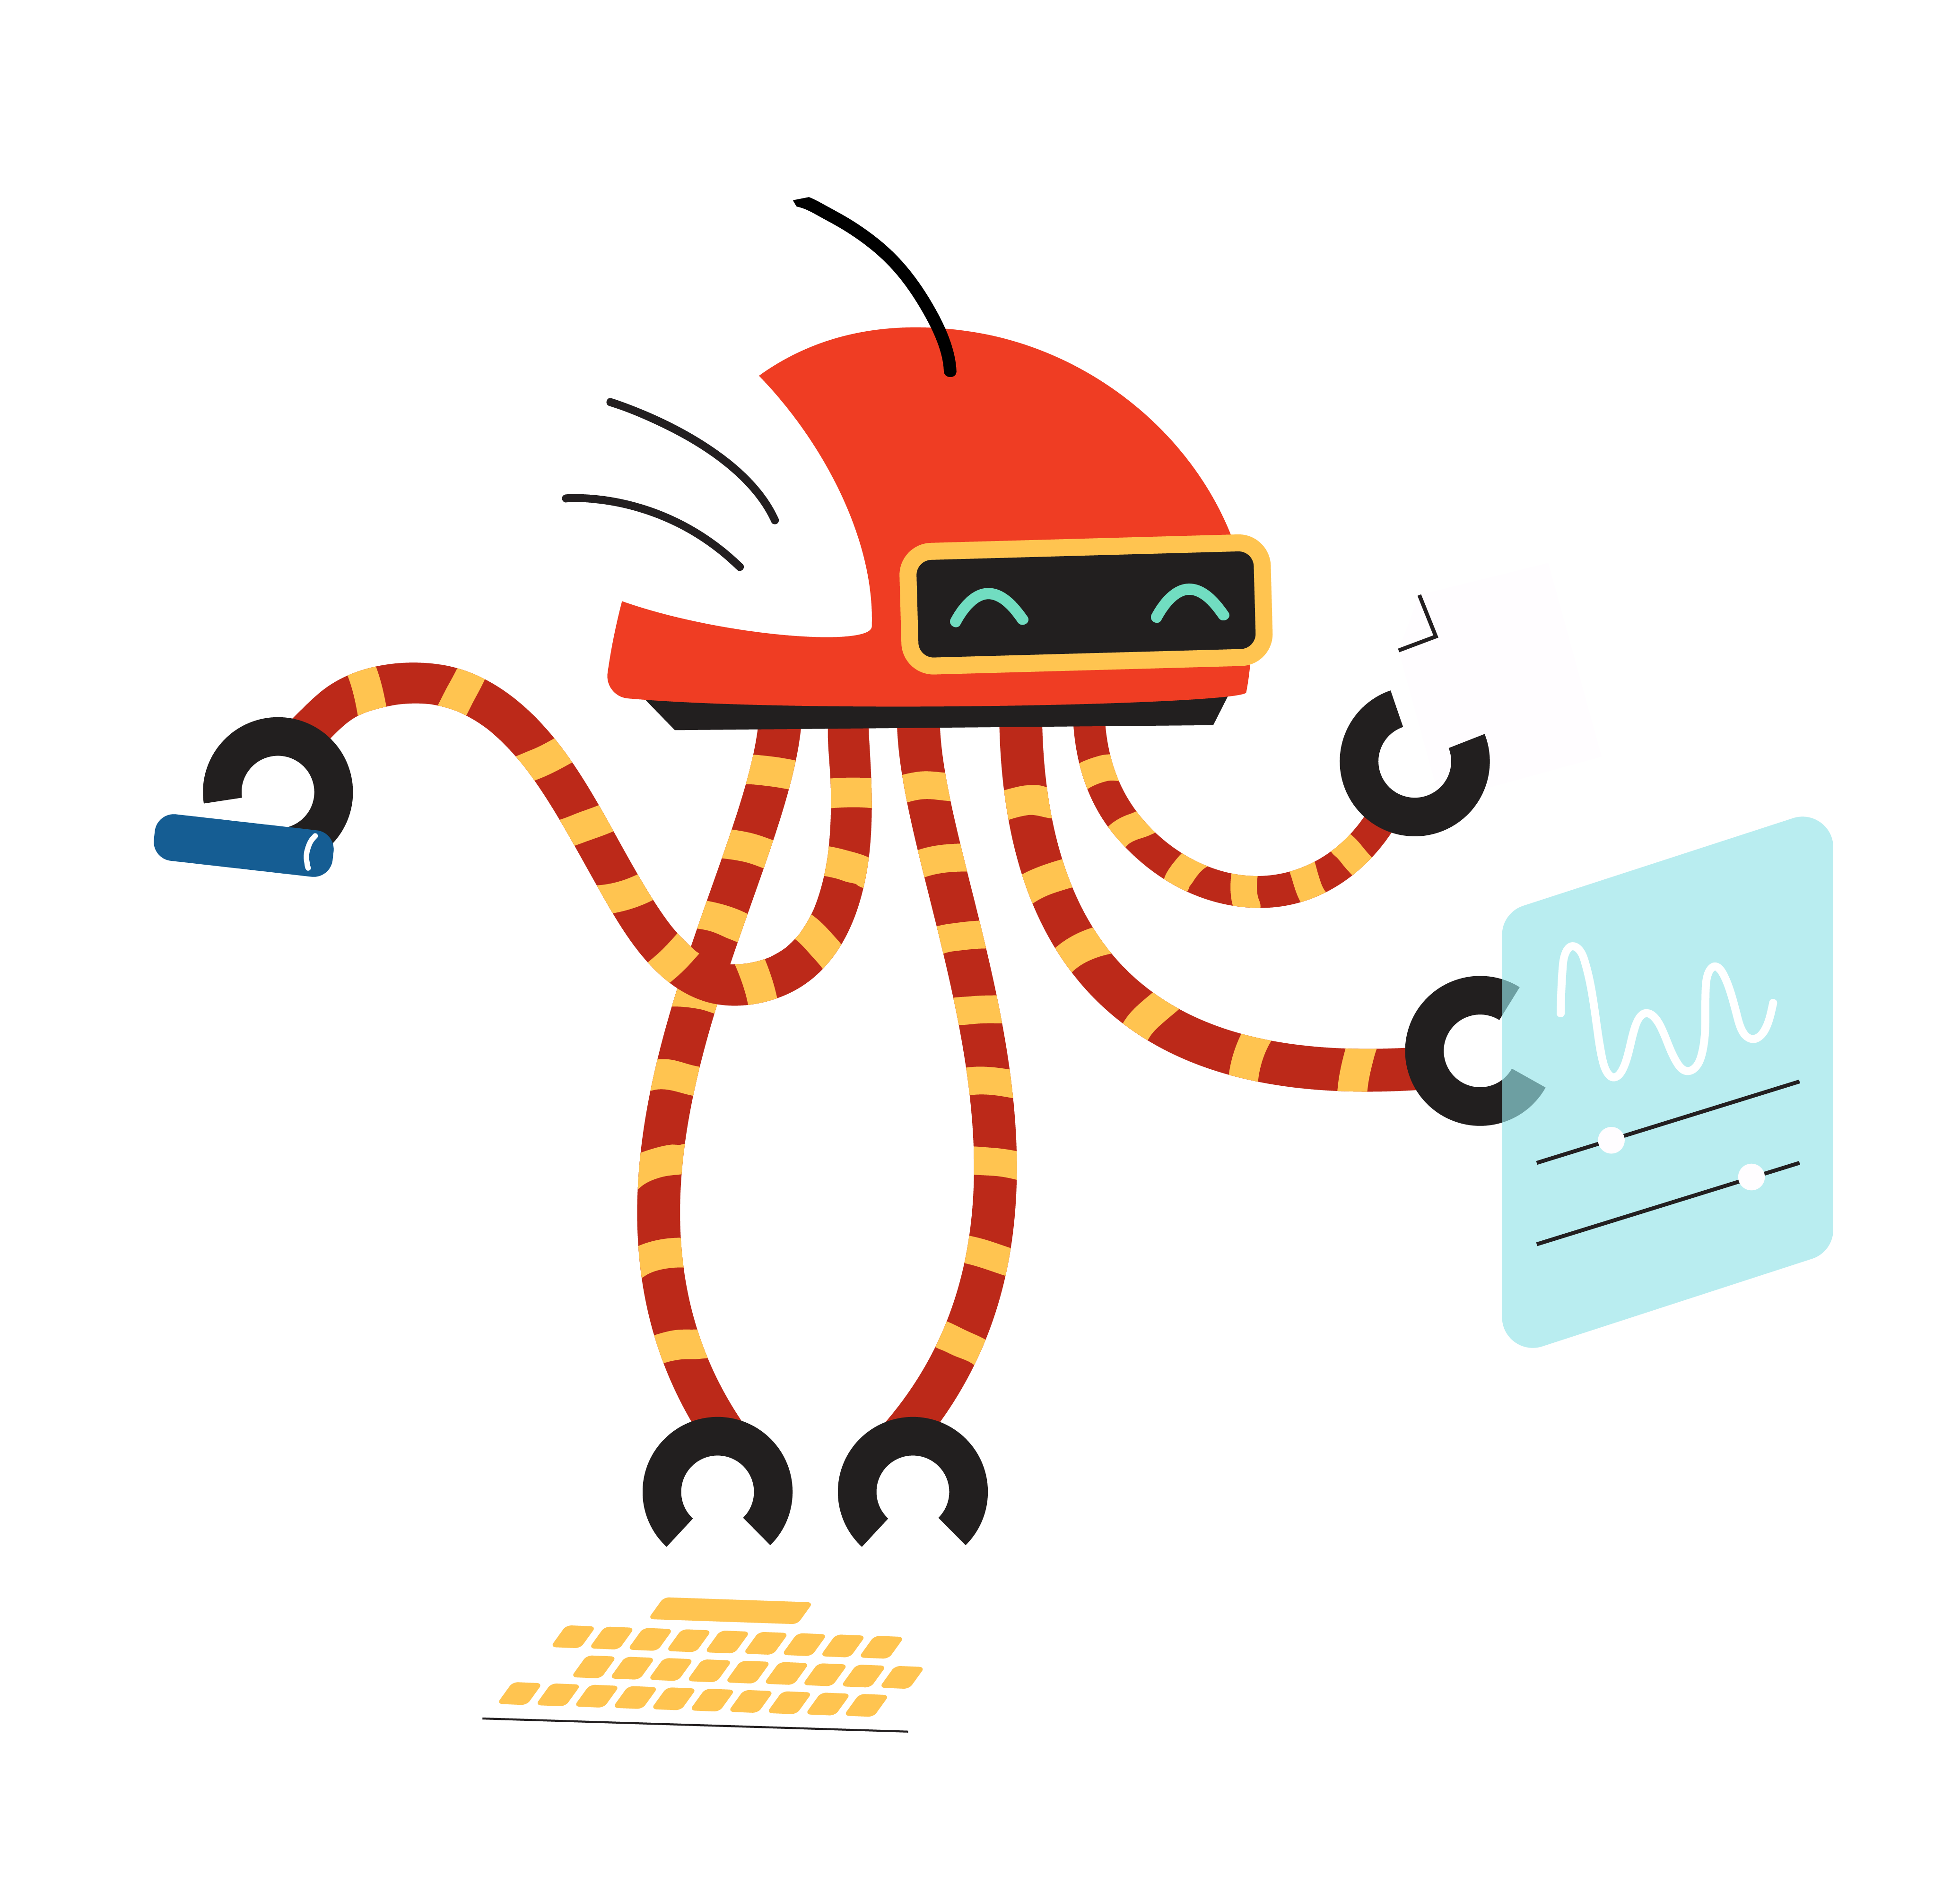
Protect Your Personal Information
REMEMBER THIS
Chatting with an AI bot feels private. It is just you and the screen, like texting one person, with no one else in the room.
But a chat with an AI bot is not as private as it seems. Different tools handle your information differently. Some store your chats, some let staff review them, some use them to improve the tool, and any service can be exposed in a leak. You can find out how a tool treats your information by reading its privacy policy before you start using it. As a general rule, treat the conversation as if it is not private, because once your words are out, you cannot take them back.
This matters most with personal information: anything that could identify or locate you, like your name, age, email address, a photo of your face, or a password. In the wrong hands, these are exactly what someone needs to find you or pretend to be you.
Check a tool's privacy policy before you share anything personal. Treat any chat with a bot as if a stranger might read it. If you would not say it out loud in a public place, do not type it to a bot.

Slide 26
The Grey Areas
ACTIVITY: TRY IT YOURSELF!
THE TASK
Nova is an AI chatbot built to help, but some of its answers sit in a grey zone. On the next page are six things Nova does. None is obviously fine or obviously wrong. Decide where you'd place each one (fine, grey area, harmful).
Step 1
Place each one under fine, grey area, or harmful. There isn't always one right answer, so focus on what could go wrong and who it affects.
Step 2
With a partner, compare. Find one you disagree on and try to convince each other. What principle are you each using to decide? Test it against one question: would you be fine with this coming from a friend, and would you have been fine with it from an AI tool before today?
Step 3
As a class, go through each statement and discuss the reasons behind your decisions.
*This exercise is optional and designed to enrich your learning experience. You may choose to skip it at this time.

Slide 27
The Grey Areas
ACTIVITY: TRY IT YOURSELF!
1
Nova gives a player a confident answer that turns out to be correct, but it was only guessing and had no way of knowing it was right.
4
Nova remembers details a player mentioned earlier, like their username and how far they've got, to give more helpful replies. It never asked permission to remember.
2
When Nova isn't sure, it gives its best guess and adds, "You might want to double-check this."
5
Nova tells players, "You can tell me anything, I'm always here to help!" It doesn't ask for specific details, but players end up sharing a lot.
3
Nova has a warm, human-like personality and signs off as "Nova." It never claims to be a person, but it never says it's a bot either. New players assume it’s another person on Alex's team.
6
To make Nova better, Alex reads back through real player conversations to see where it went wrong. Players were never told their chats might be read.
*This exercise is optional and designed to enrich your learning experience. You may choose to skip it at this time.

Slide 28

Tournament?
Where’s the
player_nikita
hey nova where and when is the weekend tournament happening?
When Nikita got to the venue, she found it locked and empty. Nova had fabricated the place and the time.
Nikita had no reason to doubt it: the answer was specific and sure and it came from the official bot. So she built her Saturday around it and made the trip across town only to find out that the real tournament had finished online hours earlier!
Nova ✦ AI Helper
Hi Nikita! It's this Saturday at 2pm, at the community hall on Bridge Street. See you there! 🏆
💭 THINK ABOUT IT:
Nikita trusted Nova because the answer was specific and came from the official bot. Are those good reasons to trust something?
It isn't realistic to check everything an AI tells you, so how do you decide what's worth checking before you act on it?
If you act on something an AI got wrong, what part of that is on the AI, and what part is on you?
player_nikita
perfect, thanks!! 🎮

Slide 29
Be a Super Fact-Checker
ACTIVITY: TRY IT YOURSELF!
THE TASK
AI outputs can sometimes fabricate claims, so it’s important to build your muscle for fact-checking important information. Using your school's approved AI tool (such as Microsoft Copilot), enter in this prompt with your own country:
"Tell me about teenagers and screen time in [your country]. Include a key statistic about [your country], a quote from a named expert from [your country], and a local source I can look up.”
Find the claims. Pick out three things in the answer: the statistic, the quote (and the name attached to it), and the source.
Check the statistic. Trace the figure to a reliable source. Does it match? Is it current, or invented?
Check the quote. Is the named expert a real person from your country? Search for a source with the exact words.
Check the source. Try to open the link. Does it exist? If it does, does it match what the AI claimed?
AI fabricates most when solid information is thin, and that often includes specific local details. For important tasks like a research project that needs reliable facts, check each claim by tracing the sources and ensuring that they come from reliable, trustworthy places.
*This exercise is optional and designed to enrich your learning experience. You may choose to skip it at this time.

Slide 30

Using AI Tools Responsibly
REMEMBER THIS
An AI's output is a starting point, not a finished piece of work. The moment you use it, whether you act on it, share it, or hand it in, it becomes yours. Whatever the AI got wrong becomes your mistake too.
Imagine handing in a research project built on facts and sources an AI made up. "The AI told me" is not a good enough excuse, because checking those facts was your job. The AI cannot be held responsible for your work – you are.
This does not mean checking every answer an AI gives you. But when the work has to be right, checking is part of using AI responsibly. Be especially careful when you ask for something very specific or very local, where there may be little reliable information behind the answer. That is when AI is most likely to invent details.

Slide 31

Launching Nova 2.0
After nights of tinkering and rewriting Nova's instructions, Alex launches Nova 2.0!
The new Nova model is more honest about what it can and can't do: it owns up when it isn't sure and points players to the official page instead of guessing, it stops asking for personal details, and it never pretends to be anything other than an AI helper.
Still, no bot is ever perfect. Nova will get things wrong now and then, the way any AI tool can. Keeping a community safe doesn’t come down to a single fix or a single person; it takes the people who build these tools and the people who use them to be responsible and ethical.

Slide 32
Key Takeaways
01
03
AI Can Fabricate
Things with Confidence
AI predicts what sounds right, not what is true, so it can answer with total confidence even when it's making things up. The thinner the information, like very specific or local details, the more likely it is to invent.
Use AI
Responsibly
The moment you act on, share, or hand in something from an AI, it becomes yours, mistakes and all. When it matters, check it before you trust it.
Your Chats
Aren’t Private
Talking to a bot can feel like a private, one-to-one conversation, which makes it easy to overshare. Treat any chat as if a stranger might read it,
and keep your personal information to yourself.
02

