Slide 1


Lesson 14.01.01
DIGITAL IDENTITY
Being Influenced
Who is influencing you online?
CYBERLITE.ORG
2023-2024 Ⓒ Cyberlite Books Pte. Ltd. All Rights Reserved.

Slide 2
The role of social media influencers on audience behaviours and beliefs
What are we learning today?
How to be a discerning follower of influencers
The impact of likes and followers on social media
CYBERLITE.ORG
2023-2024 Ⓒ Cyberlite Books Pte. Ltd. All Rights Reserved.

Slide 3
WARM UP QUESTION
Which social media influencer(s) do you follow online? Why did you choose to follow them?
CYBERLITE.ORG
2023-2024 Ⓒ Cyberlite Books Pte. Ltd. All Rights Reserved.

Slide 4
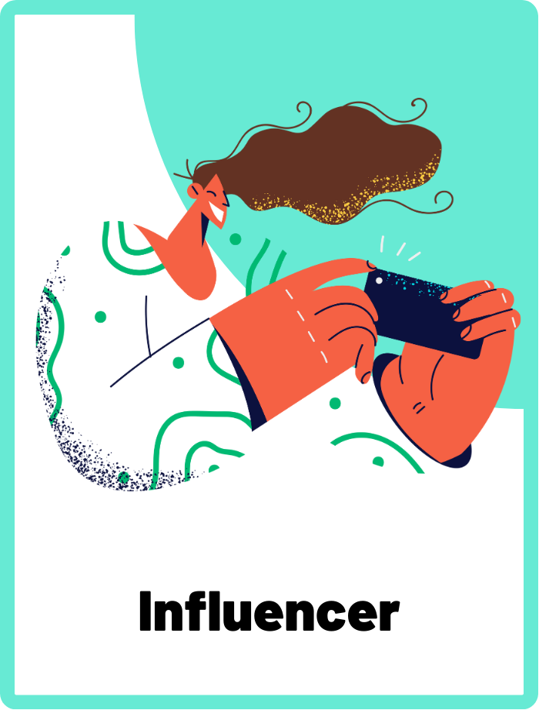
Influencer
An influencer is someone who has a significant following on social media and can affect the opinions and behaviours of their audience, often through sponsored content and endorsements.
CYBERLITE.ORG
2023-2024 Ⓒ Cyberlite Books Pte. Ltd. All Rights Reserved.

Slide 5
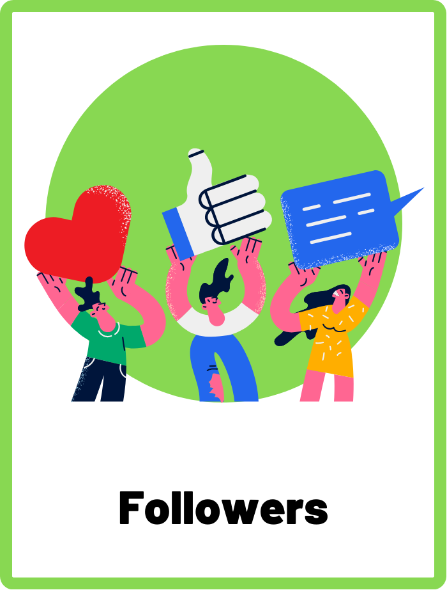
Followers
"Followers" on social media are individuals who subscribe to and receive updates from a social media profile or account.
CYBERLITE.ORG
2023-2024 Ⓒ Cyberlite Books Pte. Ltd. All Rights Reserved.

Slide 6
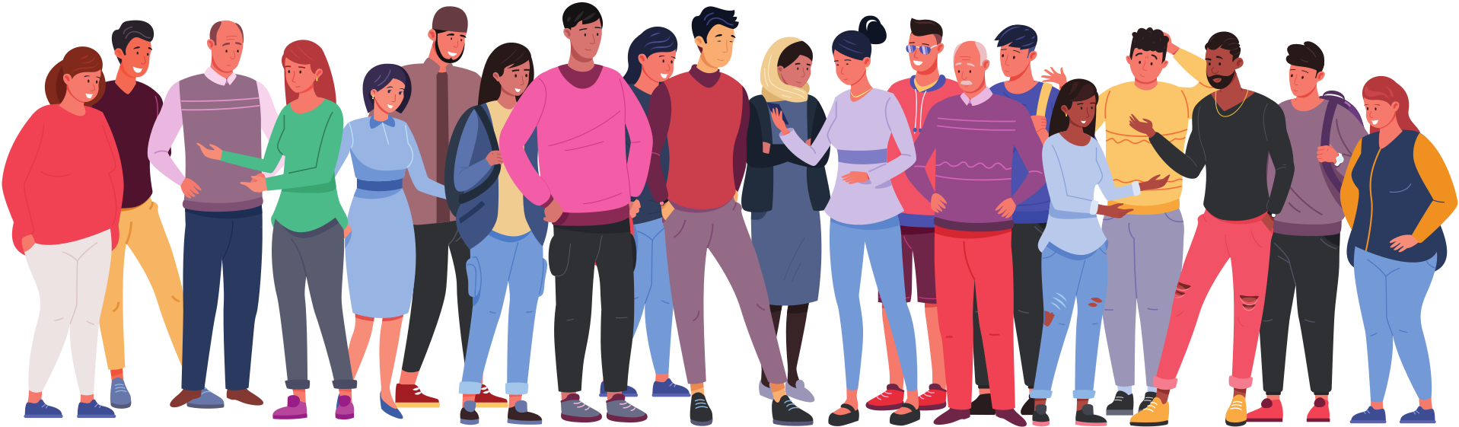
What is an Influencer?
An influencer is someone with a strong online presence who can impact the opinions, choices, and interests of their followers. They often share content about a specific topic, such as fashion, gaming, or lifestyle.
CYBERLITE.ORG
2023-2024 Ⓒ Cyberlite Books Pte. Ltd. All Rights Reserved.

Slide 7
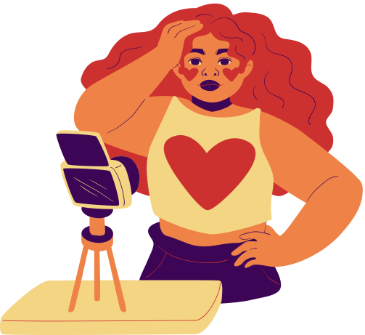
Why do people become influencers?
People become influencers because they are passionate about a particular subject and want to share their knowledge and experiences.
Some influencers enjoy connecting with their followers and may earn a living through sponsorships and partnerships.
CYBERLITE.ORG
2023-2024 Ⓒ Cyberlite Books Pte. Ltd. All Rights Reserved.

Slide 8


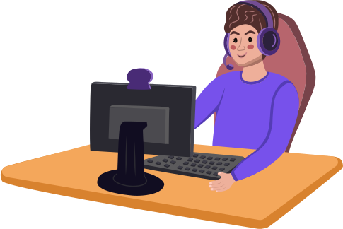

The Role of Likes and Followers
Likes and followers are indicators of an influencer's popularity and reach on social media platforms.
They can boost an influencer's credibility and opportunities for collaborations.
CYBERLITE.ORG
2023-2024 Ⓒ Cyberlite Books Pte. Ltd. All Rights Reserved.

Slide 9
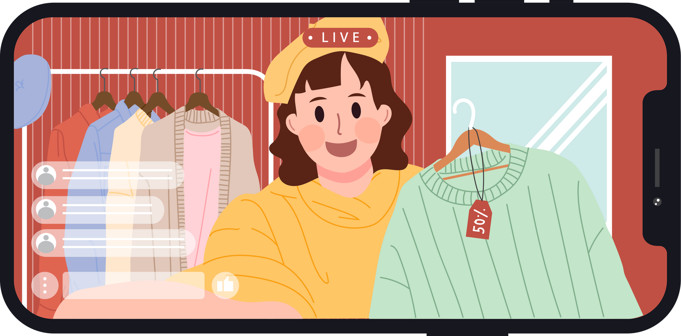
The Importance of Being a Discerning Follower
Influencers may have different motivations than you for being on social media. They often have a financial motivation for the content they post.
As a follower, it's important to be discerning and not base your opinions solely on an influencer's popularity.
CYBERLITE.ORG
2023-2024 Ⓒ Cyberlite Books Pte. Ltd. All Rights Reserved.

Slide 10
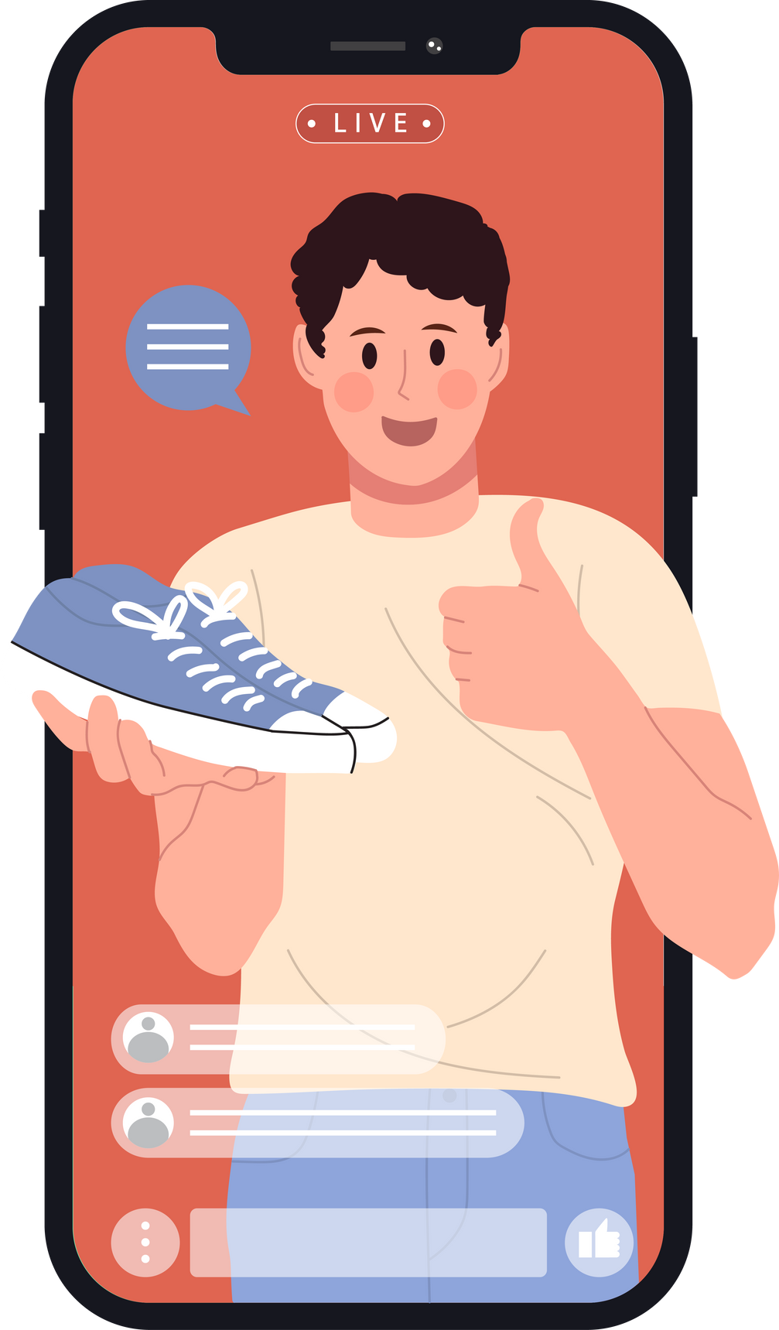
#Sponsored Content
Influencers often partner with brands and may promote products or services in sponsored posts.
Be aware that sponsored content may not always be entirely in the interest of followers. This is because the influencer has a lot of financial motivation to get their followers to purchase from the brand they’re promoting.
CYBERLITE.ORG
2023-2024 Ⓒ Cyberlite Books Pte. Ltd. All Rights Reserved.

Slide 11


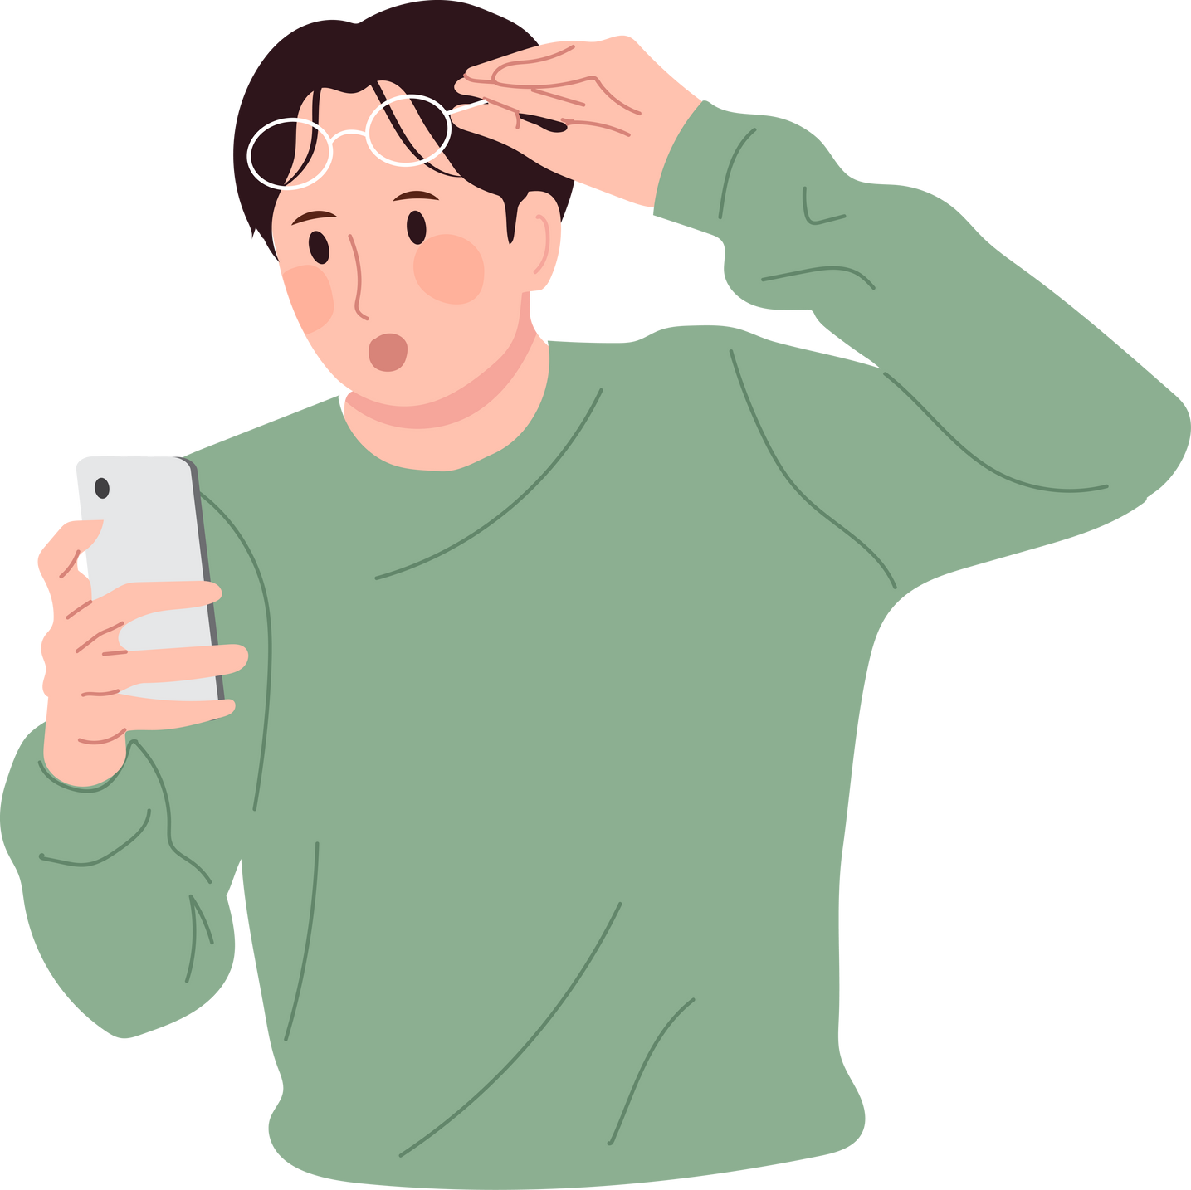
What should you consider before following?
Does this influencer’s content align with my personal value?
Remember influencers are not the most reliable or accurate sources.
Is their content positive and kind?
CYBERLITE.ORG
2023-2024 Ⓒ Cyberlite Books Pte. Ltd. All Rights Reserved.

Slide 12
ACTIVITY
Influencers: Pros and Cons
A debate on the impact of social media influencers.
CYBERLITE.ORG
2023-2024 Ⓒ Cyberlite Books Pte. Ltd. All Rights Reserved.

Slide 13
Instructions
  Split into two groups. Each team will either support or oppose the given statement.
  Each team is responsible for researching their side of the debate. This includes finding facts, examples, and arguments to support their stance. Make sure you use credible and trustworthy sources!
  Each team should outline their main points and develop clear, concise arguments. Prepare an opening statement, key points, and a closing statement.
CYBERLITE.ORG
2023-2024 Ⓒ Cyberlite Books Pte. Ltd. All Rights Reserved.

Slide 14
Instructions
Within each team, assign specific roles.
  Lead Speaker: Presents the opening and closing statements.
  Argument Presenters: Each handles a specific point of the debate.
  Rebuttal Lead: Prepares to respond to the opposing team's arguments.
The debate will follow this format:
  Opening Statements: Each team presents their initial arguments.
  Presentation of Arguments: Teams alternate presenting their main points.
  Rebuttals: Teams respond to each other’s arguments.
  Closing Statements: Each team summarises their position.
Each speaker will have a set time limit (e.g., 2-3 minutes per segment).
CYBERLITE.ORG
2023-2024 Ⓒ Cyberlite Books Pte. Ltd. All Rights Reserved.

Slide 15
Etiquettes of Debating
Before we begin the debate, we must remember the etiquettes of debating.
  Listen respectfully when someone is presenting.
  Don’t interrupt the other team.
  Present your arguments in a constructive and polite manner.
CYBERLITE.ORG
2023-2024 Ⓒ Cyberlite Books Pte. Ltd. All Rights Reserved.

Slide 16
THE STATEMENT
“Social media influencers have a positive impact on youth.”
Research and present your arguments.
CYBERLITE.ORG
2023-2024 Ⓒ Cyberlite Books Pte. Ltd. All Rights Reserved.

Slide 17
WRAP UP
What have you learned today?
Let’s reflect on today’s lesson.
CYBERLITE.ORG
2023-2024 Ⓒ Cyberlite Books Pte. Ltd. All Rights Reserved.

Slide 18
Remember This!
  Influencers can be inspiring and entertaining, but they are not the most reliable sources of information.
  Influencers may have different motivations than you. They are often posting content for financial gains.
  Think critically about the motivations behind sponsored posts.
  Be discerning about who you follow and who you allow to influence you.
CYBERLITE.ORG
2023-2024 Ⓒ Cyberlite Books Pte. Ltd. All Rights Reserved.

Slide 19
Lesson 14.01.01
Well Done!
CYBERLITE.ORG
2023-2024 Ⓒ Cyberlite Books Pte. Ltd. All Rights Reserved.

