Slide 1
Tempting Offers
LESSON 3.4
PHISHING & SCAMS
EXERCISE-IN-A-BOX

Slide 2

Do you know what phishing means?
Why do cybercriminals and bad actors do it?
WARM-UP

Slide 3
Do you know any examples of online scams?
WARM-UP

Slide 4



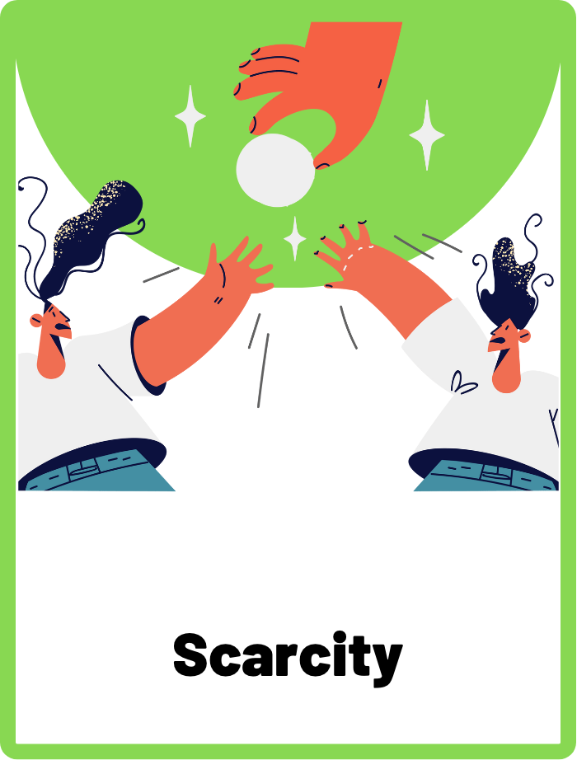
DEFINE THE KEYWORDS
What do you think these terms mean?

Slide 5
DEFINE
Curiosity Baiting
This is when scammers use something interesting or mysterious to grab your attention and get you to click on a link or download a file.

Slide 6
DEFINE
Tempting Offer
Also known as “Too Good to be True” offers. Scammers might make you an offer that sounds too good to be true in order to trick you into giving them your personal information or money.

Slide 7
DEFINE
Scarcity
Scammers might use the idea of scarcity to make you feel like you need to act fast in order to get a good deal or avoid missing out on something important.

Slide 8

INVESTIGATE THE EVIDENCE
Here are a few pieces of evidence of how phishing and scams work online. Investigate the evidence carefully and identify the different tactics that scammers have used.

Slide 9
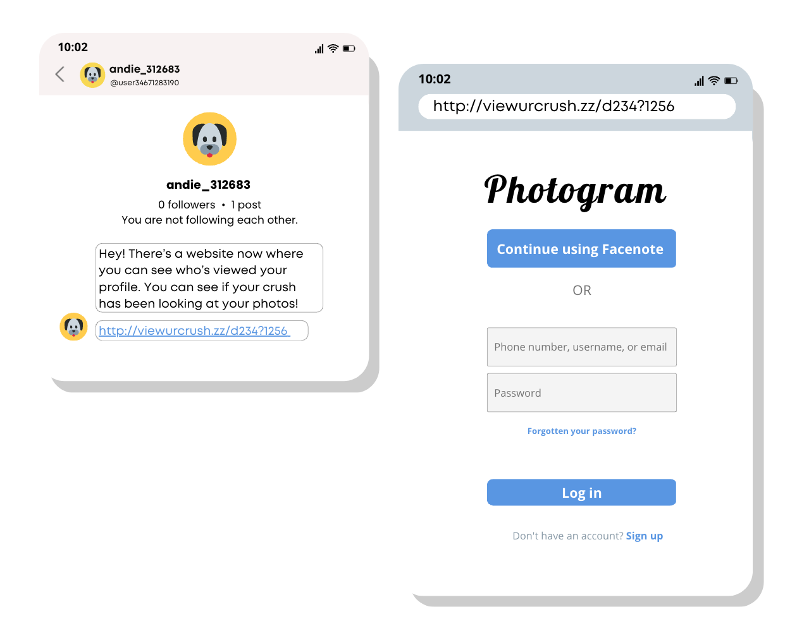
INVESTIGATE
EVIDENCE #1
Which tactic(s) has the scammer used here?
Curiosity baiting
Tempting offer
Scarcity
Identify all the clues that tell you this is a phishing scam.

Slide 10
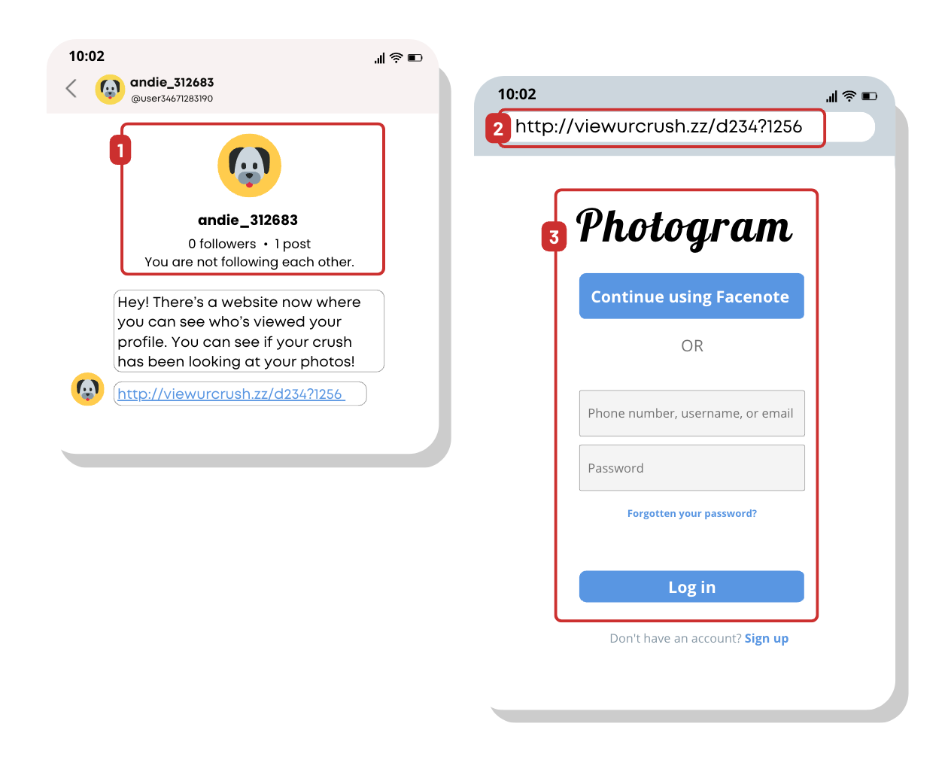
INVESTIGATE
EVIDENCE #1
WHAT? Curiosity Baiting
WHY? To steal your login credentials
RED FLAGS TO LOOK OUT FOR:
1. Unknown sender. This message was sent by an unknown sender who you are not following. Don’t click on any links for people you don’t know.
2. HTTP, not HTTPS. Always make sure any link you click starts with “HTTPS”.
3. Fake website and wrong URL. You should never enter your login credentials into websites or apps that’s not the official ones.

Slide 11
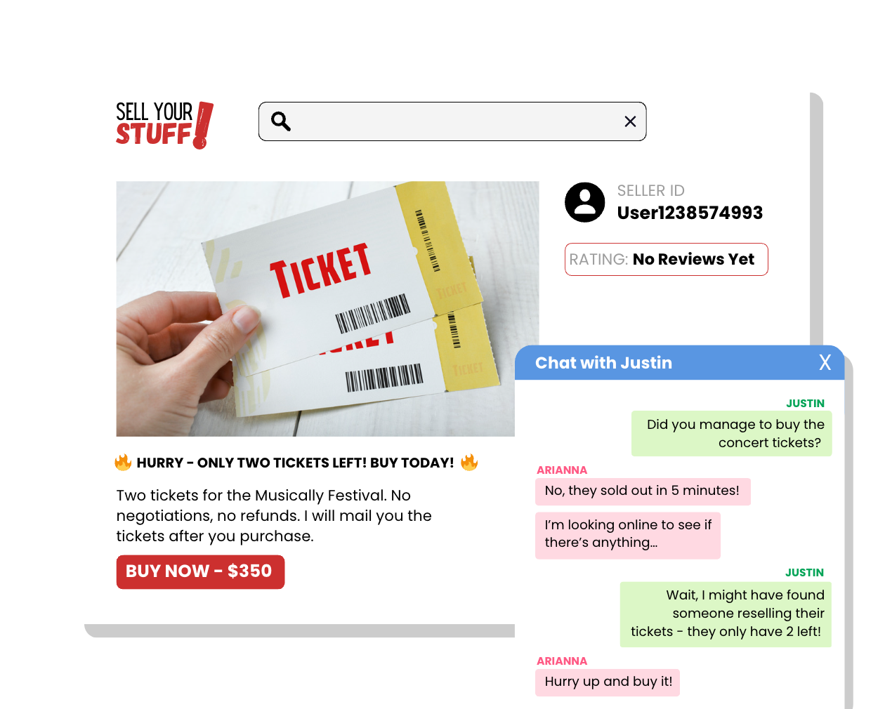
INVESTIGATE
EVIDENCE #2
Which tactic(s) has the scammer used here?
Curiosity baiting
Tempting offer
Scarcity
Identify all the clues that tell you this is a phishing scam.

Slide 12
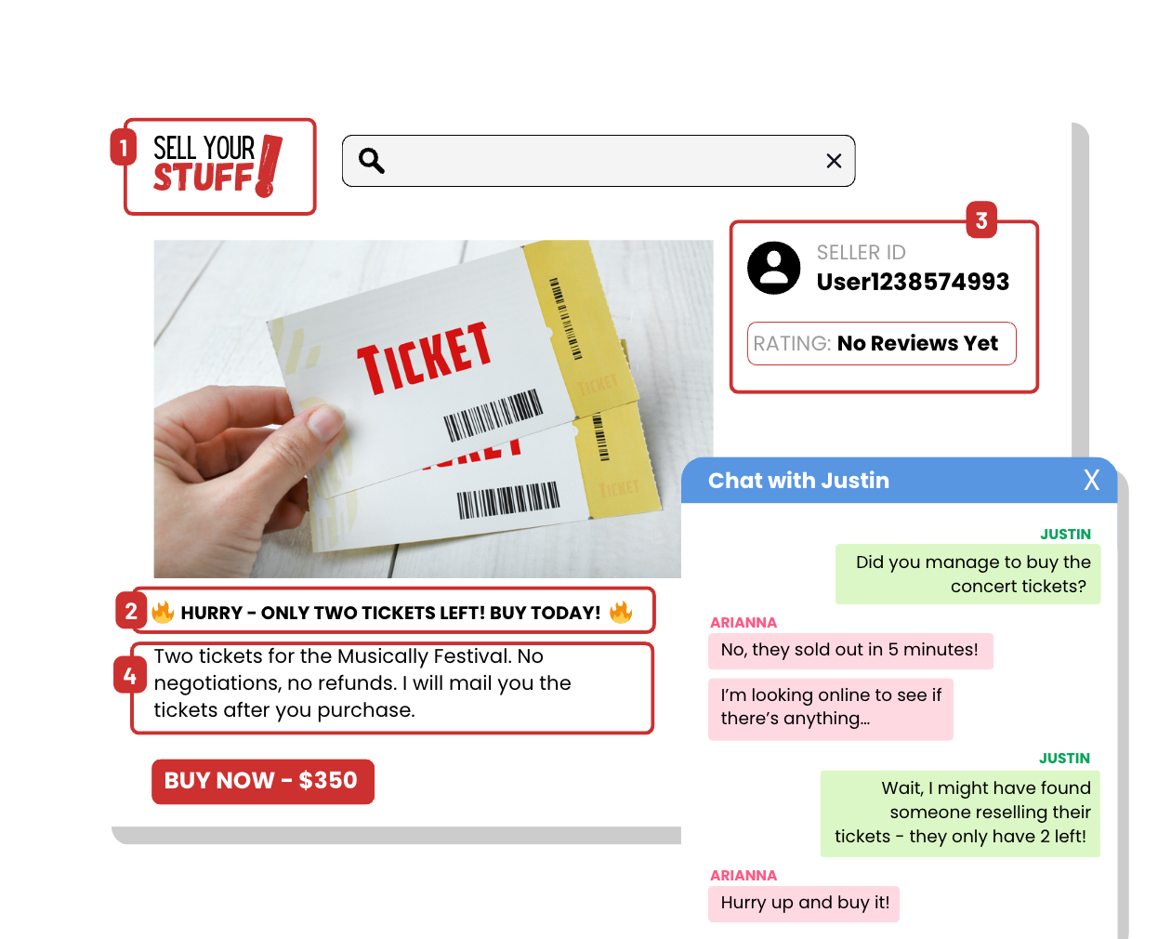
INVESTIGATE
EVIDENCE #2
WHAT? Scarcity and tempting offer
WHY? Scammers don’t want you to spend a long time thinking, they want you to act fast.
RED FLAGS TO LOOK OUT FOR:
1. Sold on an online marketplace. Sites like this allow anyone from anywhere to sell their things, which makes it difficult to verify if the seller is legitimate.
2. Persuasive language. This enhances the idea of scarcity and creates a sense of urgency.
3. No ratings. It’s a good idea to only make purchases with sellers who have high ratings on these platforms.
4. No negotiations or refunds. The seller wants you to make the purchase as quickly as possible without thinking.

Slide 13
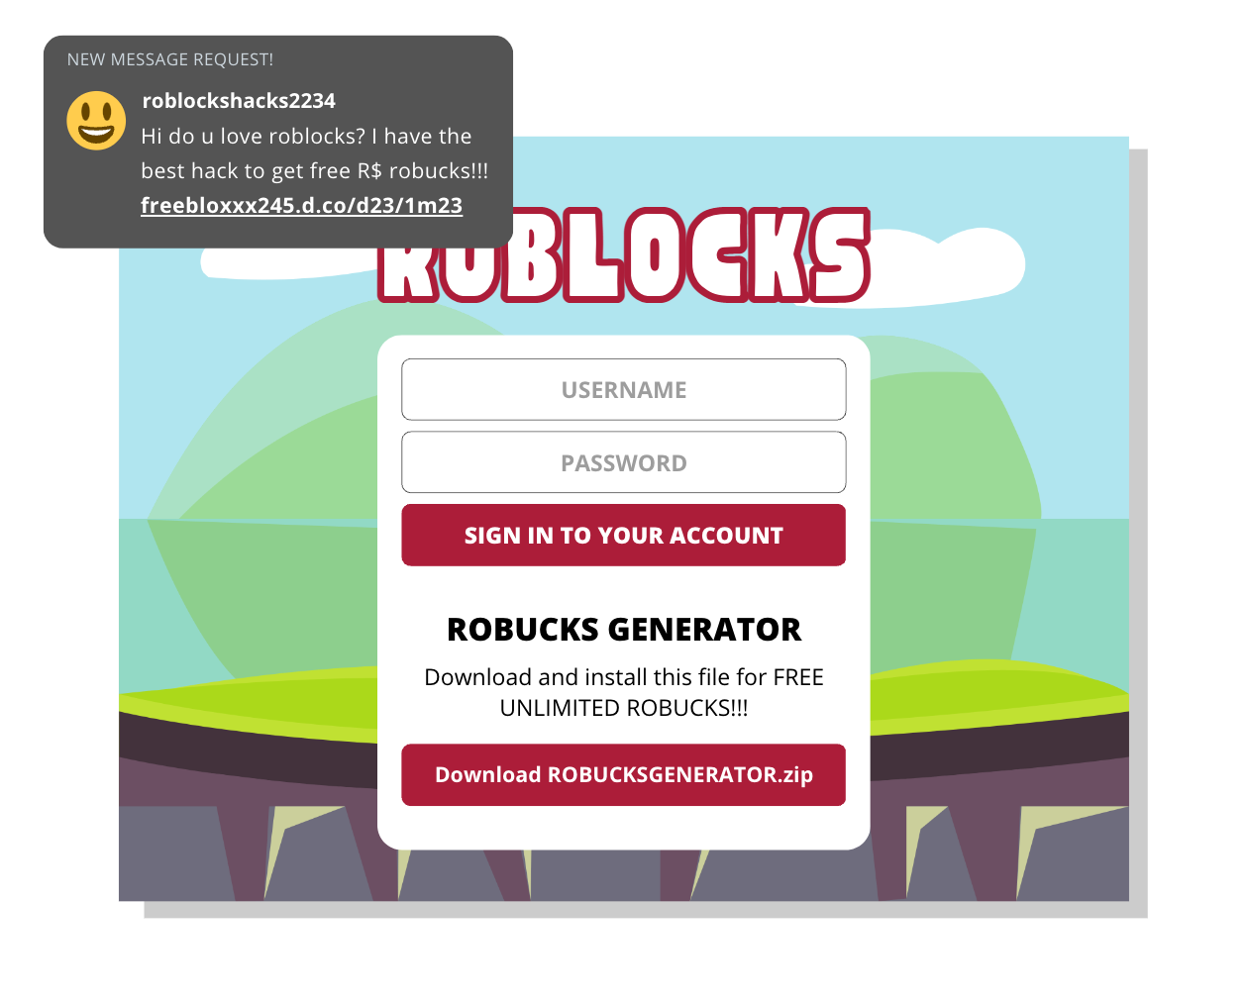
INVESTIGATE
EVIDENCE #3
Which tactic(s) has the scammer used here?
Curiosity baiting
Tempting offer
Scarcity
Identify all the clues that tell you this is a phishing scam.

Slide 14
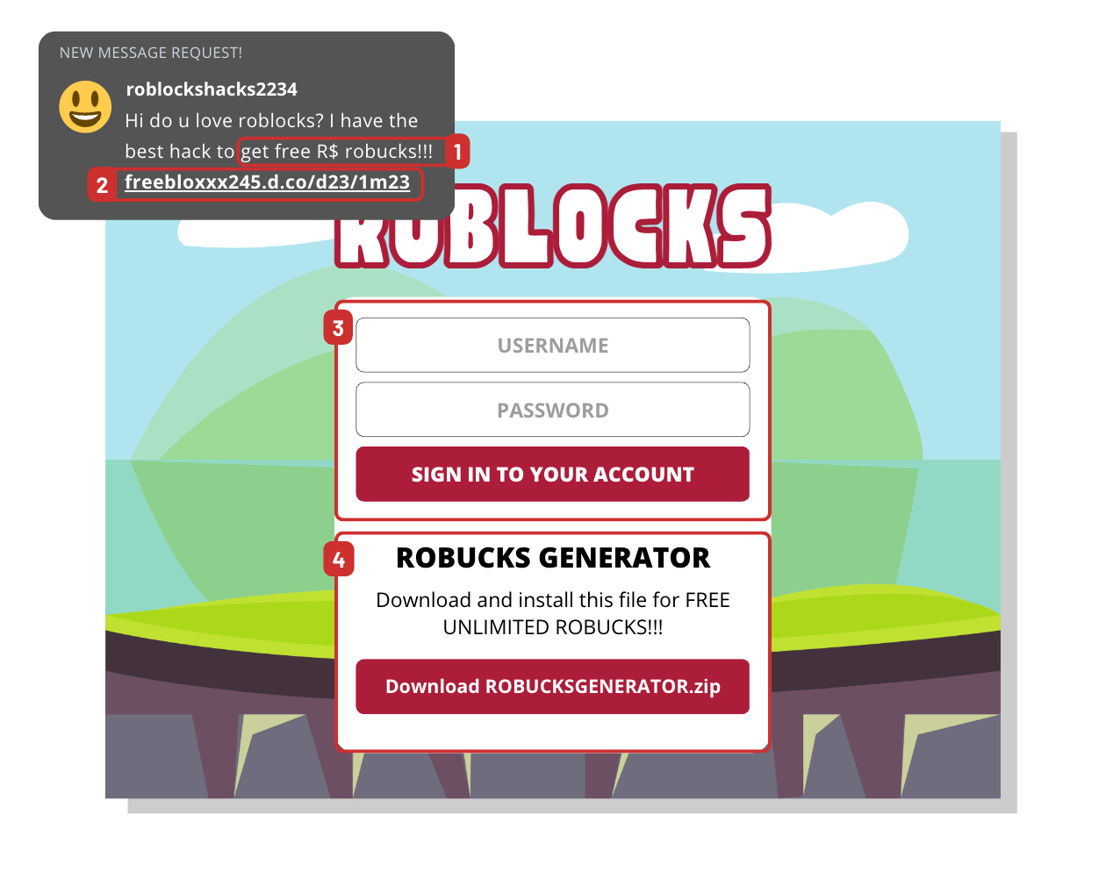
INVESTIGATE
EVIDENCE #3
WHAT? Tempting offer
WHY? To steal your login credentials and infect your device with malware
RED FLAGS TO LOOK OUT FOR:
1. “Too good to be true” offer. Don’t fall for this tempting offer!
2. Unknown link from an unknown user. Do not click on any links that don’t look right.
3. Asking to connect your account. Only enter your information to official websites.
4. Download this virus. Never download and install anything to your device from suspicious websites.

Slide 15

KEY TAKEAWAYS
Cybercriminals and bad actors create tempting scams to trick you into giving them your personal information, login credentials, or money.
Think before you click. Never click or download anything that was sent to you by an unknown or unverified user.
Use your critical judgement and don’t fall for “too good to be true” offers.

Slide 16
Well Done!
LESSON 3.4

