Slide 1


Lesson 13.10.02
GENERATIVE AI
Boundaries and Specificity
Prompt Engineering Lab Series
CYBERLITE.ORG
2023-2024 Ⓒ Cyberlite Books Pte. Ltd. All Rights Reserved.

Slide 2
Using AI Tools Safely and Responsibly
Before we get started with the lesson, we must first remember these rules of using generative AI tools safely and responsibly.
1. Never share your personal and sensitive information when interacting with AI.
2. Be aware of AI's limitations and potential biases in its responses.
3. AI has a tendency to fabricate information at times. Always remember to fact-check any AI-generated information before using it.
4.Use AI ethically: respect privacy, avoid harmful content, and think critically
CYBERLITE.ORG
2023-2024 Ⓒ Cyberlite Books Pte. Ltd. All Rights Reserved.

Slide 3
What You’ll Need
  Computer with internet access
  Access to an LLM, such as ChatGPT (link), Copilot in Bing (link), or Bard (link)
Disclaimer:
  Before using these tools, remember to check with your school and the app or site’s terms of use. Many AI tools require students to be at least 13 years old, and may require parental consent for those under 18 years old.
  The outcomes of exercises in this toolkit may differ from provided examples, as they depend on your specific inputs and the AI tools employed.
  Generative AI tools may at times produce inaccurate or fabricated information. Please verify and fact-check outputs using discretion and critical thinking.
CYBERLITE.ORG
2023-2024 Ⓒ Cyberlite Books Pte. Ltd. All Rights Reserved.

Slide 4
WHAT ARE WE LEARNING TODAY?
Boundaries and Specificity
CYBERLITE.ORG
2023-2024 Ⓒ Cyberlite Books Pte. Ltd. All Rights Reserved.

Slide 5
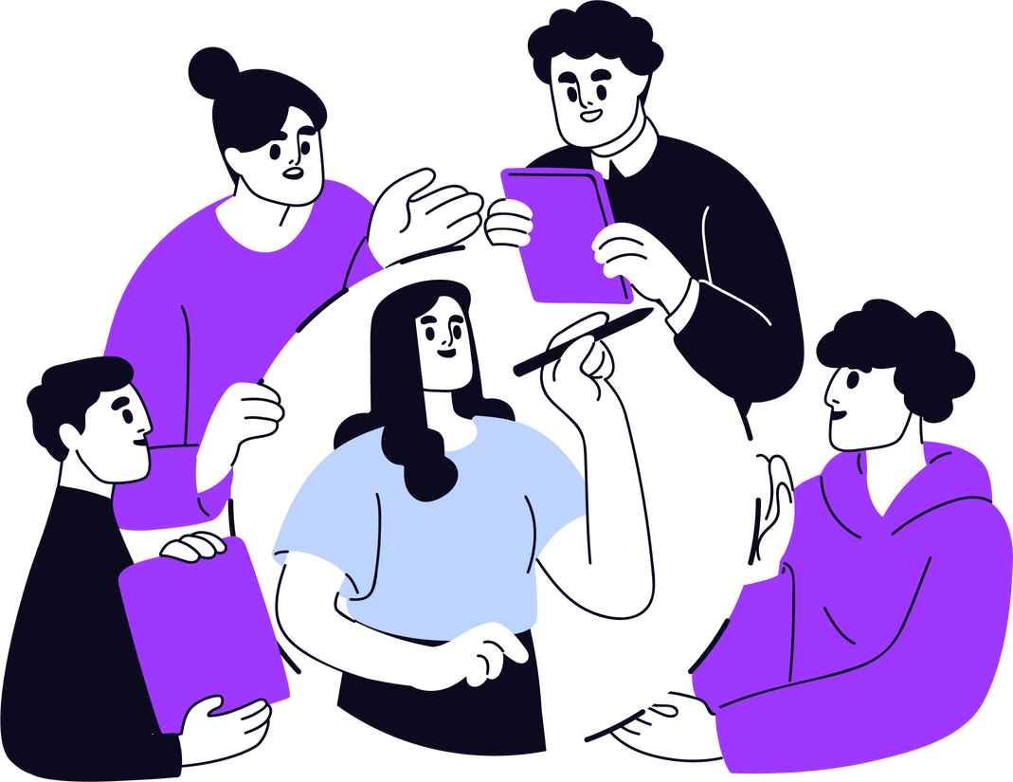
Today’s Focus
Learning to be specific with your prompts and setting clear boundaries is a good prompting skill to learn, because it helps you get relevant and appropriate responses from the AI tool.
CYBERLITE.ORG
2023-2024 Ⓒ Cyberlite Books Pte. Ltd. All Rights Reserved.

Slide 6

The Power of Being Specific
If your prompt is too vague, it may lead the AI to generate irrelevant, unexpected, or inappropriate responses. Detailing the what, why, and who of your desired output can help generate better results.
Vague Prompt
Create a poster.
Specific Prompt
Design a digital poster for a new action movie about a group of student detectives solving a school mystery.
CYBERLITE.ORG
2023-2024 Ⓒ Cyberlite Books Pte. Ltd. All Rights Reserved.

Slide 7
Drawing Lines: Setting Boundaries
Boundaries in prompts guide the AI tool on what to include or exclude. Here are some boundaries you can set:
Length
Tone & Style
Format
For example:
“500 words”
“a short essay”
“one-sentence summary”
For example:
“ in a professional tone”
“in the style of Shakespeare”
“in a friendly tone”
For example:
“a movie script”
“an informal email”
“a newspaper article”
CYBERLITE.ORG
2023-2024 Ⓒ Cyberlite Books Pte. Ltd. All Rights Reserved.

Slide 8
GROUP EXERCISE
Let’s Explore Together!
Try these examples to see the skills in action.
CYBERLITE.ORG
2023-2024 Ⓒ Cyberlite Books Pte. Ltd. All Rights Reserved.

Slide 9
Refining Prompts Exercise
Let’s transform vague prompts into specific, bounded ones. As a group, discuss what boundaries and specific details you can add to improve the following prompts.
CYBERLITE.ORG
2023-2024 Ⓒ Cyberlite Books Pte. Ltd. All Rights Reserved.

Slide 10
Refining Prompts Exercise #1
You want to learn about Newton’s Second Law of Motion, using real life examples. How would you improve this prompt?
Improve This Prompt!
Help me with science homework.
Discuss in pairs or as a class what details you would add.
CYBERLITE.ORG
2023-2024 Ⓒ Cyberlite Books Pte. Ltd. All Rights Reserved.

Slide 11
Refining Prompts Exercise #1
Here’s a suggestion of how you can improve on the prompt:
Improve This Prompt!
Help me with science homework.
Suggestion
Explain Newton's Second Law of Motion using real-life examples suitable for a 9th-grade physics student.
CYBERLITE.ORG
2023-2024 Ⓒ Cyberlite Books Pte. Ltd. All Rights Reserved.

Slide 12
Refining Prompts Exercise #2
You need to write a report on the differences between Bengal Tigers and African Elephants. How would you improve this prompt?
Improve This Prompt!
Tell me about elephants and tigers.
Discuss in pairs or as a class what details you would add.
CYBERLITE.ORG
2023-2024 Ⓒ Cyberlite Books Pte. Ltd. All Rights Reserved.

Slide 13
Refining Prompts Exercise #2
Here’s a suggestion of how you can improve on the prompt:
Improve This Prompt!
Tell me about elephants and tigers.
Suggestion
Provide a detailed comparison of the dietary habits and habitat requirements of African Elephants and Bengal Tigers.
CYBERLITE.ORG
2023-2024 Ⓒ Cyberlite Books Pte. Ltd. All Rights Reserved.

Slide 14
TRY IT YOURSELF
Independent Exploration Task
Apply the skills you’ve learned in this task.
CYBERLITE.ORG
2023-2024 Ⓒ Cyberlite Books Pte. Ltd. All Rights Reserved.

Slide 15
Your Task
As the newly elected class president, you’re in charge of your school’s recycling programme. It’s your responsibility to encourage your classmates to recycle properly.
You’ve decided to create a school-wide campaign to raise awareness about the recycling programme. Using generative AI tools, create the content for the following items in your campaign:
  A recycling contest for students to participate in.
  A 2-minute speech to address the school at the next student assembly.
  A 300 word article in the school magazine.
CYBERLITE.ORG
2023-2024 Ⓒ Cyberlite Books Pte. Ltd. All Rights Reserved.

Slide 16
Group Sharing!
What did you come up with?
CYBERLITE.ORG
2023-2024 Ⓒ Cyberlite Books Pte. Ltd. All Rights Reserved.

Slide 17
Lesson 13.10.02
Well Done!
CYBERLITE.ORG
2023-2024 Ⓒ Cyberlite Books Pte. Ltd. All Rights Reserved.

