Slide 1
Identity Exposed
Lesson 15.06.02
CYBERBULLYING & ABUSE
EXERCISE-IN-A-BOX

Slide 2

What types of personal information should you never share online?
WARM-UP

Slide 3
Do you think it’s ever okay to post someone else’s personal information online without their permission?
WARM-UP

Slide 4

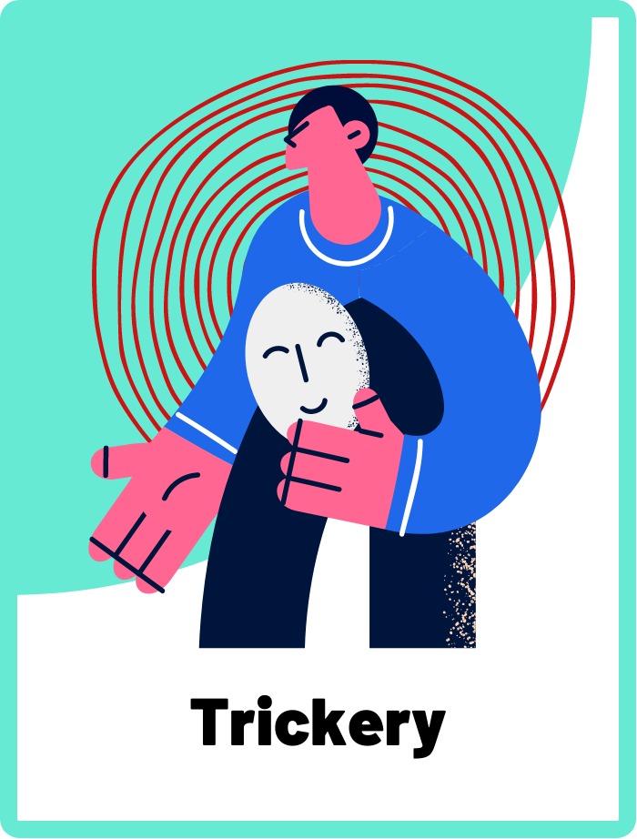
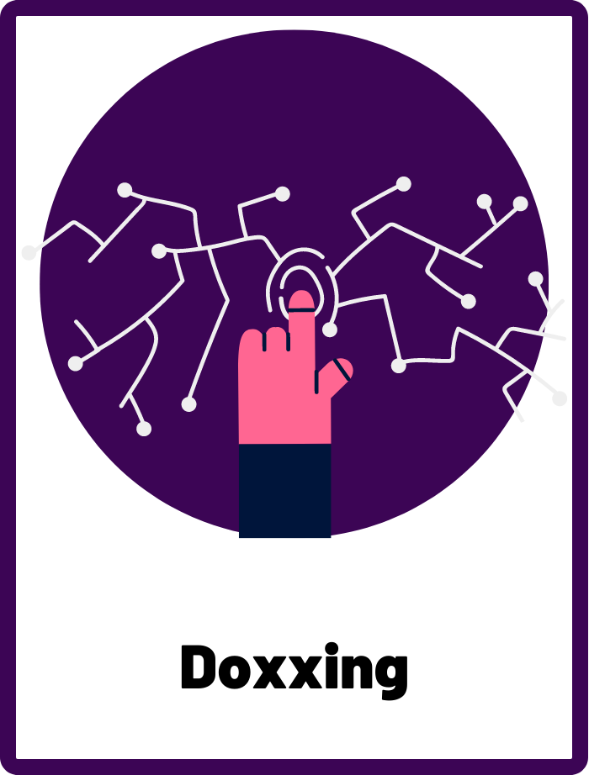
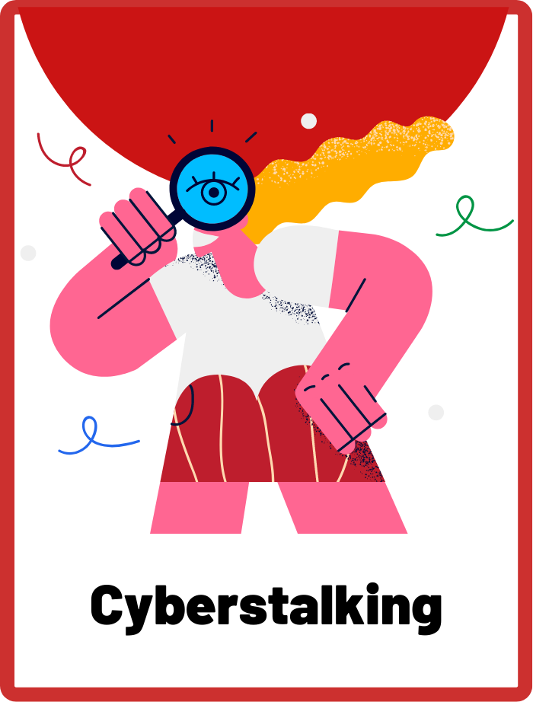
DEFINE THE KEYWORDS
What do you think these terms mean?

Slide 5
DEFINE
Trickery
When someone uses deception or lies in order to trick someone else into giving them sensitive information, such as passwords, personal details, or even secrets.

Slide 6
DEFINE
Doxxing
When someone publicly shares private and personal information about someone else, such as their full name, address, phone number, or other identifying details. This form of cyberbullying is extremely dangerous as it can make the person vulnerable or exposed.

Slide 7
DEFINE
Cyberstalking
When someone repeatedly uses technology to harass, intimidate, or threaten another person. This can include things like sending repeated or threatening messages, following someone's online activity, or posting harmful or false information about them.

Slide 8

INVESTIGATE THE SCENARIO
Read the following evidence carefully to piece together the story. Think critically about the information you are examining and consider the questions.

Slide 9
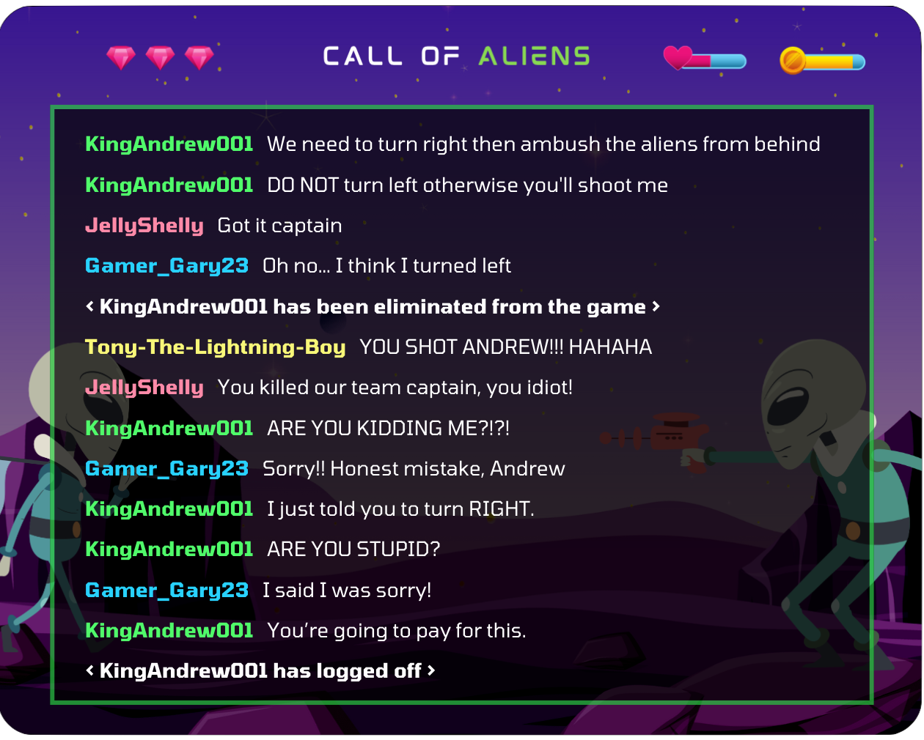
INVESTIGATE
EVIDENCE #1
LET’S DISCUSS
1. Why do you think Andrew has reacted this way? Do you think he has a right to be angry?
2. What do you think the last line that Andrew said means? How would you feel if you were Gary?

Slide 10
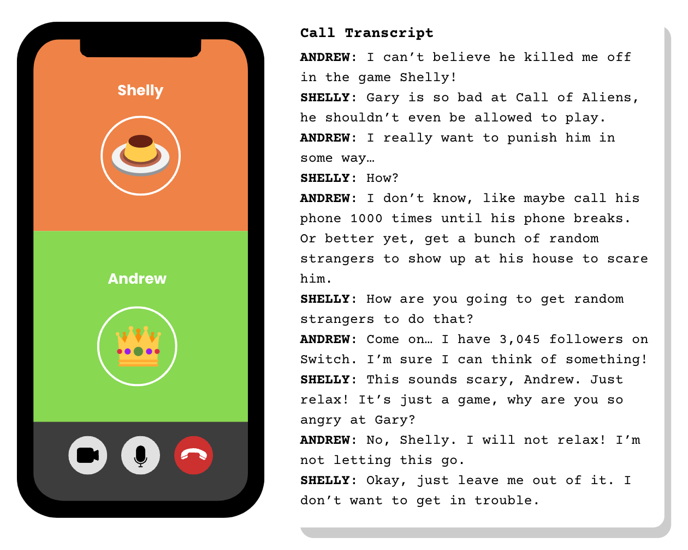
INVESTIGATE
EVIDENCE #2
LET’S DISCUSS
1. How can you describe the emotion Andrew is feeling? Who do you feel empathy for in this situation?
2. Shelly ends the call by saying she wants to stay out of it. What do you think Shelly’s responsibility might be as a good digital citizen?

Slide 11
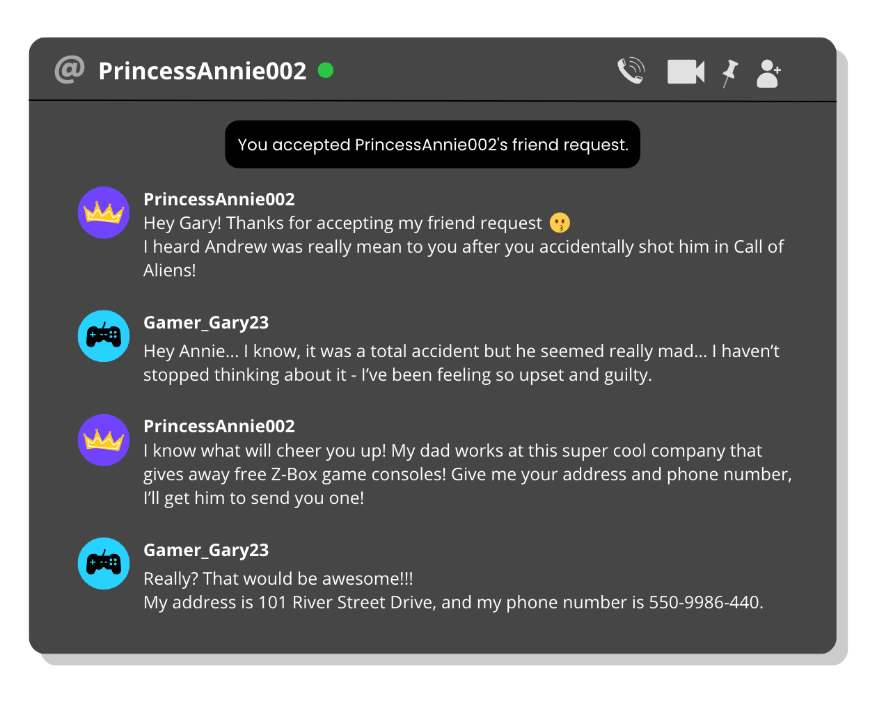
INVESTIGATE
EVIDENCE ¢3
LET’S DISCUSS
1. From this interaction, do you trust Annie’s words? Do you think she has positive or negative intentions?
2. When you meet other users online, it can be hard to identify who is trustworthy. What are some indications of a bad actor you can look out for?
3. Do you think Gary has done anything wrong here? Should he give out his address and phone number in order to receive Annie’s gift?

Slide 12
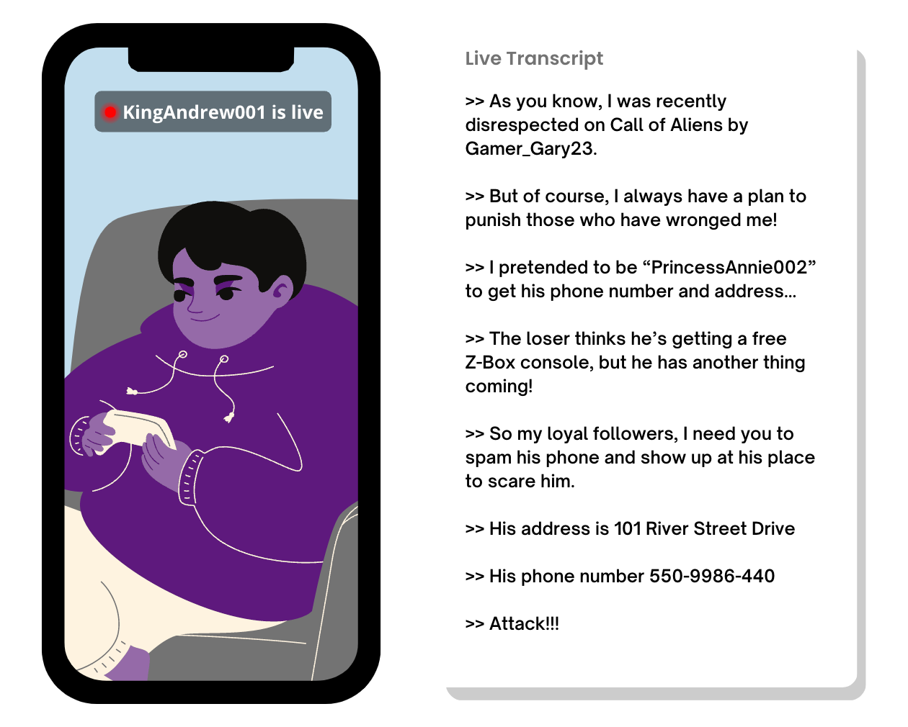
INVESTIGATE
EVIDENCE #¢
LET’S DISCUSS
1. Now that Andrew has revealed that he tricked Gary into thinking “PrincessAnnie002” was a real person, how does it change your perception of the previous conversation? Go back and think about which questions you might answer differently.
2. How did Andrew’s trickery escalate the situation beyond the initial accident in the game?
3. Identify and discuss the impact doxxing and cyberstalking can have on a person.

Slide 13
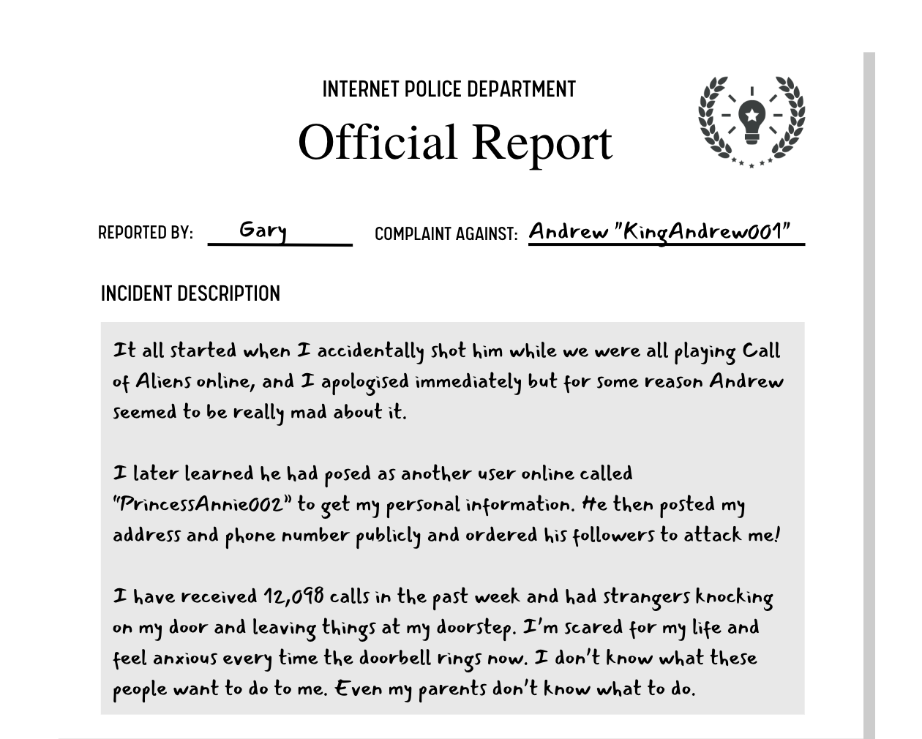
INVESTIGATE
EVIDENCE #5
LET’S DISCUSS
1. While cyberbullying takes place online, it can have serious real world implications. Do you know your local laws and the rights you have online?
2. What are some strategies you can use to protect your personal information online and prevent it from being used to harm you?
3. Why do you think people engage in trickery and doxxing in online interactions?

Slide 14

PROJECT WORK
Debate this statement: Tech companies should be responsible for making the internet a safe space, not individuals or governments.
Decide if you will be debating in support of tech companies, individuals, or the government. Prepare and present your argument with strong evidence.

Slide 15
Debate this statement: Tech companies should be responsible for making the internet a safe space, not individuals or governments.
What should your project outcome look like?
Decide if you will be debating in support of tech companies, individuals, or the government. Prepare and present your argument with strong evidence.
Tech companies can be any company that creates social media apps or online games.
Instructions and Questions to Consider:
Choose a side. Begin by deciding which side of the debate you will be on: tech companies, individuals, or the government.
Research your side of the argument and gather evidence to support your position. Consider using statistics, news articles, and expert opinions to back up your claims.
What role should tech companies, individuals, or the government play in creating a safe online environment?
What are the potential drawbacks or consequences of relying on tech companies, individuals, or the government to make the internet a safe space?
How can tech companies, individuals, or the government work together to create a safer online environment?
Prepare, practice, and present a compelling argument using your research.

Slide 16
Classroom Debate
Present your arguments to the class.

Slide 17

KEY TAKEAWAYS
Never share your personal information to people you don’t know or trust online in order to protect yourself from online attacks such as doxxing or cyberstalking.
Manipulating someone to give information is considered trickery, and should never be tolerated by upstanders.
Cyberstalking and doxxing are extremely harmful and damaging forms of online abuse, and should be reported immediately.

Slide 18
Well Done!
Lesson 15.06.02

