Slide 1
Follow Me Around Paris
LESSON 3.2
PRIVACY & INFORMATION SECURITY
EXERCISE-IN-A-BOX

Slide 2

Do you post anything on social media? How do you choose what to share online?
WARM-UP

Slide 3

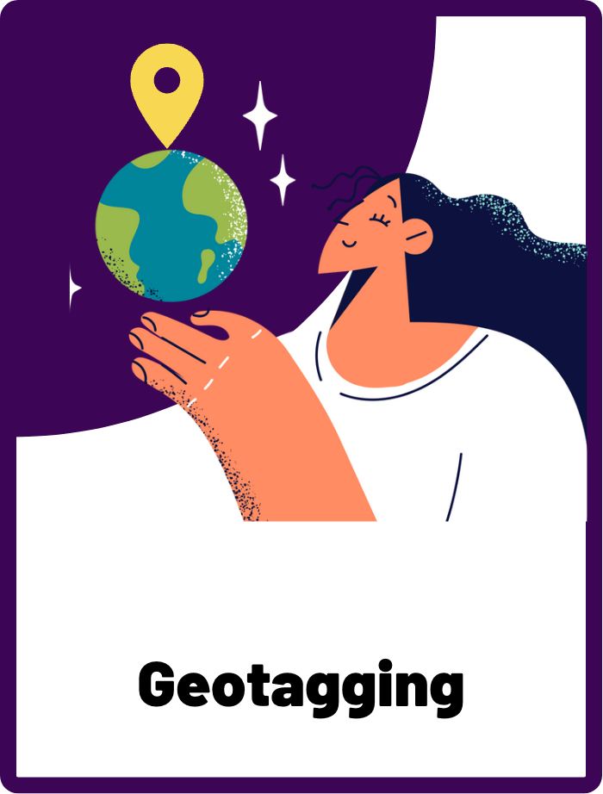
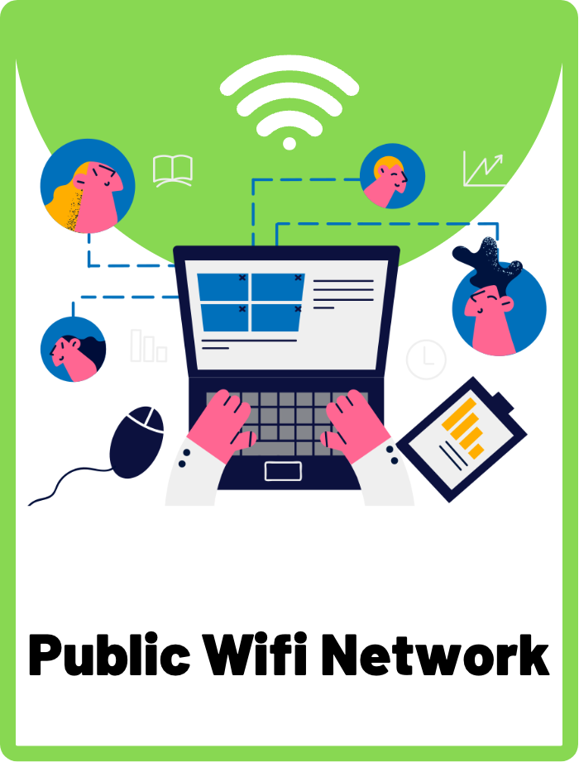
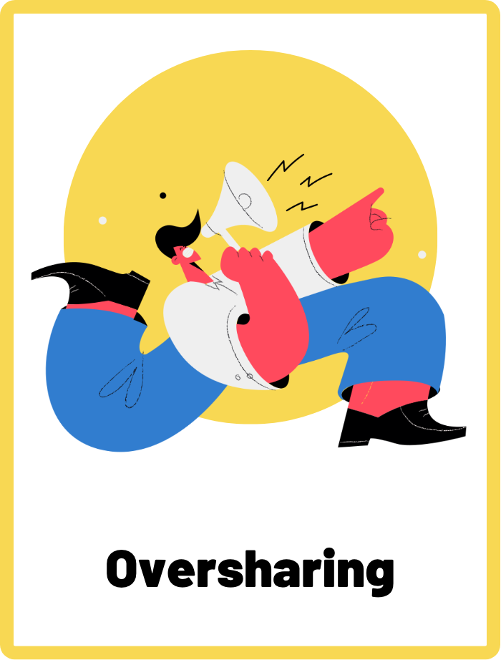
DEFINE THE KEYWORDS
What do you think these terms mean?

Slide 4
DEFINE
Geotagging
A feature that allows you to add location information, like the name of a place or its coordinates, to a photo or video you post online.

Slide 5
DEFINE
Public Wifi Network
Public wifi networks are wifi networks available for anyone, typically in places like coffee shops, airports, or libraries. Public networks can be unsafe to use because bad actors or malicious criminals can intercept your connection and potentially steal your personal information, such as your passwords, credit card information, or other sensitive data.

Slide 6
DEFINE
Oversharing
Oversharing on social media is when you share too much personal information online, such as your location or phone number. Sharing too much information online can have serious negative consequences as it leaves you vulnerable to many cyber risks.

Slide 7

INVESTIGATE THE SCENARIO
Read the following evidence carefully to piece together the story. Think critically about the information you are examining and consider the questions.

Slide 8
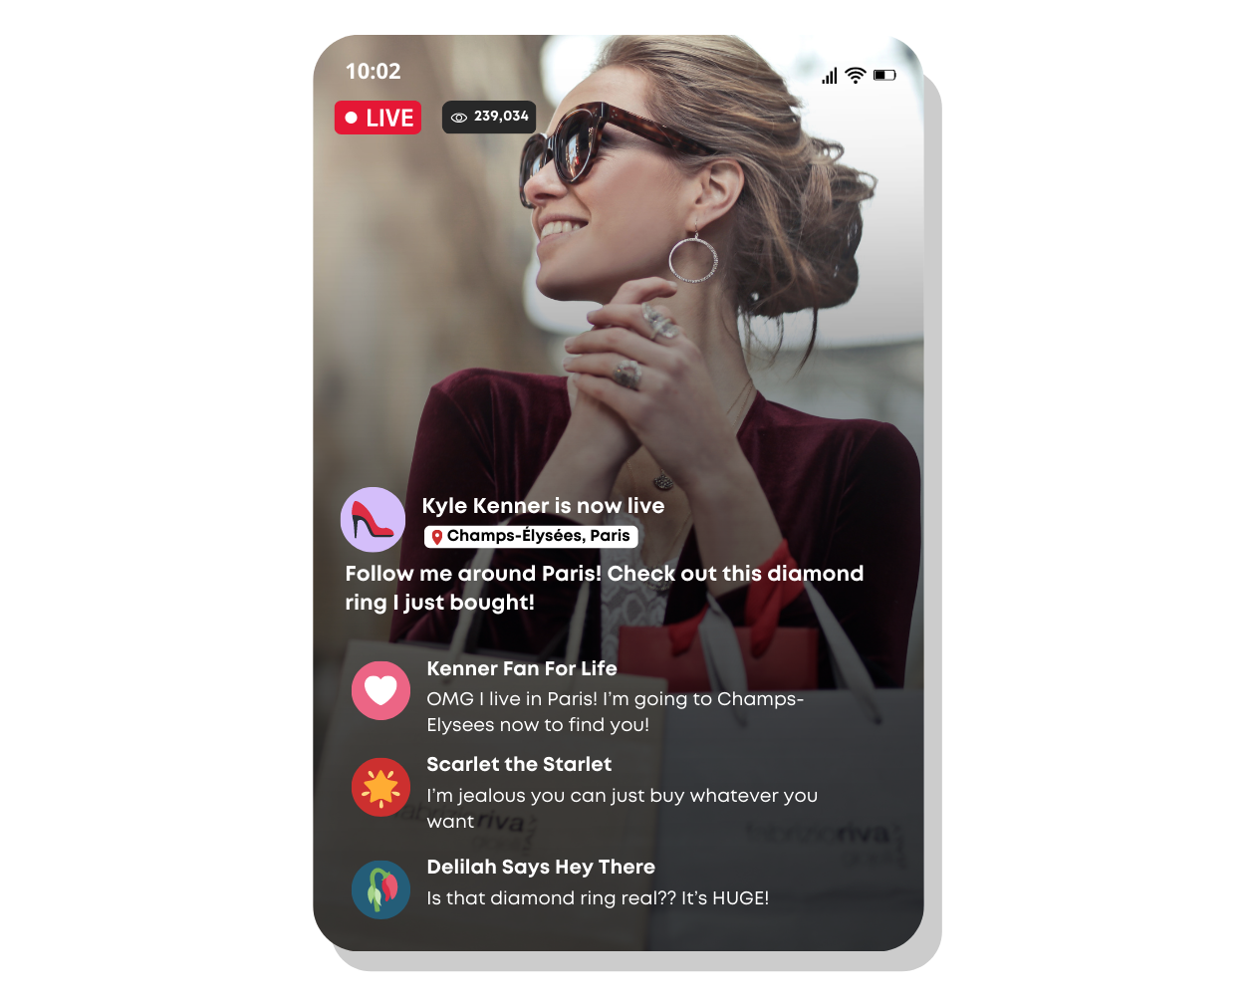
INVESTIGATE
EVIDENCE #1
LET’S DISCUSS
1. Do you think it’s a good idea for Kyle to livestream and share her exact location? Why or why not?
2. Why might it not be safe for Kyle to overshare her shopping on social media?

Slide 9
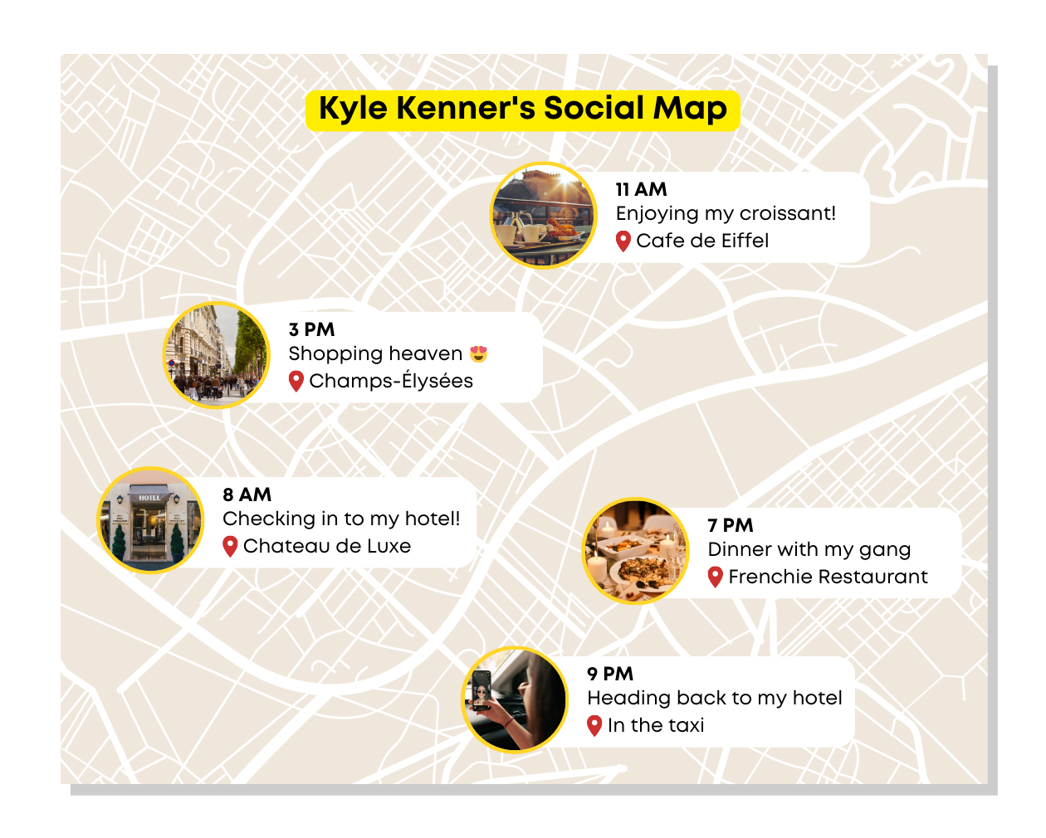
INVESTIGATE
EVIDENCE #2
LET’S DISCUSS
1. What specific details about Kyle's activities and location did she share on her social media platform?

Slide 10
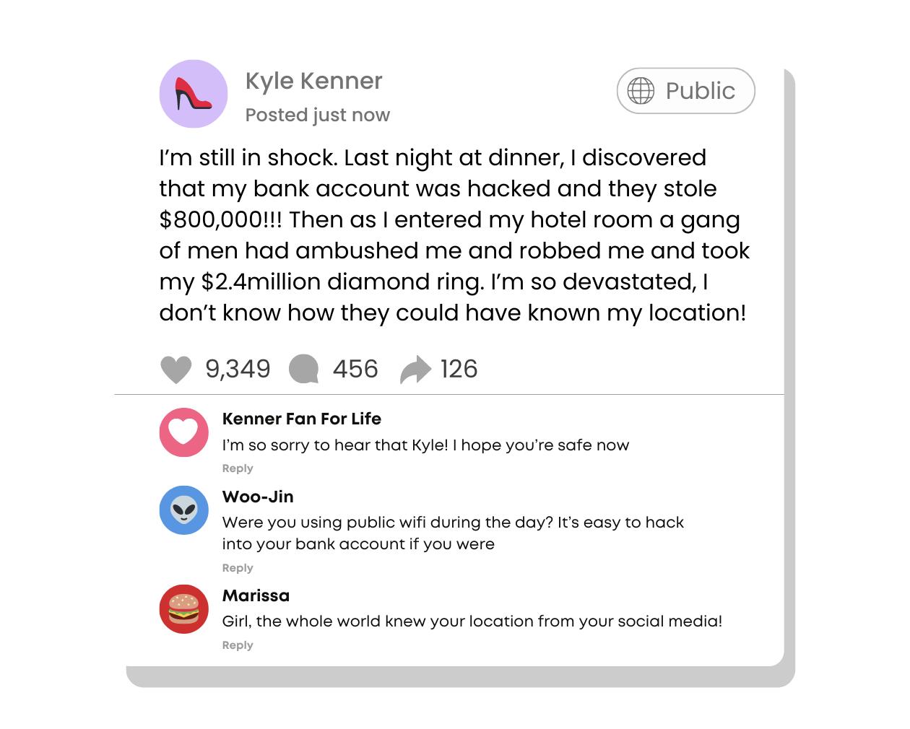
INVESTIGATE
EVIDENCE #3
LET’S DISCUSS
1. How do you think the thieves were able to find out which hotel Kyle was staying at?
2. What are some potential negative consequences that Kyle could face as a result of geotagging her location on social media?

Slide 11
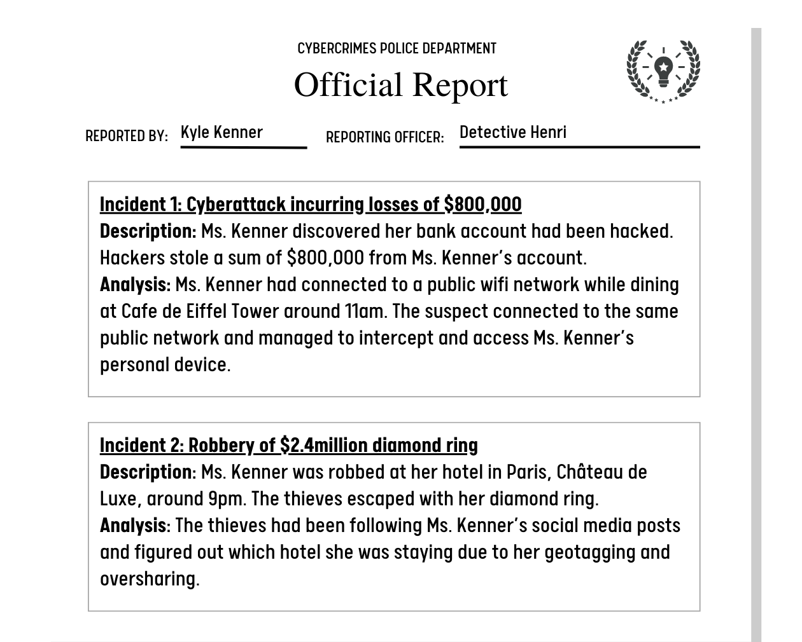
INVESTIGATE
EVIDENCE #4
LET’S DISCUSS
1. How could Kyle have prevented these crimes from occurring?
2. What could Kyle have done to protect her device from getting hacked on a public wifi network?
3. What behaviours should Kyle change so this doesn’t happen again?

Slide 12
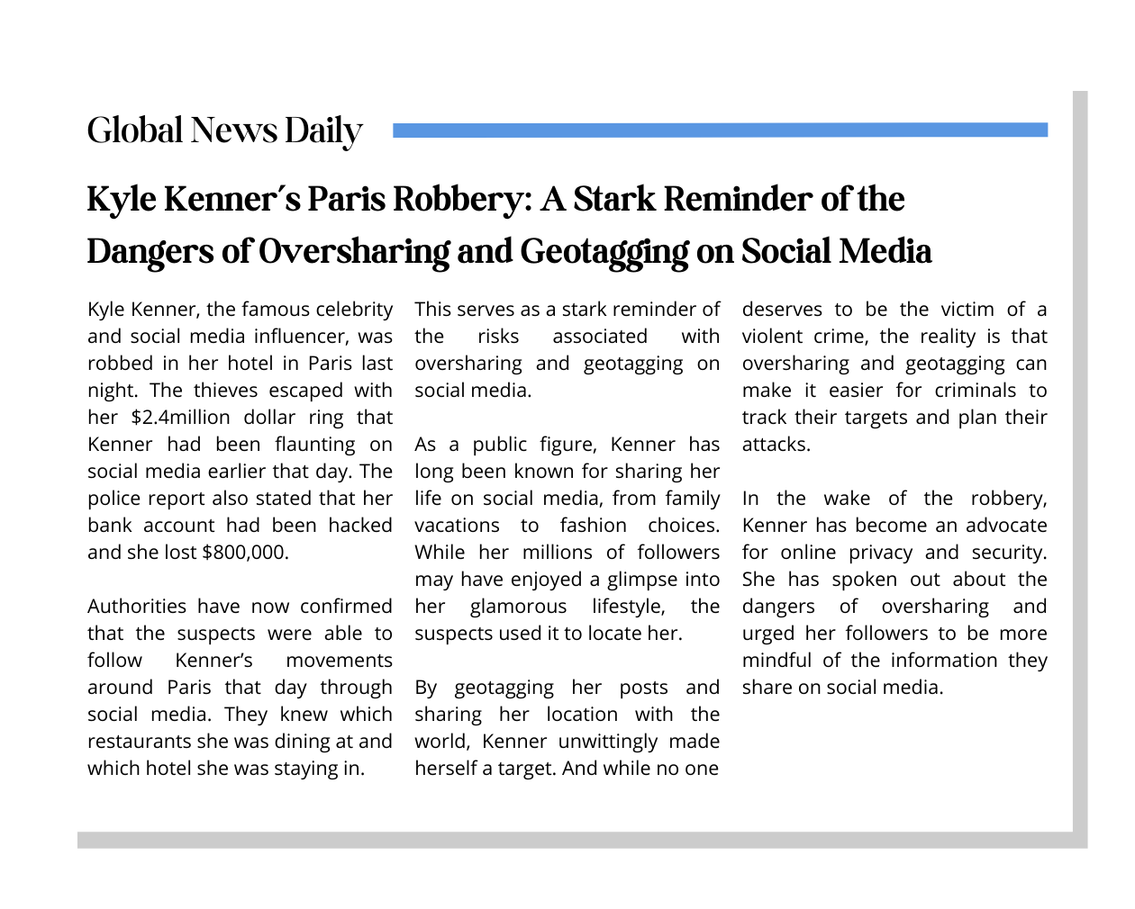
INVESTIGATE
EVIDENCE #5
LET’S DISCUSS
1. How could Kyle protect her privacy while still sharing her experiences with her followers?
2. How can geotagging contribute to the danger of oversharing on social media?

Slide 13

KEY TAKEAWAYS
While social media can be a good way to connect with others, it is never a good idea to overshare your activities on social media. Think about the types of information you should keep private to keep yourself safe.
Don’t geotag your posts, especially in real-time (such as live streaming). You never know who is watching or following you.
Public wifi networks are unsecured connections, so hackers can easily intercept your device. Make sure you are on a secure, private wifi network if you are making online payments or entering sensitive information.

Slide 14
Well Done!
LESSON 3.2

