Slide 1
The Green Machine
Lesson 15.03.02
DIGITAL MEDIA LITERACY
EXERCISE-IN-A-BOX

Slide 2

What’s an example of fake news you’ve heard recently? Why do you think people spread fake news?
WARM-UP

Slide 3



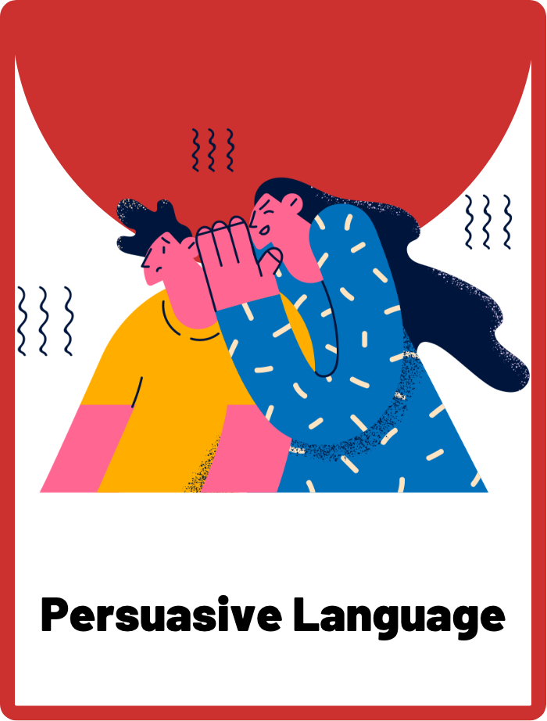
DEFINE THE KEYWORDS
What do you think these terms mean?

Slide 4
DEFINE
Disinformation
Disinformation is false information that is spread deliberately, often with the intention of misleading people or influencing their beliefs or behaviour. Disinformation can be spread through social media, news articles, advertisements, or other sources. It is often created and spread by individuals or organisations who have a particular agenda, such as a political or ideological goal.

Slide 5
DEFINE
Financial Motivations
Refers to the economic incentives that may drive individuals or organisations to engage in disinformation campaigns. Financial motivations may include the desire to gain more profits or maintain a competitive advantage in the market. Disinformation can be used as a tool to achieve these financial goals by creating false or misleading narratives that can influence public perception or consumer behaviour, ultimately leading to financial gain.

Slide 6
DEFINE
Persuasive Language
The use of language that is used to convince the audience to take a certain action, adopt a certain belief, or change their perspective on a particular issue. Being able to identify and analyse persuasive language helps individuals critically evaluate the information presented to them and make informed decisions. This includes recognizing techniques such as emotional appeals, loaded language, and rhetorical questions, among others.

Slide 7

INVESTIGATE THE SCENARIO
Read the following evidence carefully to piece together the story. Think critically about the information you are examining and consider the questions.

Slide 8

INVESTIGATE
EVIDENCE #1
LET’S DISCUSS
1. How does GreenWheel Motors use persuasive language in this advertisement to make the LeafRunner car appear more attractive to consumers?
2. How do financial motivations influence the marketing strategies of companies?
3. How can we as consumers be more critical of advertising claims and information presented to us?

Slide 9
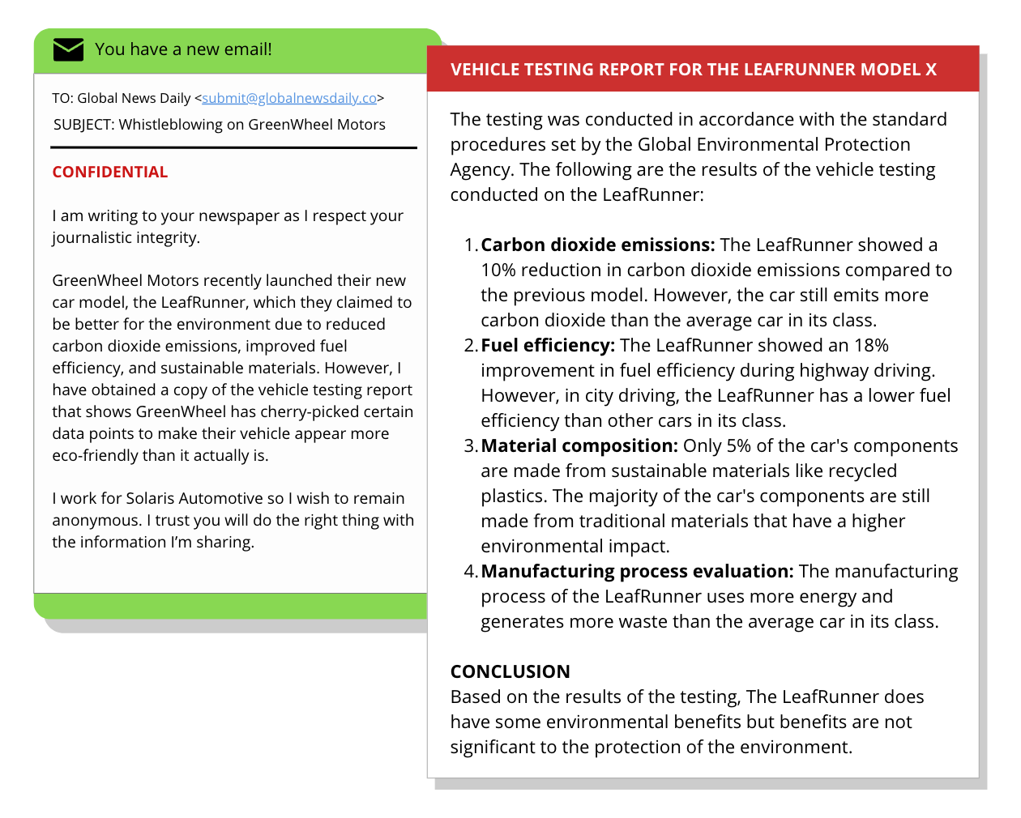
INVESTIGATE
EVIDENCE #2
LET’S DISCUSS
1. Why is it important to evaluate the source of information, particularly when it comes to whistleblowing?
2. What are the ethical implications of cherry-picking data in the LeafRunner ad? How might this impact GreenWheel Motors’ reputation and credibility?

Slide 10
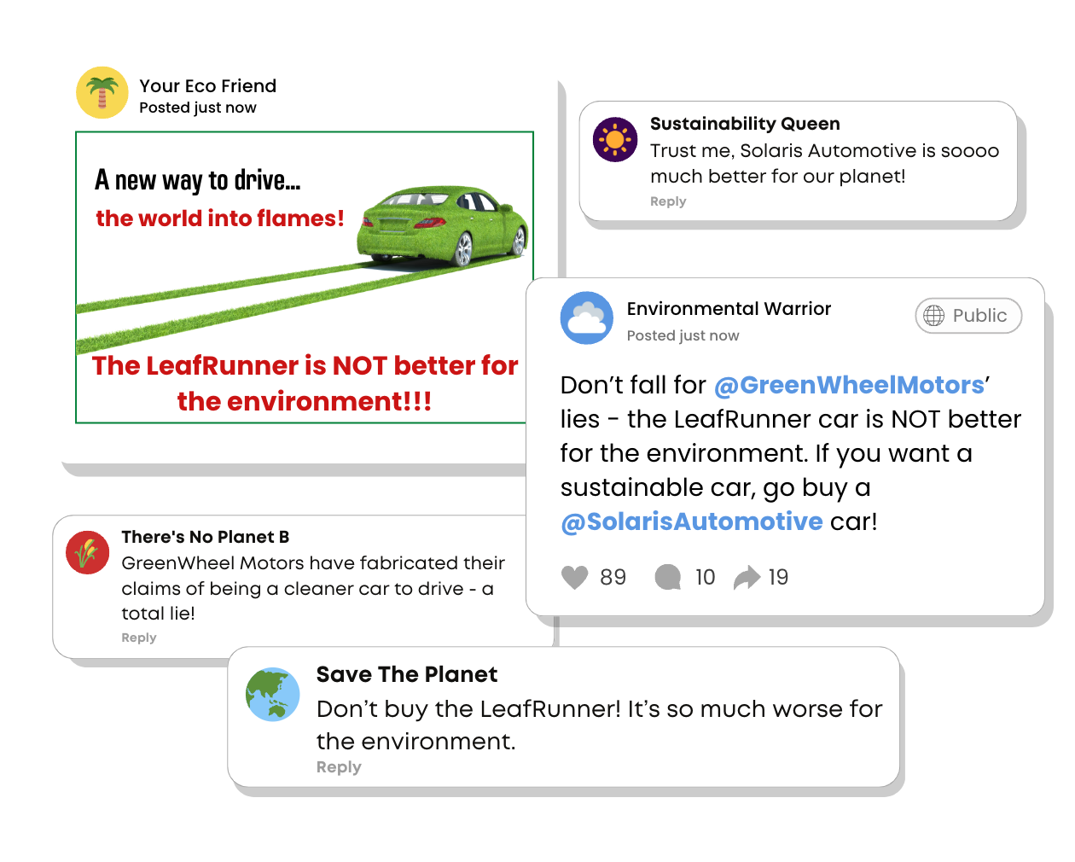
INVESTIGATE
EVIDENCE #3
LET’S DISCUSS
1. Individuals and organisations may purposefully spread disinformation on social media to persuade the public of a certain opinion. How might this affect people who come across such content?
2. What are some potential consequences of negative social media posts for GreenWheel Motors?

Slide 11
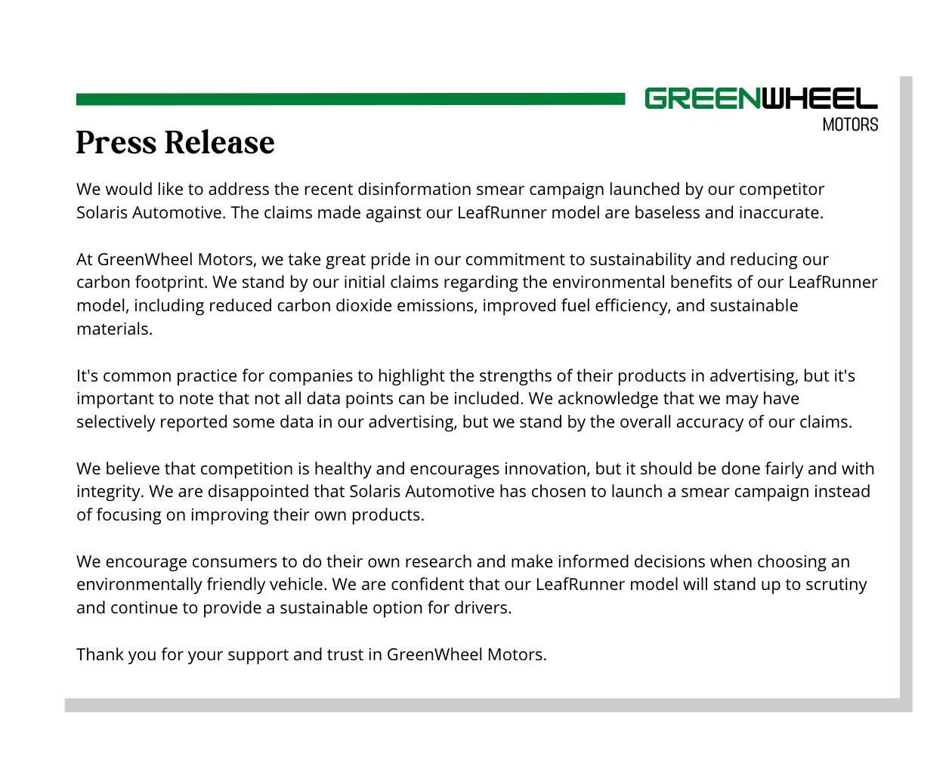
INVESTIGATE
EVIDENCE #4
LET’S DISCUSS
1. Identify how this press release has been framed in GreenWheel Motor’s favour.
2. Is it ethical for GreenWheel Motors to selectively choose the types of data they want to present? Does it still count as factual?

Slide 12
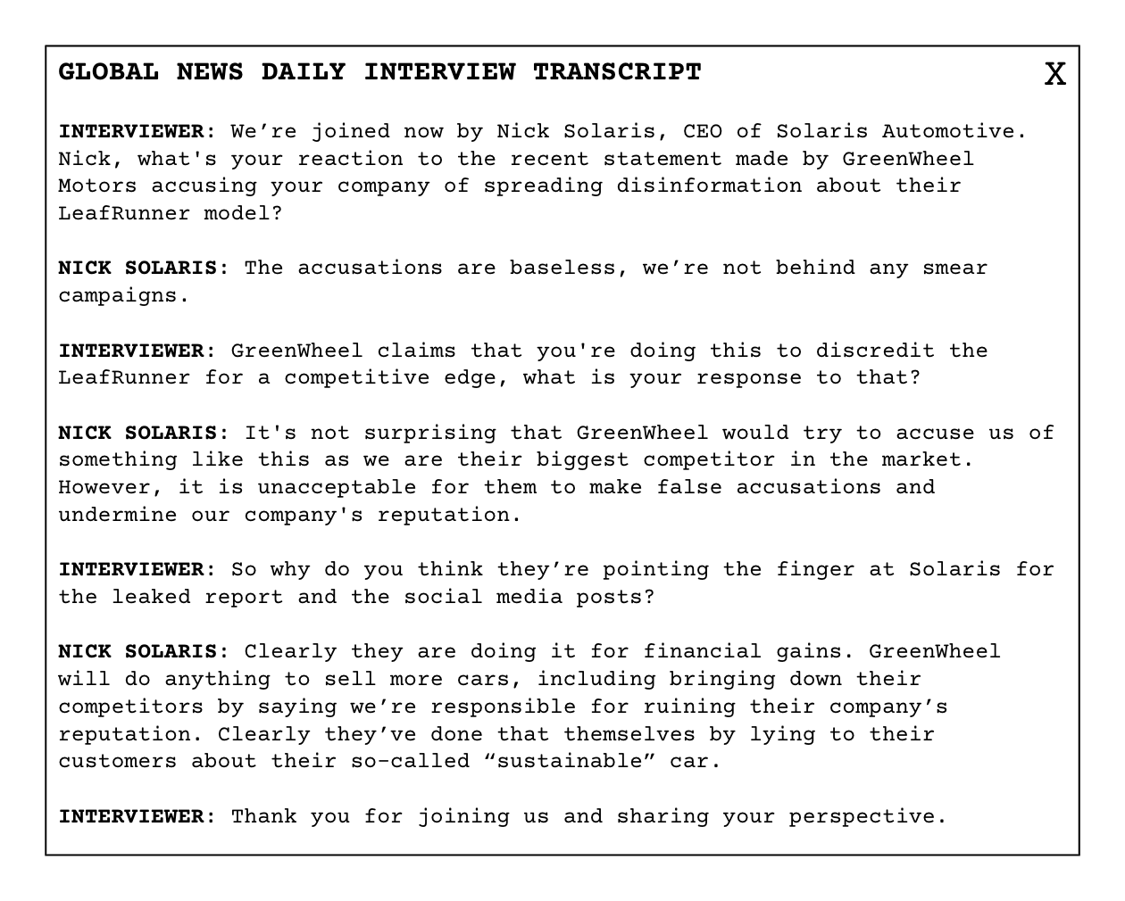
INVESTIGATE
EVIDENCE #5
LET’S DISCUSS
1. Who do you think is the one spreading disinformation?
GreenWheels has falsely advertised the claims of their eco-friendly car, the LeafRunner, therefore they are spreading disinformation.
Solaris Automotive was the whistleblower and published the vehicle testing report. They may also be behind the social media smear campaign so they are spreading disinformation.
2. What financial motivations might each company have for spreading disinformation?

Slide 13

PROJECT WORK
Report on how anti-vaccination groups spread disinformation during the COVID-19 pandemic, and conduct an analysis on the persuasive language they used and what their potential financial motivations might be.
This should be a visual or written report that summarises your findings and offers suggestions on how students should consume news with a critical eye.

Slide 14
Report on how anti-vaccination groups spread disinformation during the COVID-19 pandemic, and conduct an analysis on the persuasive language they used and what their potential financial motivations might be.
What should your project outcome look like?
This should be a visual or written report that summarises your findings and offers suggestions on how students should consume news with a critical eye.
Instructions and Questions to Consider:
What types of disinformation have anti-vaccination groups spread?
Where have they spread this disinformation (e.g., social media, websites, pamphlets, etc.)? Can you find some real examples?
What tactics do anti-vaccination groups use to spread their message (such as persuasive language or cherry picking data)?
How do they use persuasive language to sway their audience's opinions?
Who might have financial interests in spreading anti-vaccination messages?
What steps can individuals take to verify the accuracy of information they encounter online?
Create a visual or written report that summarises your findings and conclusions in a clear and compelling way. Use graphs, charts, and other visual aids to help convey your message. Be sure to include a works cited or references page to show where you obtained your information.

Slide 15
Share Your Project!
Present your projects to the class.

Slide 16

KEY TAKEAWAYS
Disinformation can be spread through all sorts of digital media, from social media to advertisements to unofficial or fake news sites.
Persuasive language is one tactic that is used commonly to sway one’s opinion, especially in advertising or fake news. It’s important to consume news and media with a discerning eye to understand when such tactics are in use.
Consider what the financial motivations could be behind any news coverage, press releases, or interviews. Ask yourself who could be benefiting from the message that is being shared.

Slide 17
Well Done!
Lesson 15.03.02

