Slide 1
Money or Love?
LESSON 4.4
PHISHING & SCAMS
EXERCISE-IN-A-BOX

Slide 2

Why do you think phishing attacks and scams occur? What do the cybercriminals want?
WARM-UP

Slide 3
How do phishing attacks and scams impact victims?
WARM-UP

Slide 4

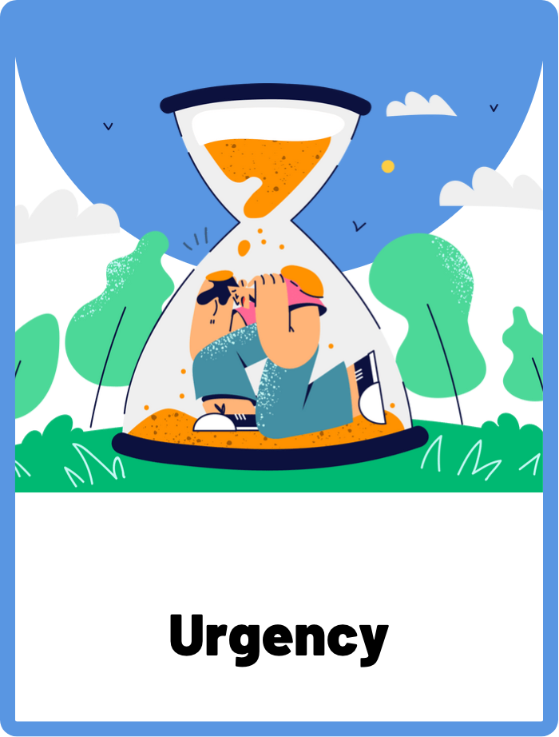
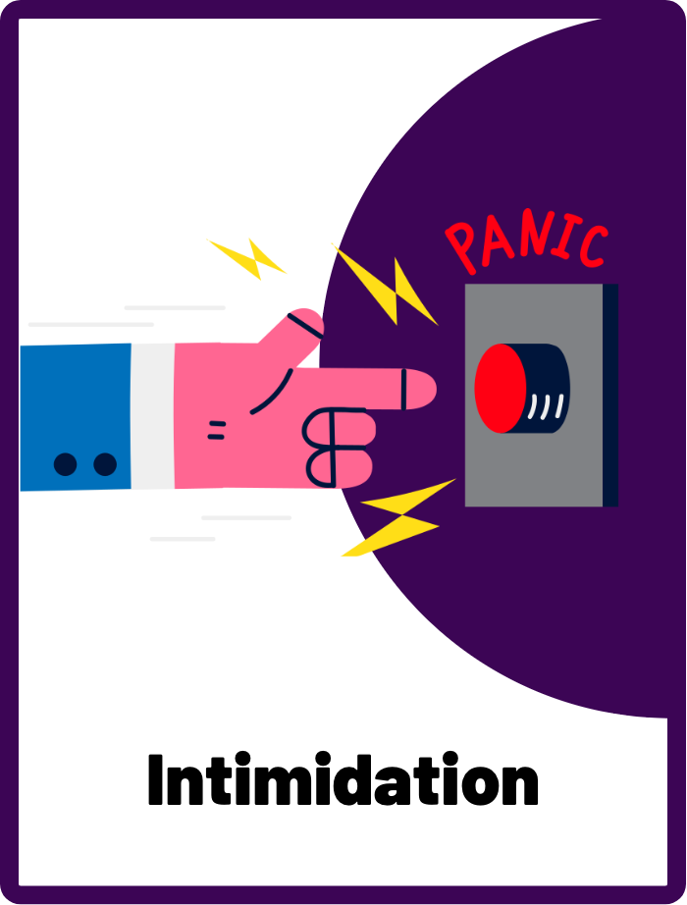
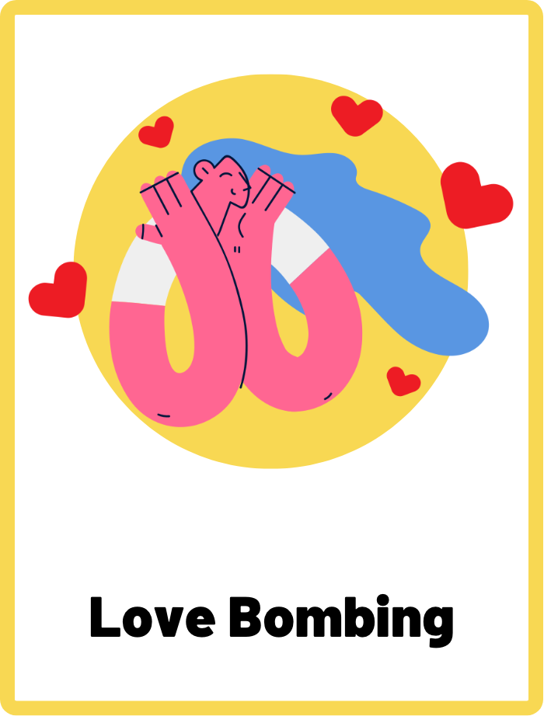
DEFINE THE KEYWORDS
What do you think these terms mean?

Slide 5
DEFINE
Urgency
A tactic used by scammers to create a sense of urgency in their victims to take immediate action without thinking it through. The message is designed to cause fear and panic within the recipient.

Slide 6
DEFINE
Intimidation
Intimidation is a scare tactic used by cybercriminals to create fear or a sense of threat in the victim to coerce them into clicking on a link, providing personal information, or making a payment.

Slide 7
DEFINE
Love Bombing
Scammers may quickly profess their love and affection for their victims, using language that is romantic and overly sentimental. They often love bomb in romance scams to quickly gain the trust and affection of their victims through excessive flattery and declarations of love.

Slide 8

INVESTIGATE THE EVIDENCE
Here are a few pieces of evidence of how phishing and scams work online. Investigate the evidence carefully and identify the different tactics that scammers have used.

Slide 9
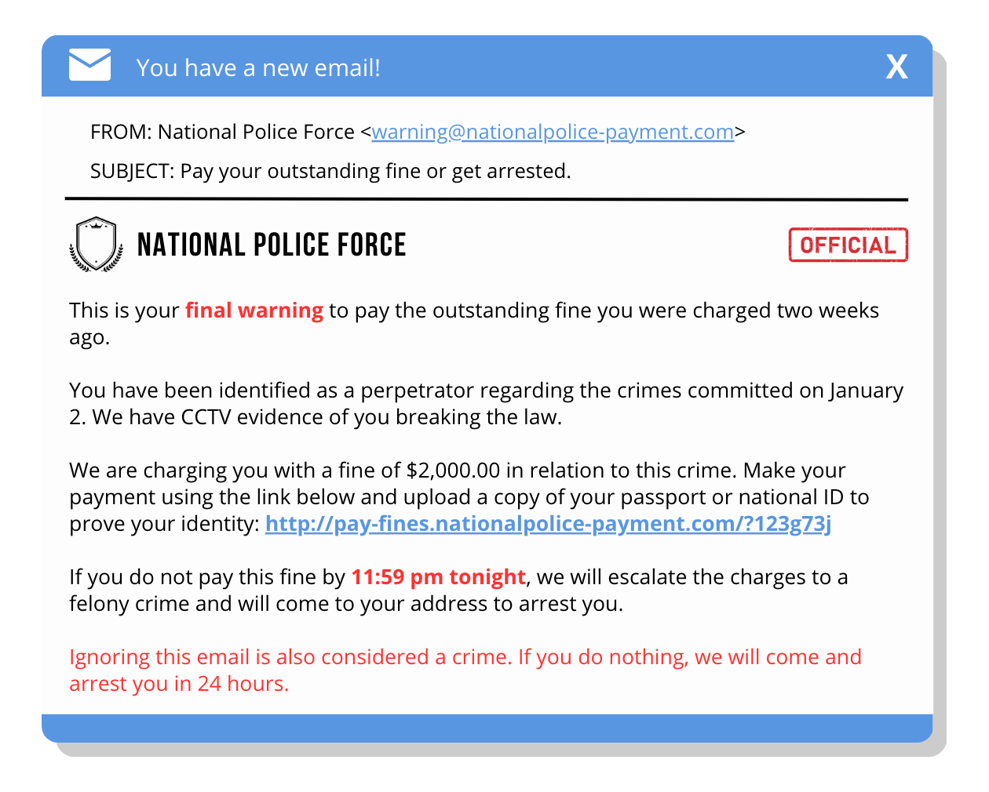
INVESTIGATE
EVIDENCE #1
Which tactic(s) has the scammer used here?
Urgency
Intimidation
Love bombing
Identify all the clues that tell you this is a phishing scam.

Slide 10
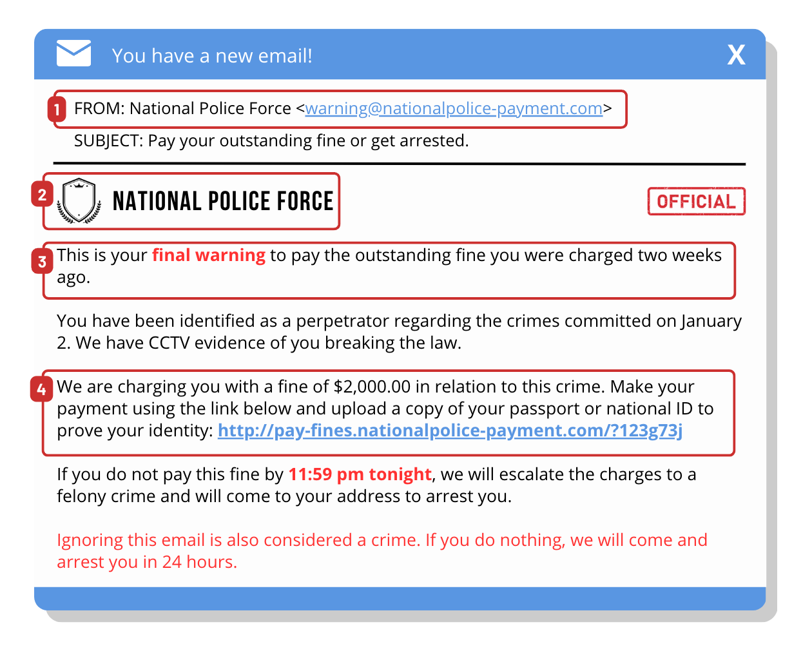
INVESTIGATE
EVIDENCE #1
WHAT? Intimidation and urgency
WHY? To scam victims of money and personal information
RED FLAGS TO LOOK OUT FOR:
1. Always check the sender before acting out of fear. If you are unsure, call the official or national helpline to verify the email.
2. Scammers may use official logos to trick users. Don’t blindly believe the message because of the logo.
3. The intimidating and urgent nature of the message can make you act carelessly. Seek help from trusted adults or official authorities.
4. Always check the URL before making payments or providing personal information.

Slide 11
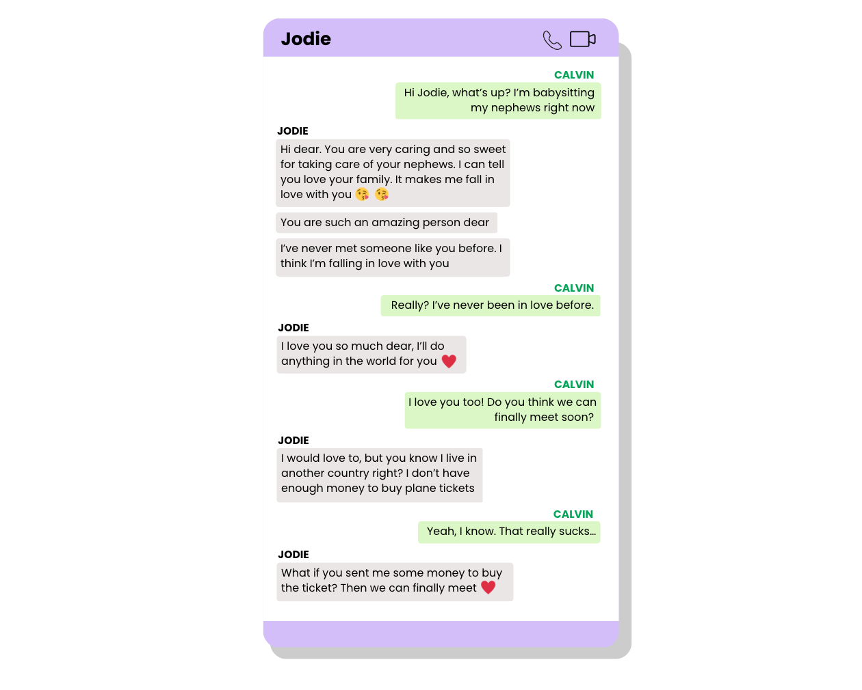
INVESTIGATE
EVIDENCE #2
Which tactic(s) has the scammer used here?
Urgency
Intimidation
Love bombing
Identify all the clues that tell you this is a phishing scam.

Slide 12
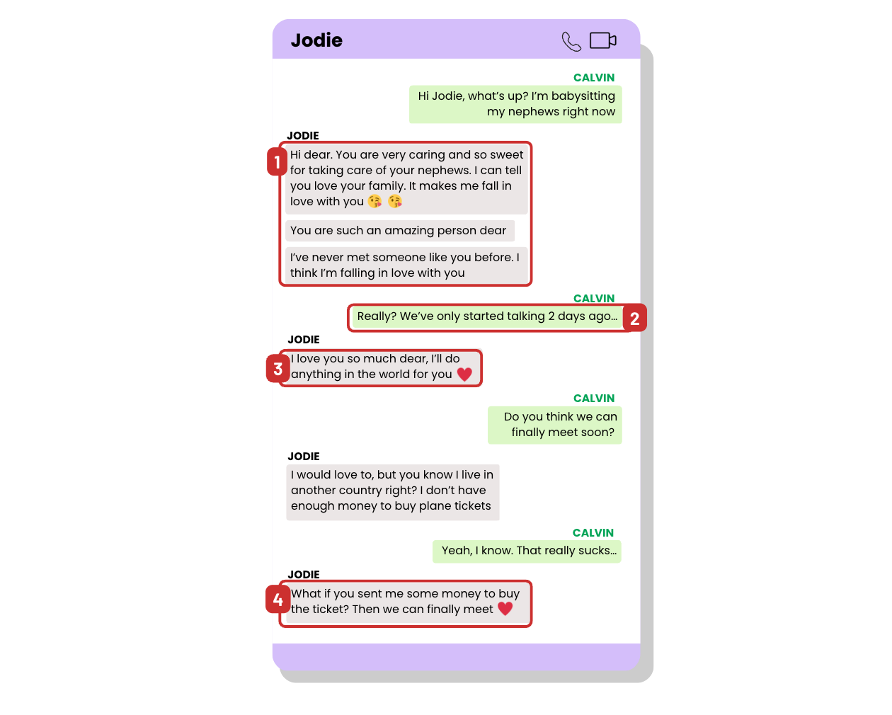
INVESTIGATE
EVIDENCE #2
WHAT? Love bombing
WHY? To get victims to transfer money through romance scams
RED FLAGS TO LOOK OUT FOR:
1. Love scammers will often shower you with flattery and compliments to gain your trust.
2. Love bombing can often feel like the relationship is moving very fast. Listen to your gut feeling to see if the pace feels unnatural or forced.
3. Jodie doesn’t use a lot of personalised language (such as calling Calvin by name) and often mirrors what Calvin has just said without providing much information about herself.
4. Be careful of sending money to someone you don’t know in real life.

Slide 13
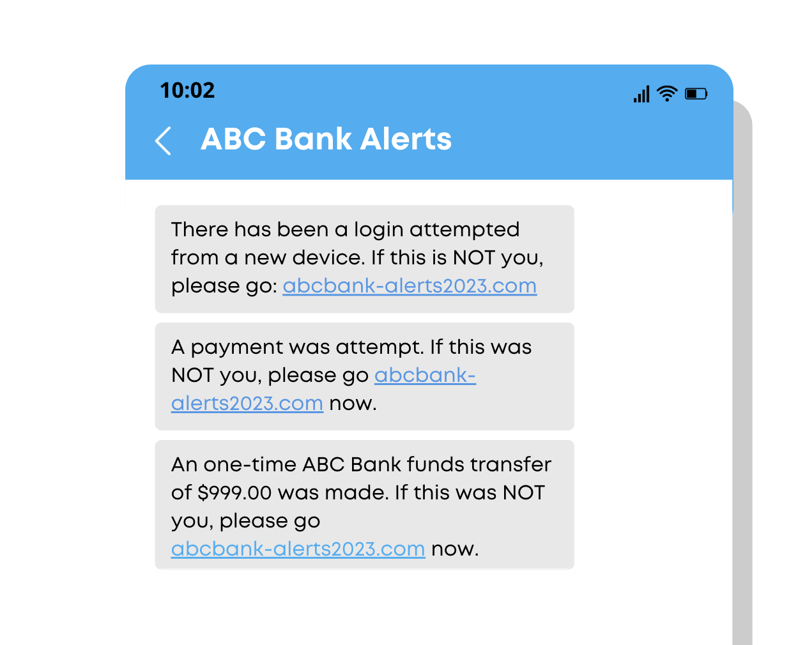
INVESTIGATE
EVIDENCE #3
Which tactic(s) has the scammer used here?
Urgency
Intimidation
Love bombing
Identify all the clues that tell you this is a phishing scam.

Slide 14
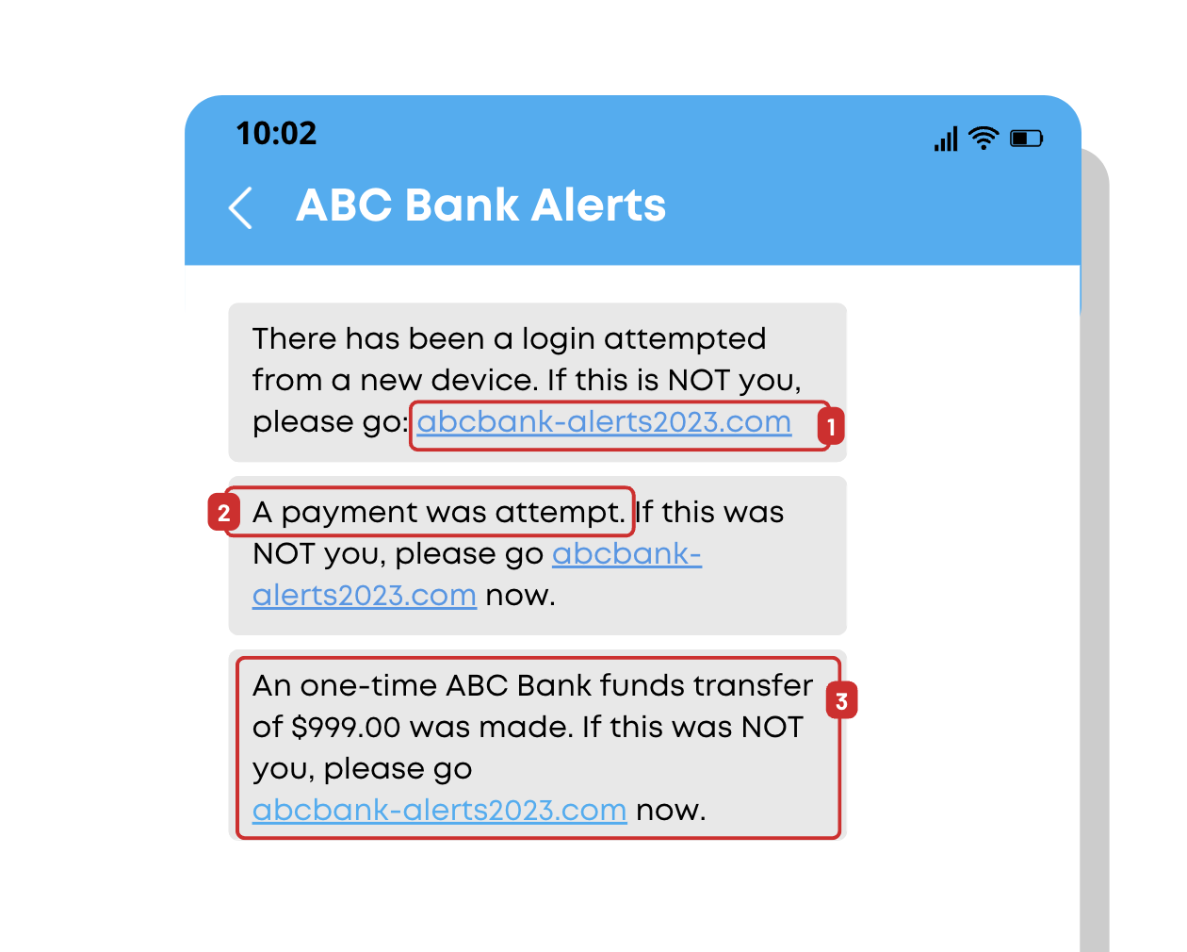
INVESTIGATE
EVIDENCE #3
WHAT? Urgency
WHY? To steal login credentials, banking details, or personal information through phishing links
RED FLAGS TO LOOK OUT FOR:
1. Always check the URL link before clicking to ensure it’s the official address.
2. The grammatical errors in these messages are red flags. Official communications from banks will be written properly.
3. If you are unsure of a message’s authenticity, call your bank’s official hotline for assistance. Do not call any phone numbers that may be in the suspicious messages.

Slide 15

KEY TAKEAWAYS
Don’t panic. If you receive messages that instil fear, panic, or urgency, remember to take a step back and look out for the red flags. Scams are often designed to persuade the victims to act fast without thinking.
If you are unsure of a message you’ve received, ask a trusted adult for help. You should call the national or official hotline for verification and assistance. Never call the phone number provided in the suspicious message as it could lead you back to the scammer.
Be aware of anyone who showers you with compliments and love too quickly or early. This could be a sign of love bombing in a romance scam.
Remember to always check who the sender of the message is.

Slide 16
Well Done!
Lesson 16.04.02

