Slide 1
The Flat Earth Hoax
LESSON 4.3
DIGITAL MEDIA LITERACY
EXERCISE-IN-A-BOX

Slide 2

When you come across news on social media, how often do you fact-check the information? Do you go online to search for trustworthy sources to verify the information?
WARM-UP

Slide 3
If you see 10 social media accounts reporting on the same news, does it make the news truthful and reliable?
WARM-UP

Slide 4

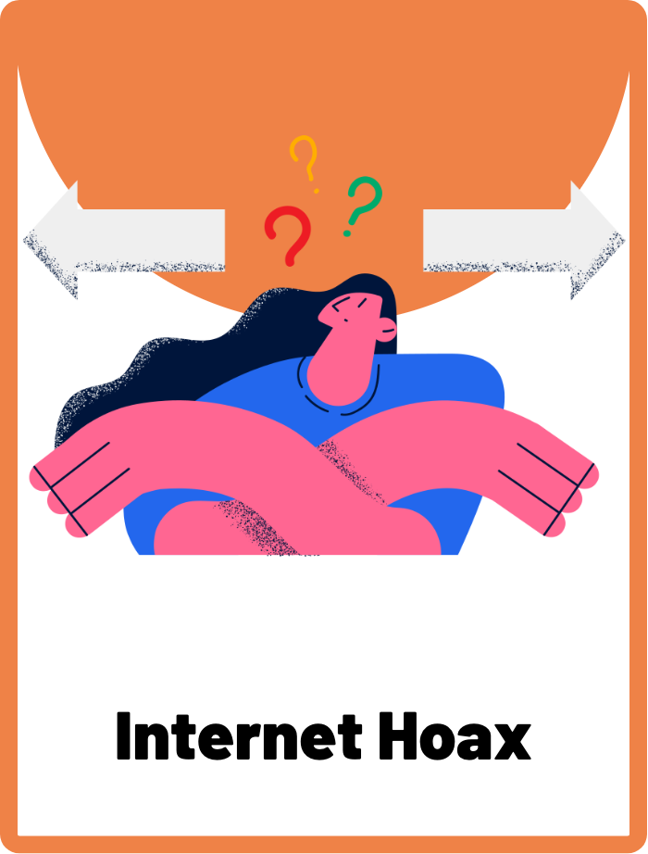
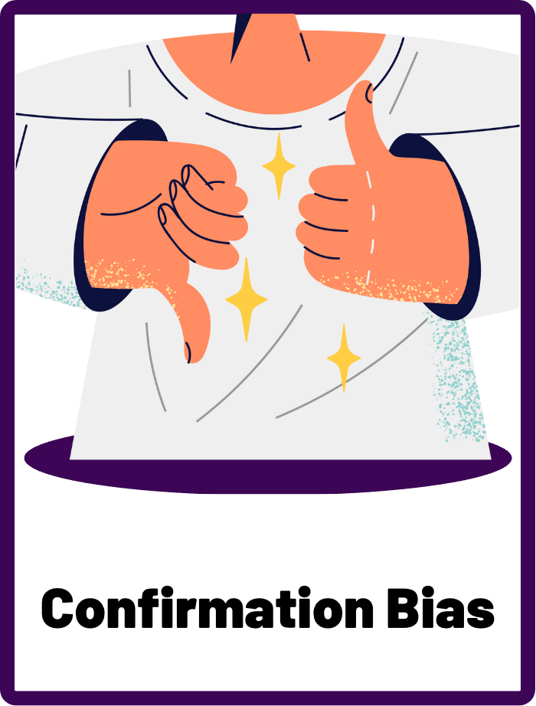
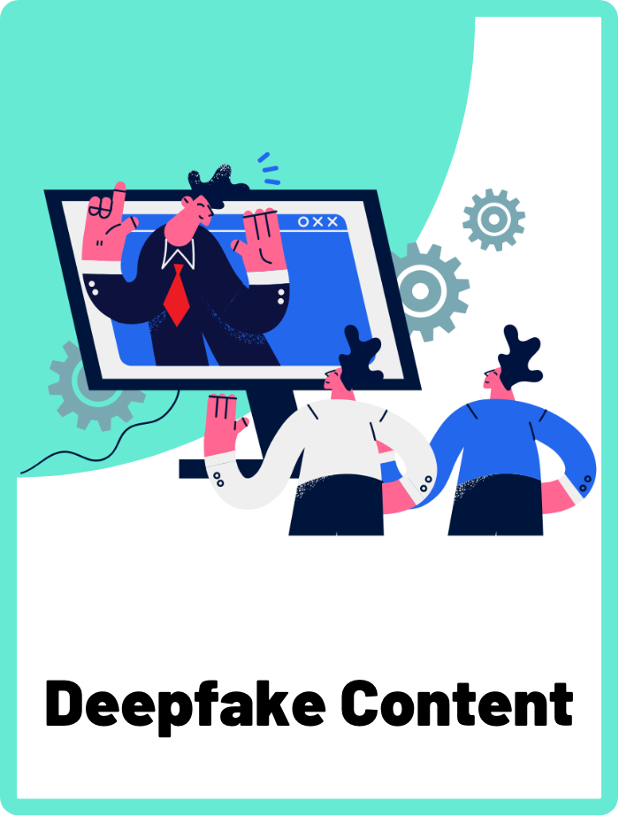
DEFINE THE KEYWORDS
What do you think these terms mean?

Slide 5
DEFINE
Internet Hoax
An internet hoax is a fabricated story or false information spread online with the intention of misleading or deceiving people. It often takes the form of a sensational news story or social media post that appears to be legitimate but is actually entirely or partially false. Internet hoaxes can cause confusion, panic, and misinformation if they are believed and shared widely.

Slide 6
DEFINE
Confirmation Bias
Confirmation bias is the tendency to seek out, interpret, and remember information in a way that confirms one's preexisting beliefs, while disregarding or minimising information that contradicts them.

Slide 7
DEFINE
Deepfake Content
Deepfake content are videos, audio recordings, or images created using artificial intelligence (AI) to make it appear as though someone is saying or doing something that they didn't do. Deep fakes can be very convincing, and are created for various reasons, such as entertainment or satire. They can also be used for more malicious purposes, such as spreading misinformation or creating fake news.

Slide 8

INVESTIGATE THE SCENARIO
Read the following evidence carefully to piece together the story. Think critically about the information you are examining and consider the questions.

Slide 9
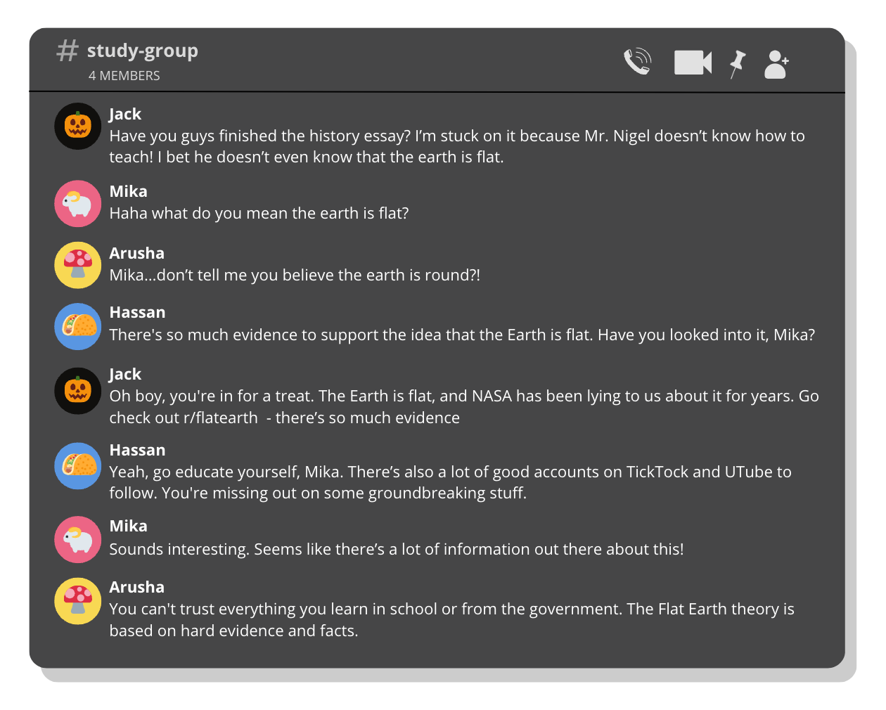
INVESTIGATE
EVIDENCE #1
LET’S DISCUSS
1. Jack believes that Mika should not trust credible sources such as schools, governments, or NASA for information. Why would this be dangerous?
2. Are Reddit, Wikipedia, or Youtube credible and trustworthy sources for facts and information? Why or why not?

Slide 10
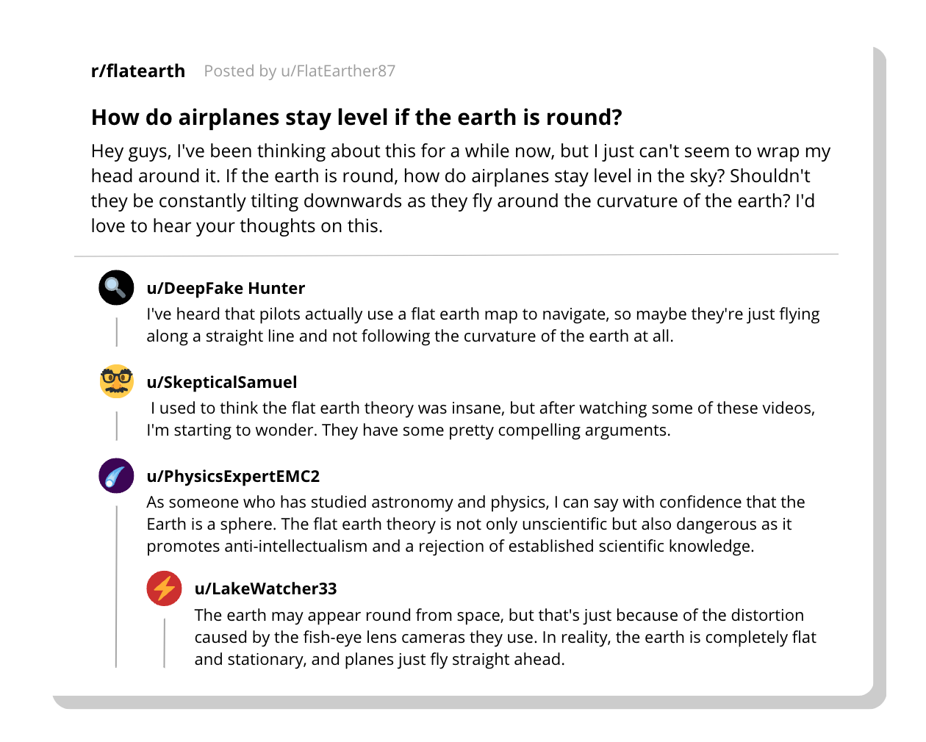
INVESTIGATE
EVIDENCE #2
LET’S DISCUSS
1. How does this forum on the Flat Earth theory contribute to the spread of misinformation?
2. How can we recognise and overcome these confirmation biases?

Slide 11
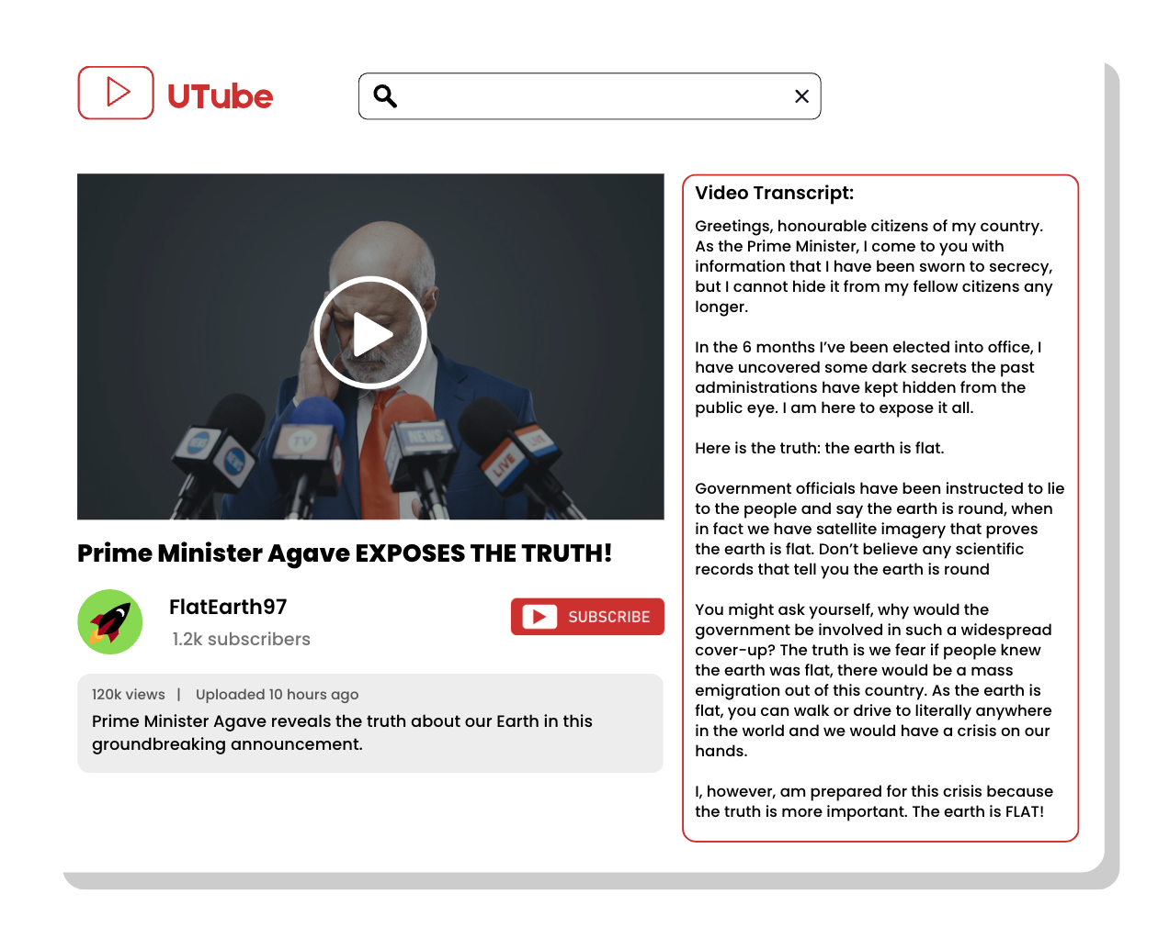
INVESTIGATE
EVIDENCE #3
LET’S DISCUSS
1. How would you judge whether or not this video is credible?
2. What is the purpose of posting a deepfake video of Prime Minister Agave?
3. What is the relationship between deepfake videos and internet hoaxes?

Slide 12
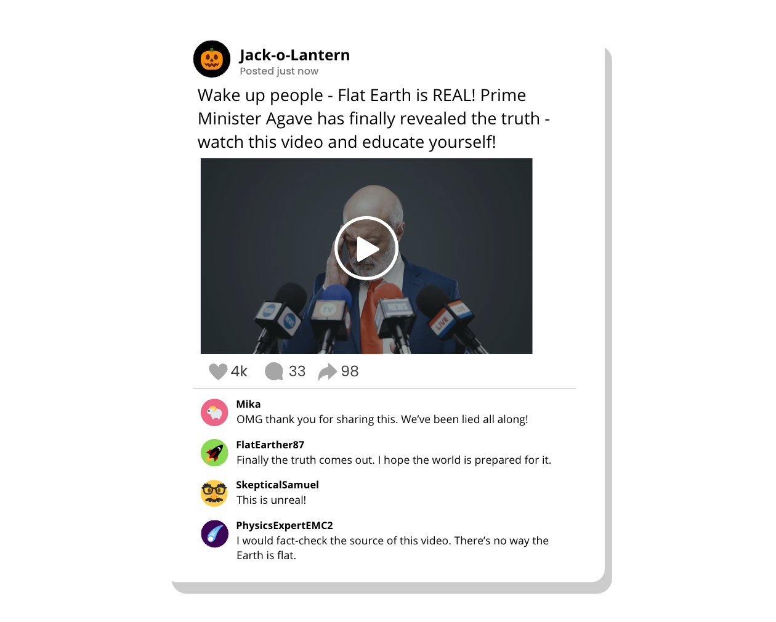
INVESTIGATE
EVIDENCE #4
LET’S DISCUSS
1. Why are sensational internet hoaxes harmful to our society?
2. Why do people fall for internet hoaxes, even when there is no evidence to support them?

Slide 13
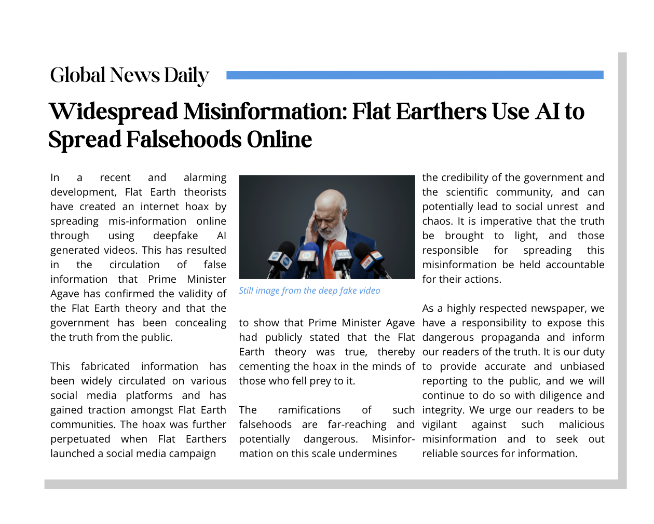
INVESTIGATE
EVIDENCE #5
LET’S DISCUSS
1. How have Flat Earthers created an internet hoax in this case?
2. What impact does the spread of misinformation have on the credibility of the government and scientific community?
3. What is the responsibility of highly respected newspapers in relation to misinformation? Why are they credible sources of information?

Slide 14

KEY TAKEAWAYS
Deepfake content can be dangerous and perpetuate confirmation bias by presenting false information as real.
It is important to fact-check anything you read online by verifying information with trustworthy and reliable sources so you don’t fall for internet hoaxes.
User-generated content websites such as Reddit, Wikipedia, or social media are not reliable sources of news and facts.
Confirmation bias can be a harmful type of cognitive bias that perpetuates extremism if it isn’t balanced with diverse opinions and checked against factual information.

Slide 15
Well Done!
LESSON 4.3

