Slide 1


LESSON 2.2
PRIVACY & INFORMATION SECURITY
Smart Device, Smart Security
How smart is your device?
CYBERLITE.ORG
2024 Ⓒ Cyberlite Books Pte. Ltd. All Rights Reserved.

Slide 2
What are Internet of Things (IoT) devices?
What are we learning today?
The cyber risks and security challenges of our smart devices

Slide 3
WARM UP QUESTION
What do you think makes a device “smart”?
For example, a smart phone or a smart watch.

Slide 4
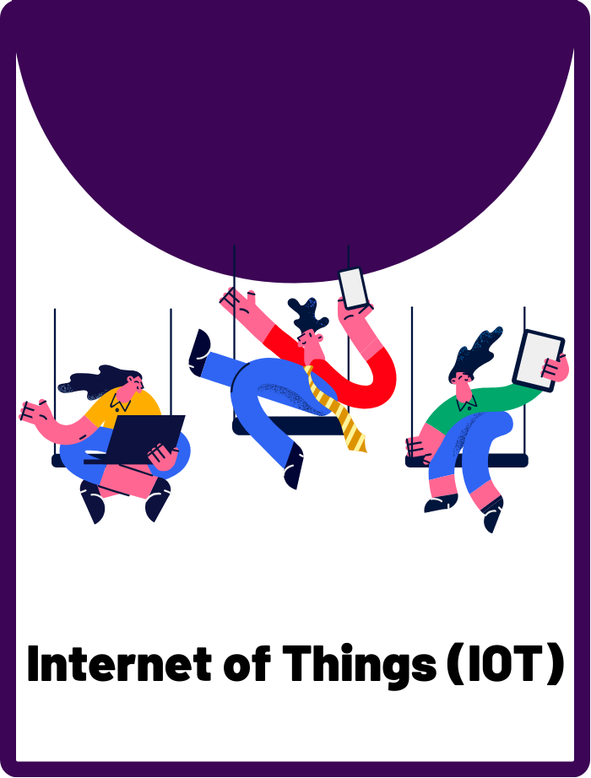
Internet of Things (IOT)
A network of physical objects ("things") that are embedded with sensors, software, and other technologies, allowing them to connect and exchange data with each other and the internet. This is what makes some devices “smart”.

Slide 5

Device Security
The practice of protecting computer hardware and software from threats and ensuring it is safe and secure to use.

Slide 6
How many devices can you name that are connected to the internet?
Brainstorm as a group and write it on the board!

Slide 7



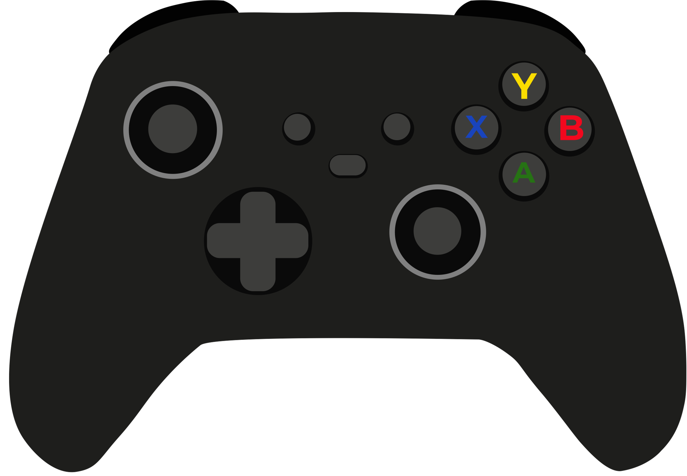

Internet of Things (IoT) Devices
IoT devices are everyday objects that connect to the internet, like smartwatches, home assistants, and even some refrigerators!

Slide 8
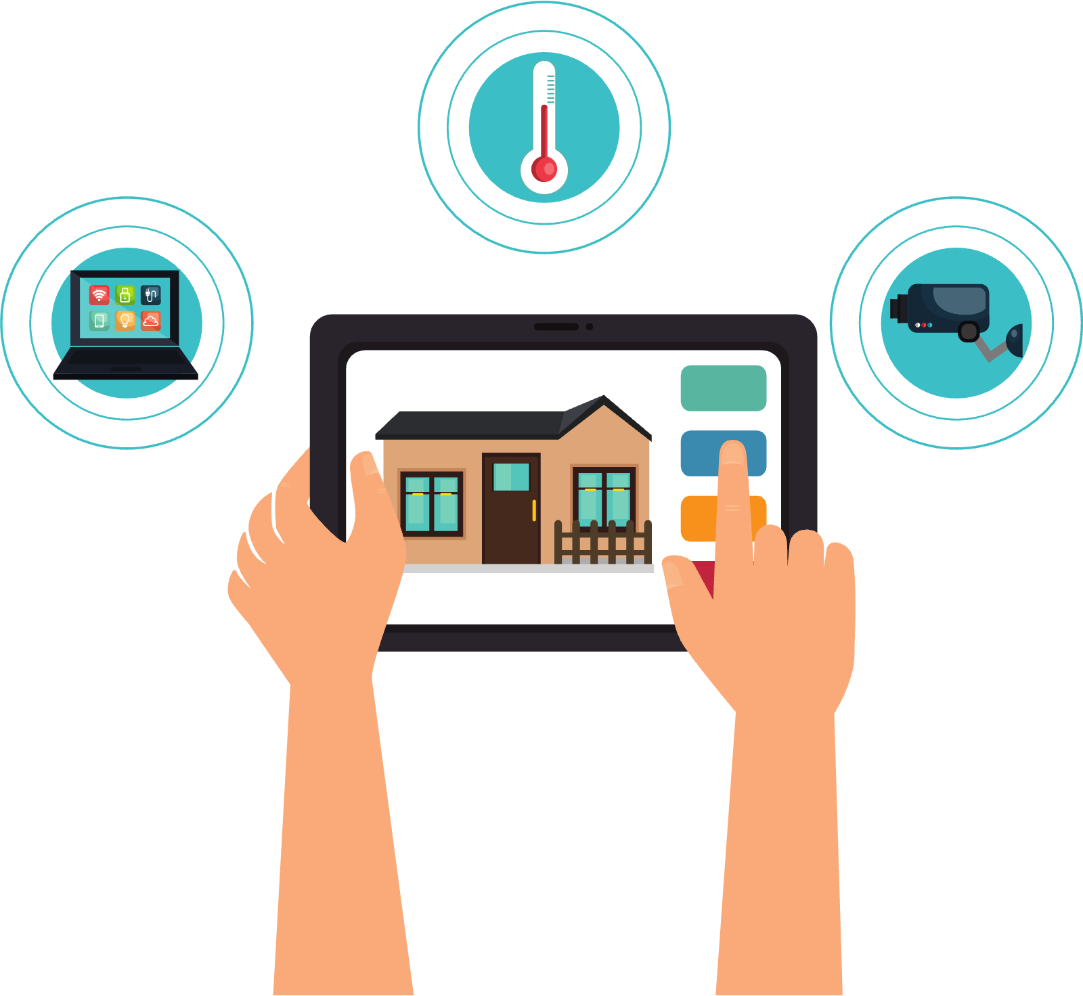
Why do we need to secure our IoT devices?
IoT devices can be vulnerable because they're always connected to the internet, making them targets for hackers.

Slide 9
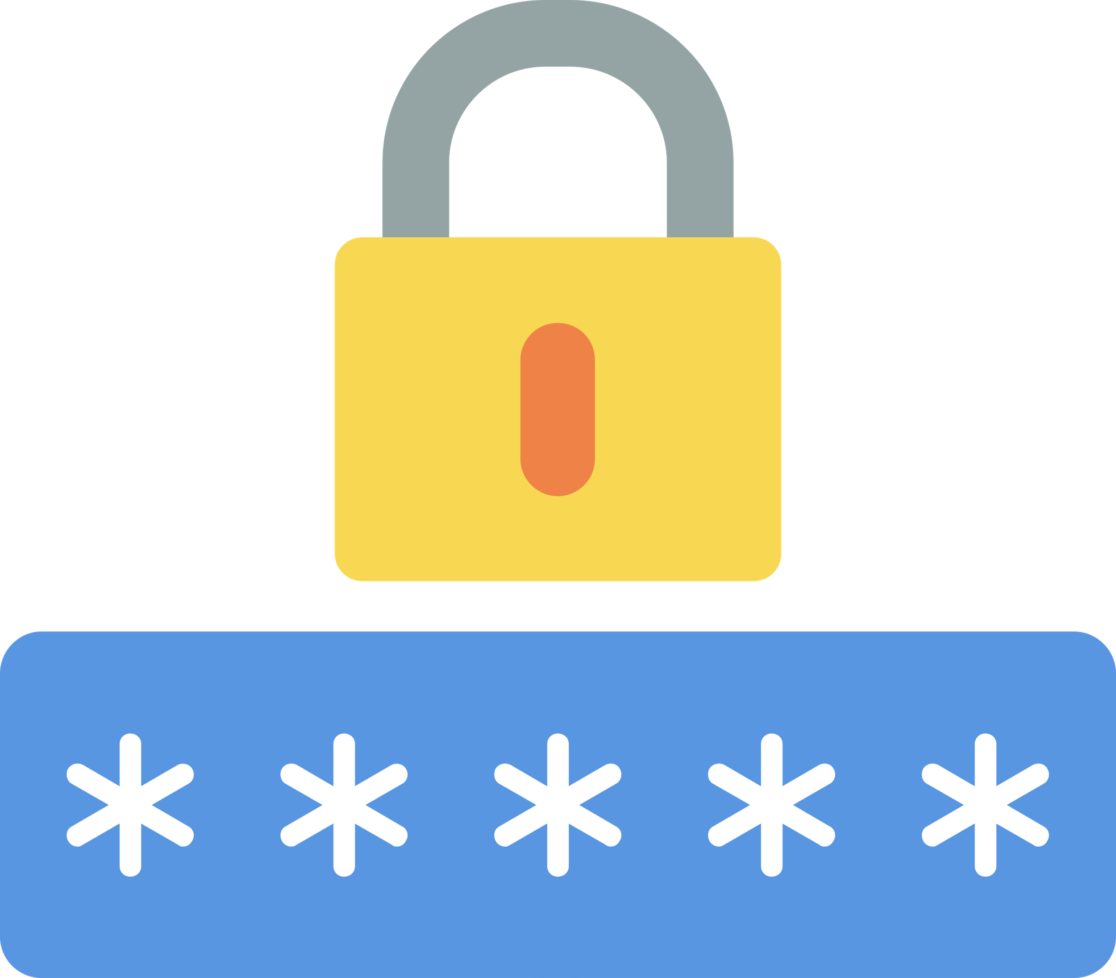



Securing our IoT devices
Device security means protecting your smartphones, tablets, laptops, and other electronic devices from being hacked.
Use strong passwords
Update devices
Don’t share personal information

Slide 10
ACTIVITY
IoT Device Detectives
Can you find all the IoT devices that a hacker might access?

Slide 11
Your Mission
There are three IoT devices in every image. Can you find them all?
Ready? Let’s Play!
Ready? Let’s Play!

Slide 12
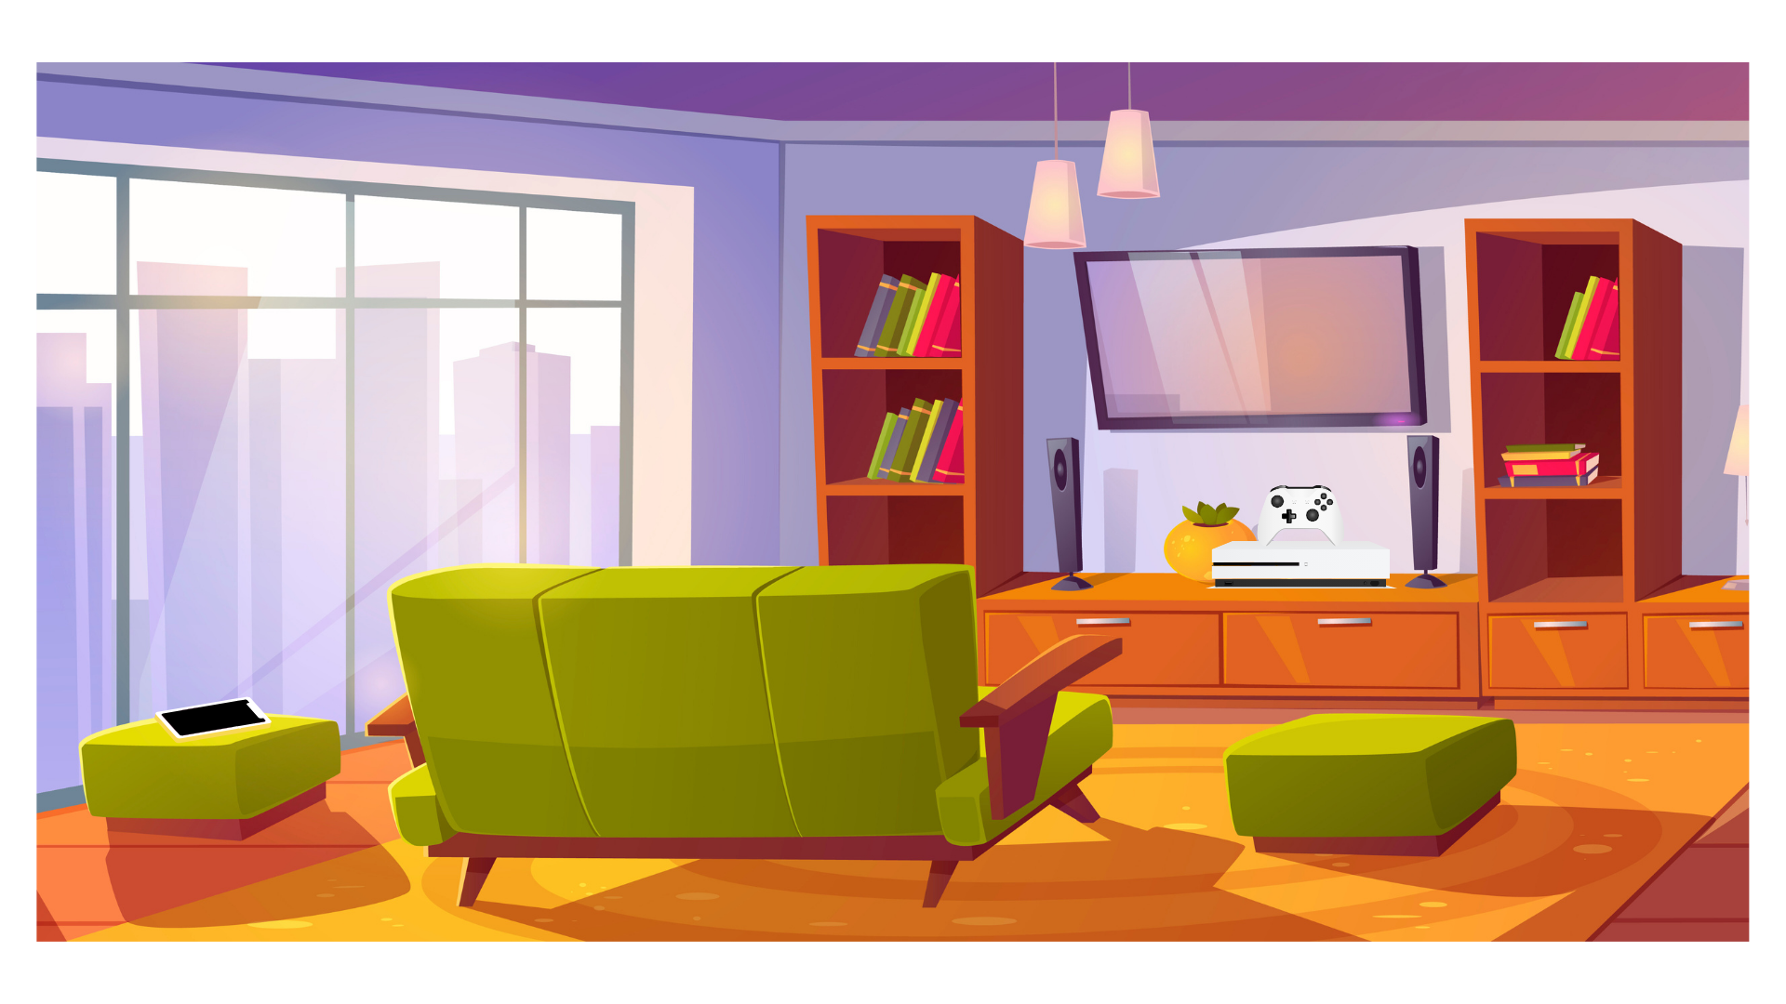
Can you find 3 IoT devices in this living room?

Slide 13
Here they are!
Smart TV
Smart Phone
Game Console

Slide 14
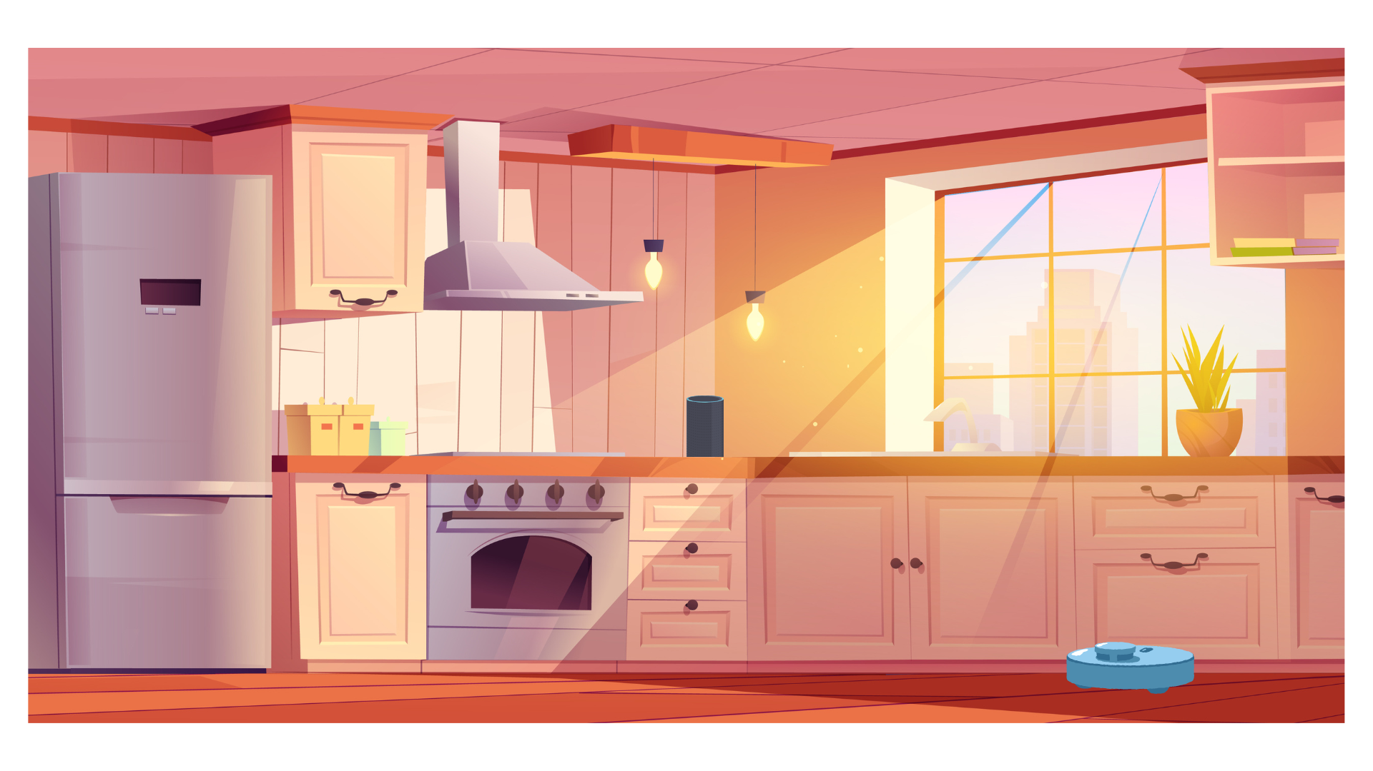
Can you find 3 IoT devices in this kitchen?

Slide 15
Here they are!
Smart Refrigerator
Smart Home Assistant
Robot Vacuum

Slide 16
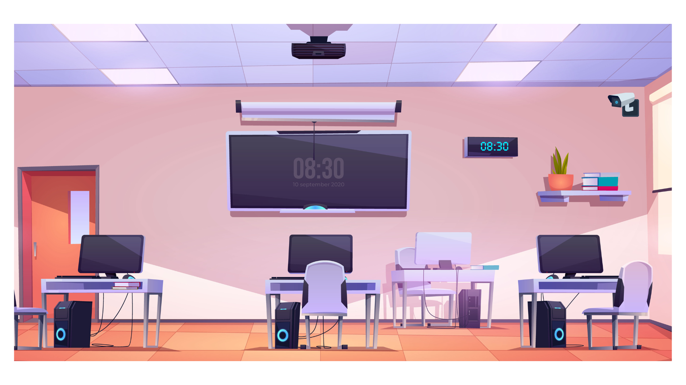
Can you find 3 IoT devices in this classroom?

Slide 17
Here they are!
Smart Interactive Whiteboard
Security Camera
Computer

Slide 18
WRAP UP
What have you learned today?
Let’s reflect on today’s lesson.

Slide 19
Remember This!
  IoT devices are everyday objects that connect to the internet, which makes them vulnerable to hackers.
  Keeping your personal devices and IoT gadgets secure is like being a superhero for your own tech world.
  Regularly updating passwords, software, and being mindful of what you download are key to protecting your digital life.

Slide 20
LESSON 2.2
Well Done!

