Slide 1

LESSON 3.10
GENERATIVE AI
Roleplaying with Prompts
Prompt Engineering Lab Series

Slide 2
Using AI Tools Safely and Responsibly
Before we get started with the lesson, we must first remember these rules of using generative AI tools safely and responsibly.
1. Never share your personal and sensitive information when interacting with AI.
2. Be aware of AI's limitations and potential biases in its responses.
3. AI has a tendency to fabricate information at times. Always remember to fact-check any AI-generated information before using it.
4.Use AI ethically: respect privacy, avoid harmful content, and think critically

Slide 3
What You’ll Need
  Computer with internet access
  Access to a generative AI tool such as ChatGPT, Microsoft Copilot, or Gemini.
Disclaimer:
  Before using these tools, remember to check with your school and the app or site’s terms of use. Many AI tools require students to be at least 13 years old, and may require parental consent for those under 18 years old.
  The outcomes of exercises in this toolkit may differ from provided examples, as they depend on your specific inputs and the AI tools employed.
  Generative AI tools may at times produce inaccurate or fabricated information. Please verify and fact-check outputs using discretion and critical thinking.

Slide 4
WHAT ARE WE LEARNING TODAY?
Roleplaying Technique

Slide 5


The Power of Roleplaying
Roleplaying in AI prompts means assigning a specific character or profession to AI. Adding a simple role can help the AI infer a lot of information, like the tone and style of the outputs.
CYBERLITE.ORG
2023-2024 Ⓒ Cyberlite Books Pte. Ltd. All Rights Reserved.

Slide 6
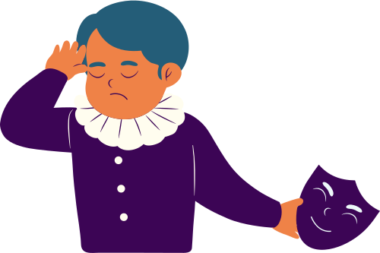
Examples of Roleplaying Prompts
For example, you can ask the AI to roleplay by including these phrases:
  “Act like Shakespeare”
  “You are a food critic”
  “Act as a social media influencer”

Slide 7
GROUP EXERCISE
Let’s Explore Together!
Try these examples to see the skills in action.
CYBERLITE.ORG
2023-2024 Ⓒ Cyberlite Books Pte. Ltd. All Rights Reserved.

Slide 8

Let’s Write Haikus!
1. Enter these prompts into the LLM (ChatGPT, Copilot in Bing, or Bard).
Try This Prompt!
Act as an 18th century English poet, and write a haiku about music.
Try This Prompt!
Act as a social media influencer, and write a haiku about music.
Try This Prompt!
Act as a __(fill in the blank)__, and write a haiku about music
2. Compare and contrast the differences between each role.

Slide 9
TRY IT YOURSELF
Independent Exploration Task
Apply the skills you’ve learned in this task.

Slide 10
Your Task
You are writing a play about the mystery of Miss Violet’s missing gold jewellery. In this scene, the detective is questioning three different suspects about their alibis at the time of the theft. The suspects are:
  Aruna, Miss Violet’s angsty 15-year-old daughter with an attitude problem.
  Tom, the paranoid assistant who’s constantly sweating with worry.
  Susan, the sharp and witty elderly neighbour who doesn’t like to be bothered.
Using generative AI, write the alibis for each character.
Tip: Start by providing the AI with the context of the play. Then include role playing instructions for each character.

Slide 11
Group Sharing!
What did you come up with?

Slide 12
LESSON 3.10
Well Done!

