Slide 1
Let’s Meet Up
LESSON 4.5
ONLINE RELATIONSHIPS
EXERCISE-IN-A-BOX

Slide 2

What are some online behaviours you would consider unsafe or risky?
WARM-UP

Slide 3

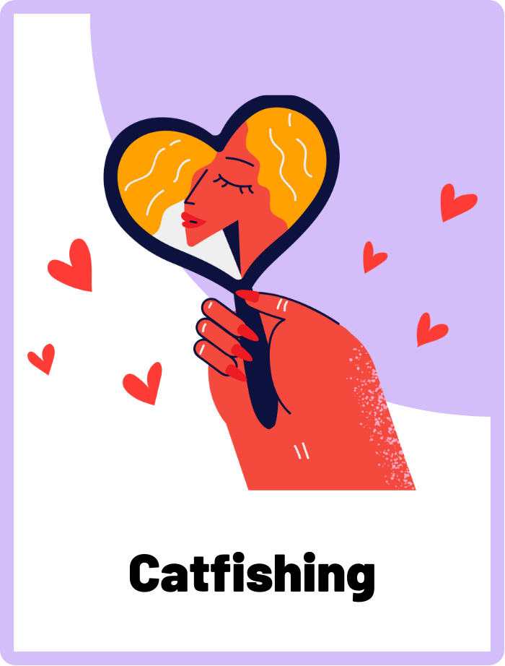
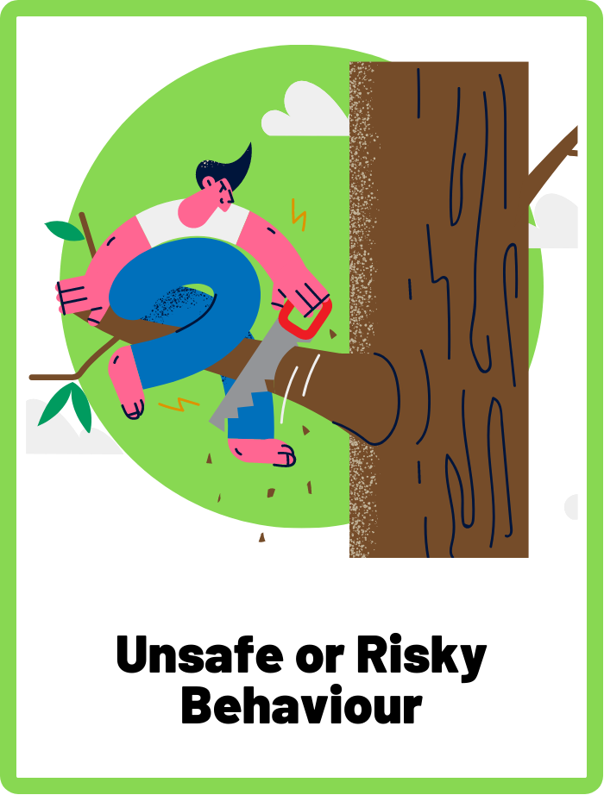
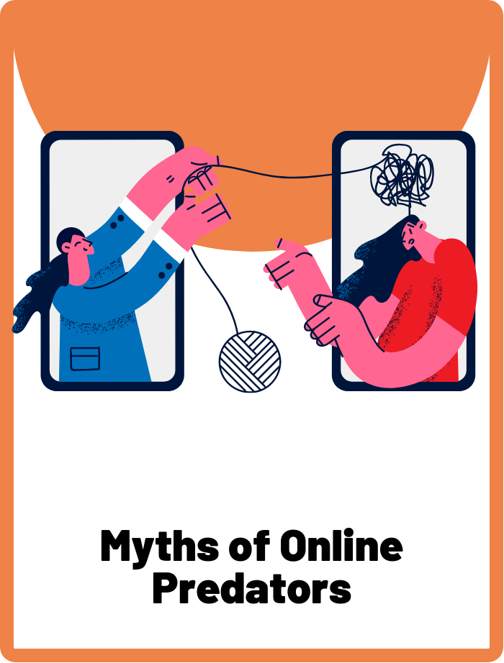
DEFINE THE KEYWORDS
What do you think these terms mean?

Slide 4
DEFINE
Catfishing
Catfishing is when someone pretends to be someone else online by using a fake identity, often with the intention of deceiving others. This can include using fake profile pictures, names, and personal information to create a false persona. People may engage in catfishing for various reasons, such as seeking attention, manipulating others, or attempting to scam people.

Slide 5
DEFINE
Unsafe or Risky Behaviour
Unsafe or risky behaviours online refer to actions that can potentially expose someone to harm, such as sharing personal information with strangers, clicking on suspicious links, or engaging in inappropriate communication. These behaviours can lead to negative consequences like cyberbullying, identity theft, or exposure to harmful content.

Slide 6
DEFINE
Myths of Online Predators
Myths of online predators are false beliefs or misconceptions that people may have about strangers who use the internet to harm others, such as the belief that all online predators are old men or that they can only be found on specific websites.

Slide 7

INVESTIGATE THE SCENARIO
Read the following evidence carefully to piece together the story. Think critically about the information you are examining and consider the questions.

Slide 8
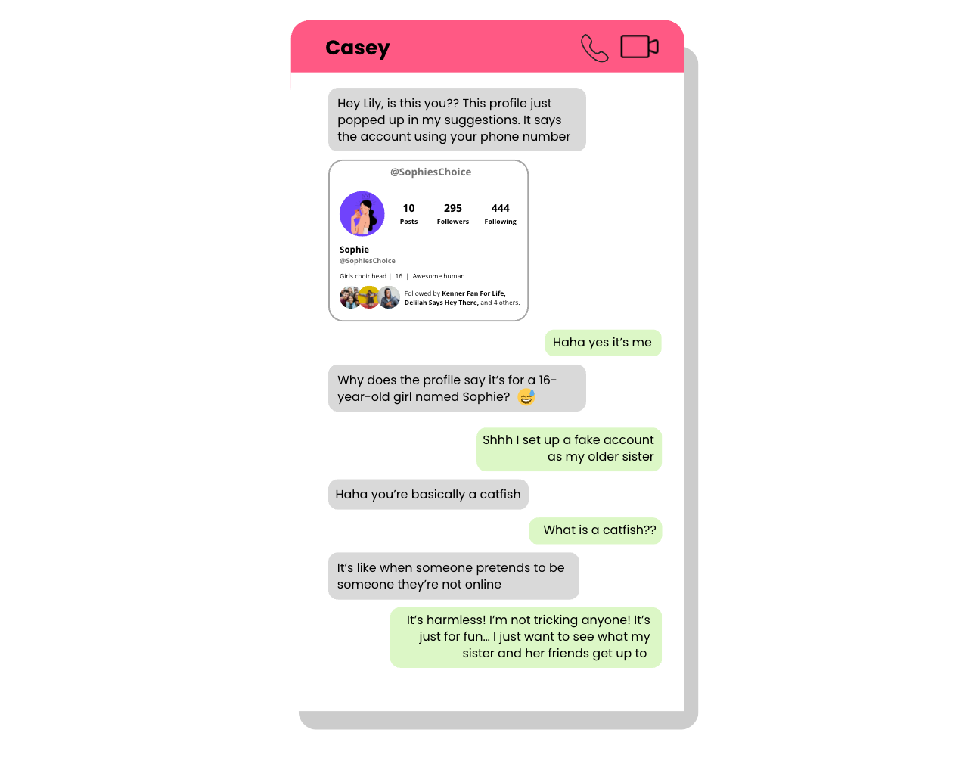
INVESTIGATE
EVIDENCE #1
LET’S DISCUSS
1. Can someone be a catfish even if they don't intend to trick anyone? Why or why not?
2. What do you think is Lily’s motivations for setting up a fake online profile?

Slide 9
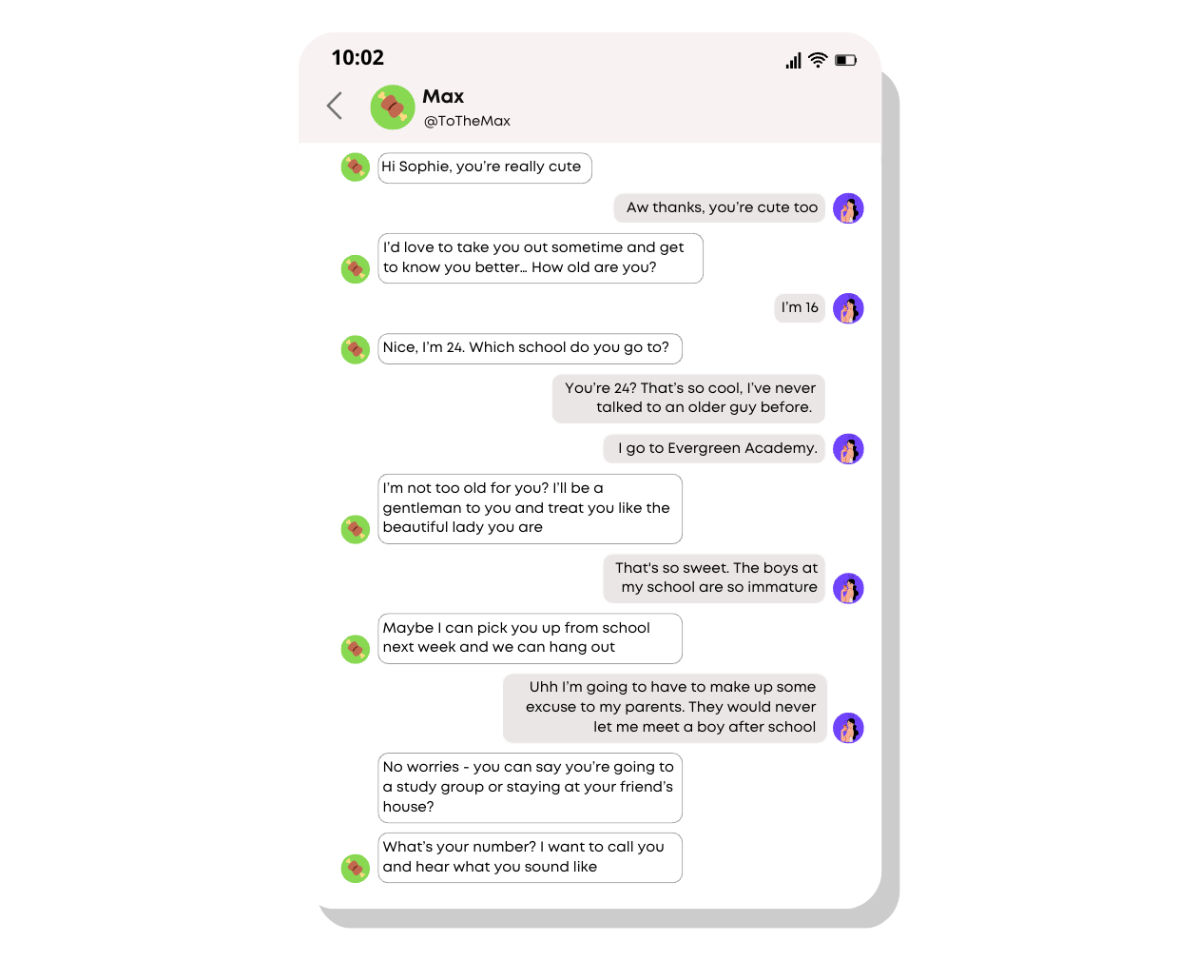
INVESTIGATE
EVIDENCE #2
LET’S DISCUSS
1. What are some warning signs in this conversation that suggest Max may not have good intentions?
2. What are some potential risks of meeting someone you've only talked to online?

Slide 10
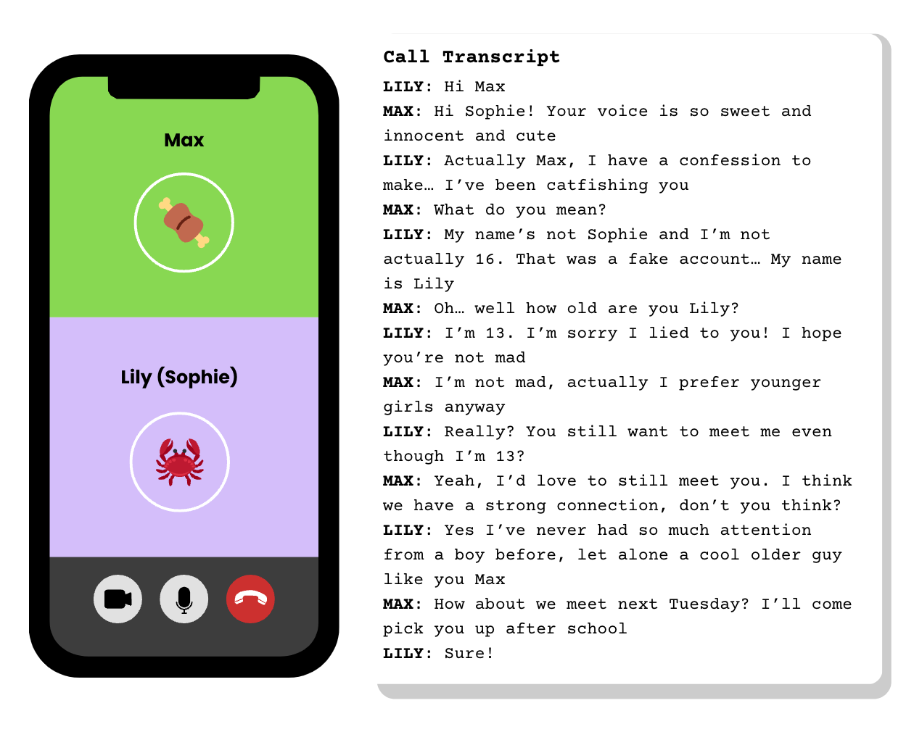
INVESTIGATE
EVIDENCE #3
LET’S DISCUSS
1. What are some red flags in this conversation between Lily and Max?
2. What kind of unsafe or risky behaviour is Lily engaging in?

Slide 11
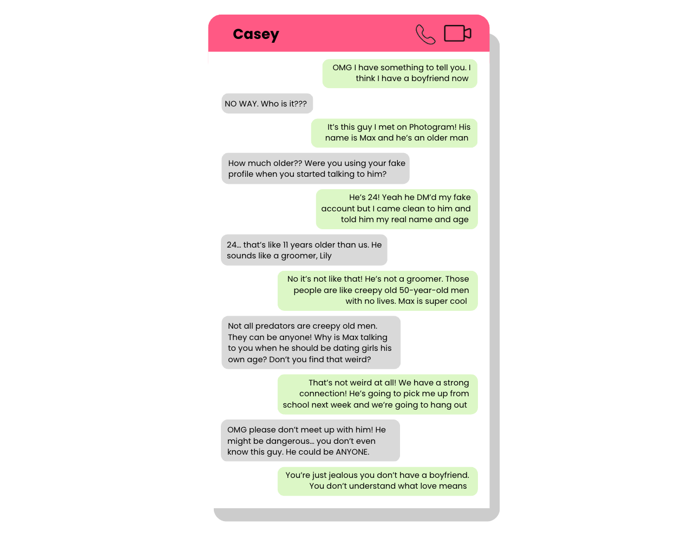
INVESTIGATE
EVIDENCE #4
LET’S DISCUSS
1. What are some potential risks of meeting someone in person who you met online?
2. Do you think Max is in love with Lily because of their strong connection? Is Casey right in thinking Max could be a groomer?
3. What are some myths about online predators that need to be debunked?

Slide 12
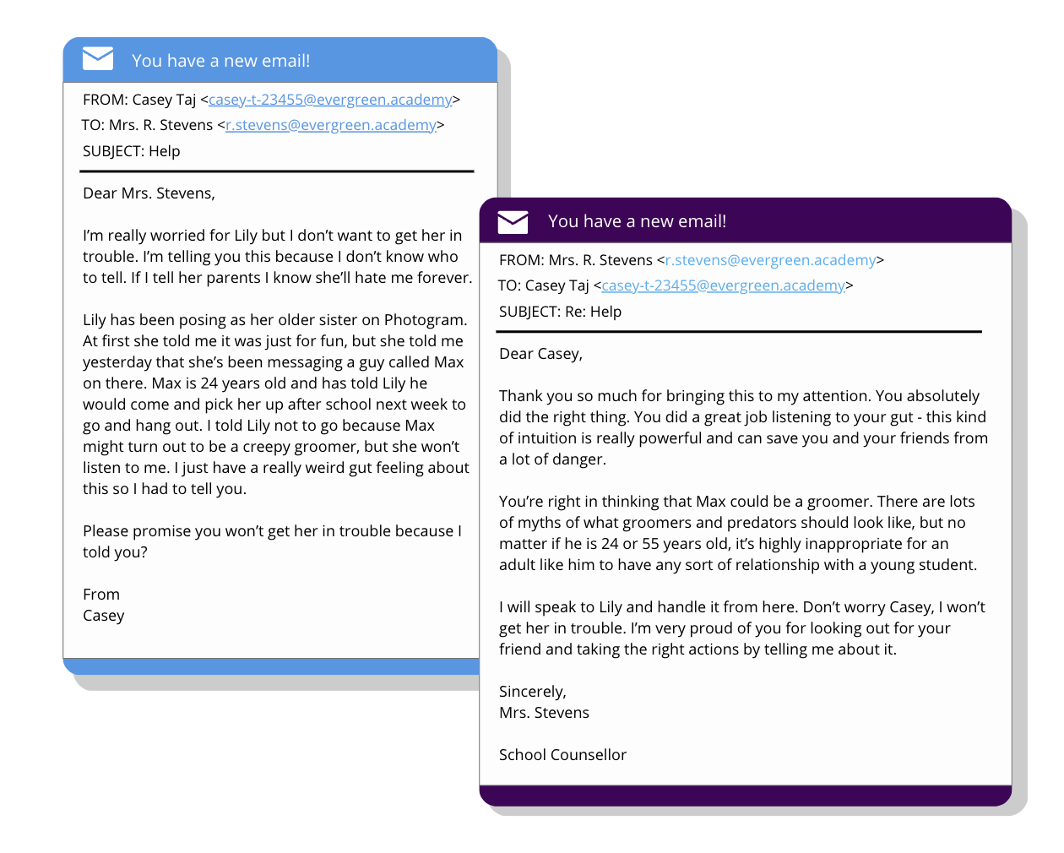
INVESTIGATE
EVIDENCE #5
LET’S DISCUSS
1. Do you think Casey did the right thing by telling the school counsellor, Mrs. Stevens?
2. Why is it important to trust your instincts and listen to your gut?
3. Why is it important to tell a trusted adult if you or someone you know is in an unsafe online relationship?

Slide 13

KEY TAKEAWAYS
There are common myths and misconceptions about what an online groomer or predator should look like, but in reality they can be anyone.
It is dangerous to meet up with someone you’ve only communicated with online, because you never know who you’re talking to on the other side of the screen. They could be a catfish or an online groomer.
Unsafe or risky behaviours can lead to dangerous situations. Always be alert and use critical judgement before you put yourself in harm’s way.

Slide 14
Well Done!
LESSON 4.5

