Slide 1
When Reputation Turns Sour
LESSON 4.1
DIGITAL IDENTITY
EXERCISE-IN-A-BOX

Slide 2

Is your social media account set to private or public? Why did you choose to do that?
WARM-UP

Slide 3

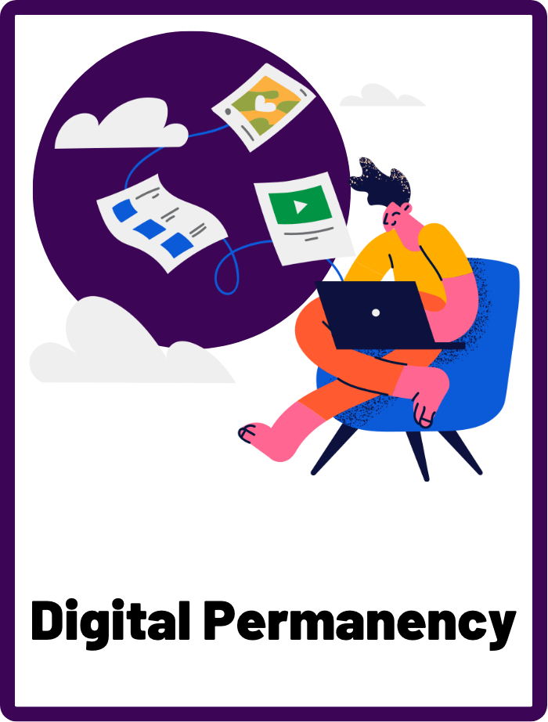
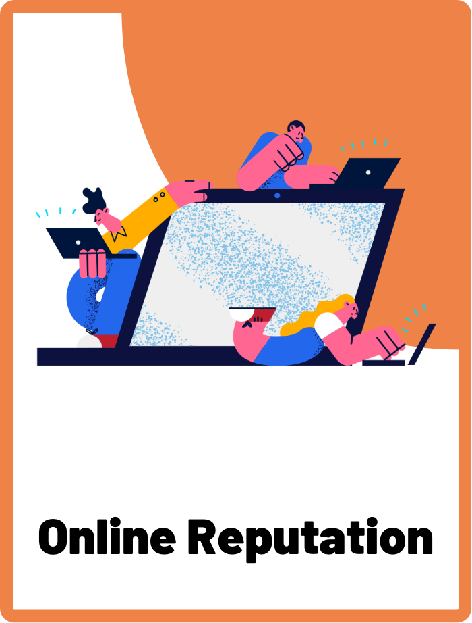
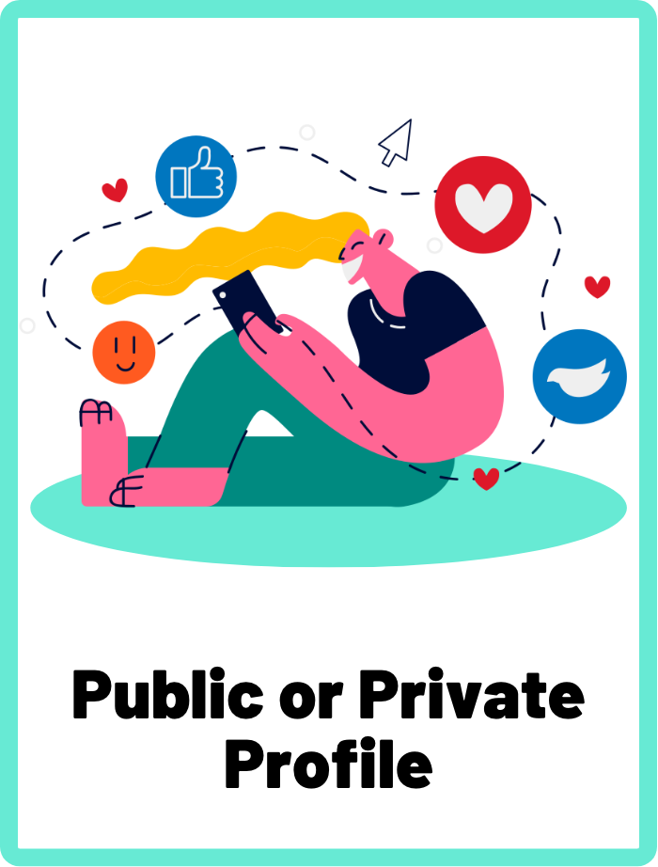
DEFINE THE KEYWORDS
What do you think these terms mean?

Slide 4
DEFINE
Digital Permanency
The concept that anything posted online may remain available and accessible indefinitely, creating a permanent digital record.

Slide 5
DEFINE
Online Reputation
The perception and opinion others form about an individual based on their online presence and activities. It can be influenced by things like the pictures you post, the comments you make, and the people you associate with online.

Slide 6
DEFINE
Public or Private Profile
A public social media account is a profile that can be viewed by anyone on the internet, regardless of whether they are friends with or follow the account holder. A private social media account is a profile that is only accessible to people who have been granted permission by the account holder, such as friends or followers.

Slide 7

INVESTIGATE THE SCENARIO
Read the following evidence carefully to piece together the story. Think critically about the information you are examining and consider the questions.

Slide 8
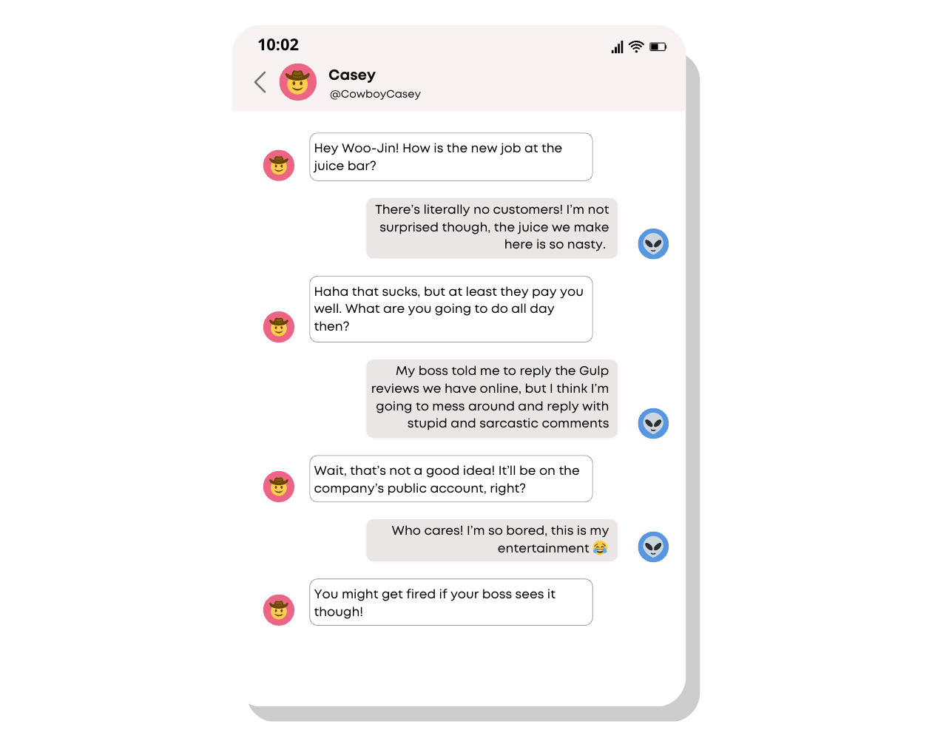
INVESTIGATE
EVIDENCE #1
LET’S DISCUSS
1. Why might Woo-Jin’s boss care about what he posts on the company’s social media account?
2. What is the difference between a public and private social media profile, and why does it matter?

Slide 9
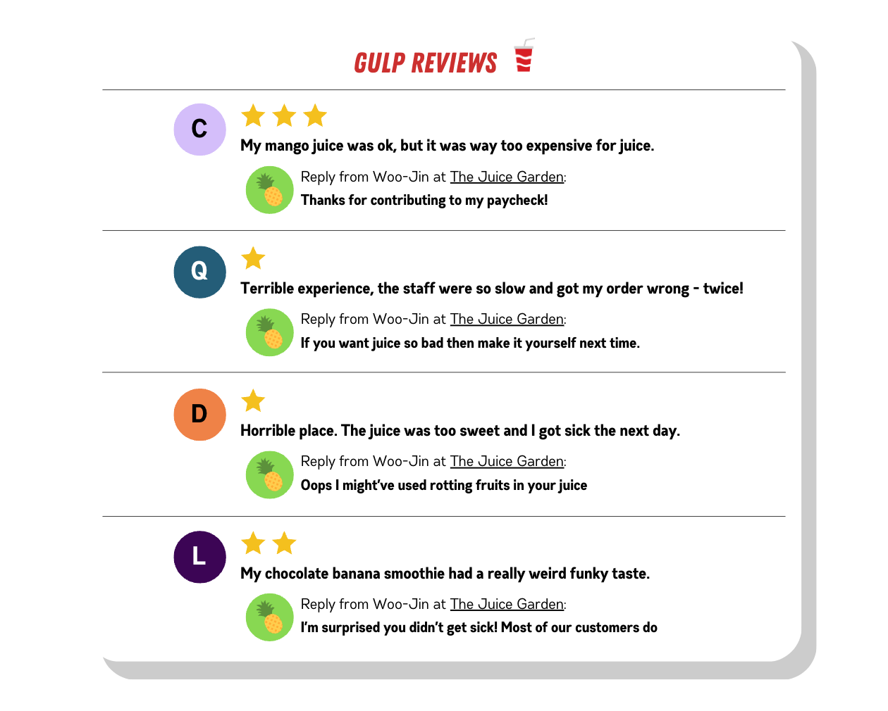
INVESTIGATE
EVIDENCE #2
LET’S DISCUSS
1. How might Woo-Jin’s replies affect The Juice Garden’s online reputation?
2. How does the concept of digital permanency apply to these Gulp reviews and Woo-Jin’s replies?

Slide 10
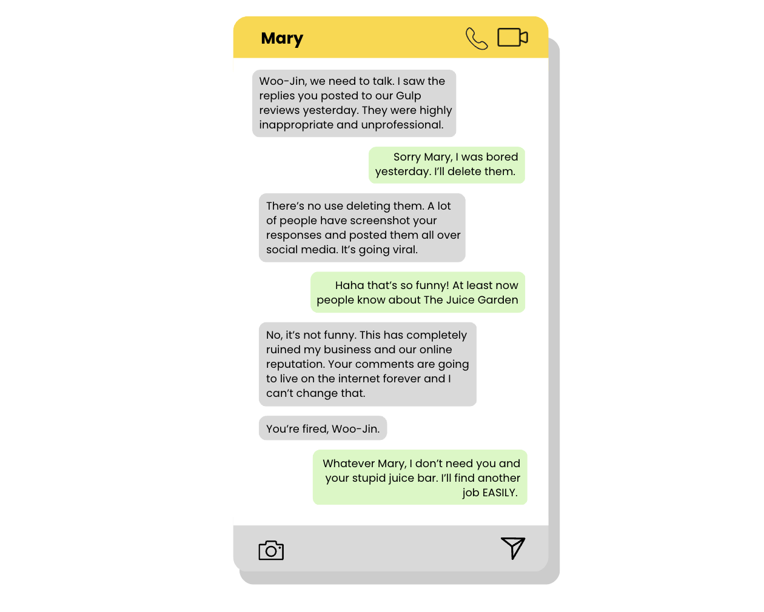
INVESTIGATE
EVIDENCE #3
LET’S DISCUSS
1. What is the importance of maintaining a good image online? Think about it in a professional work context.
2. What is the impact of social media on the spread of information, especially when it comes to negative content?
3. What are the potential consequences of not taking digital permanency seriously?

Slide 11
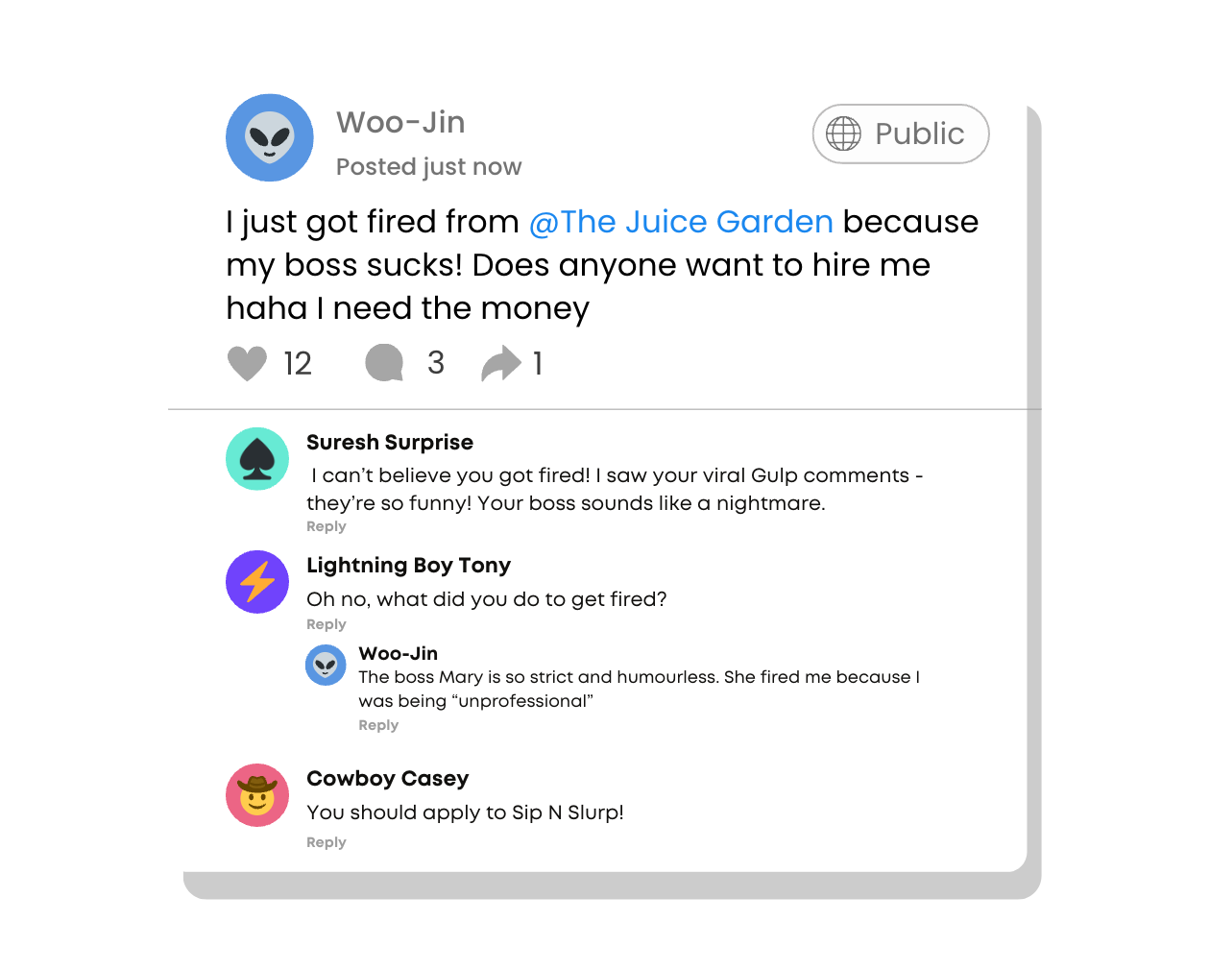
INVESTIGATE
EVIDENCE #4
LET’S DISCUSS
1. Do you think this is an appropriate message for Woo-Jin to post to his public social media account? Why or why not?
3. What are some potential negative consequences Woo-Jin might face after posting this?

Slide 12
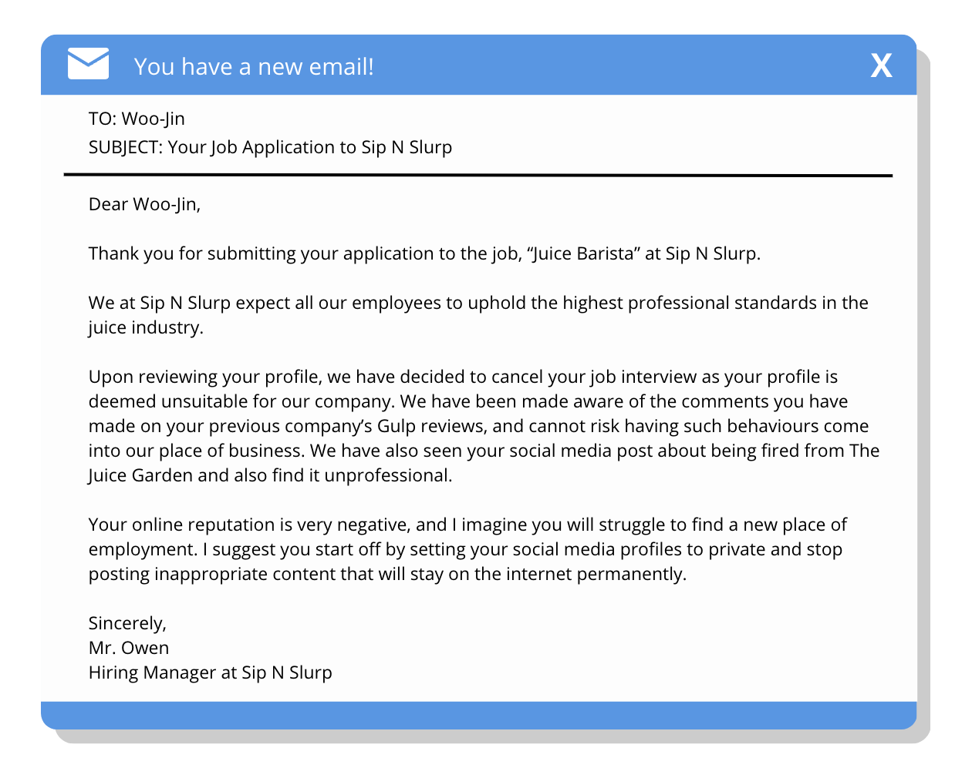
INVESTIGATE
EVIDENCE #5
LET’S DISCUSS
1.What is the reason for cancelling Woo-Jin's job interview at Sip N Slurp?
2. What advice can you give Woo-Jin to help him improve his online reputation?

Slide 13

KEY TAKEAWAYS
Everything you post online is permanent, so think twice before posting!
Your online reputation can have a significant impact on your life, such as job or education opportunities. Make sure your maintain a positive online reputation.
Be very considerate and thoughtful before posting or leaving a comment online if your social media profile is set to public.

Slide 14
Well Done!
LESSON 4.1

